Slide 1
The Impact of Conservatism and
Supply Chain Finance on Bad Debt Expense
Discussion
Vivek Raval

Slide 2
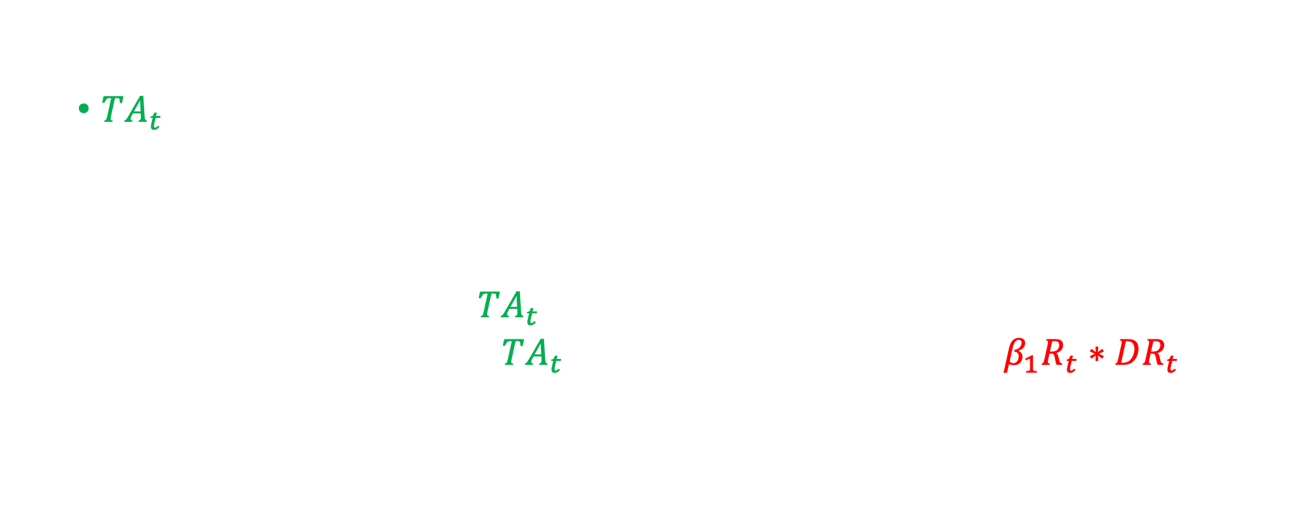
Modeling earnings as a function of changing economics
Jones 1991:
  $TA_{t}=a_{1}\left(\frac{1}{A_{t−1}}\right)+a_{2}\left(ΔREV_{t}\right)+a_{3}\left(PPE_{t}\right)+ε_{t}$
Basu 1997:
  Symmetrical: ${CFO}_{t}+TA_{t}=α_{0}+β_{0}\left(R_{t}\right)+ε_{t}$
  Asymmetrical: ${CFO}_{t}+TA_{t}=α_{0}+α_{1}DR_{t}+β_{0}\left(R_{t}\right)+β_{1}R_{t}∗DR_{t}+ε_{t}$
Can we add asymmetry to an accrual model?
Change in firm economics

Slide 3
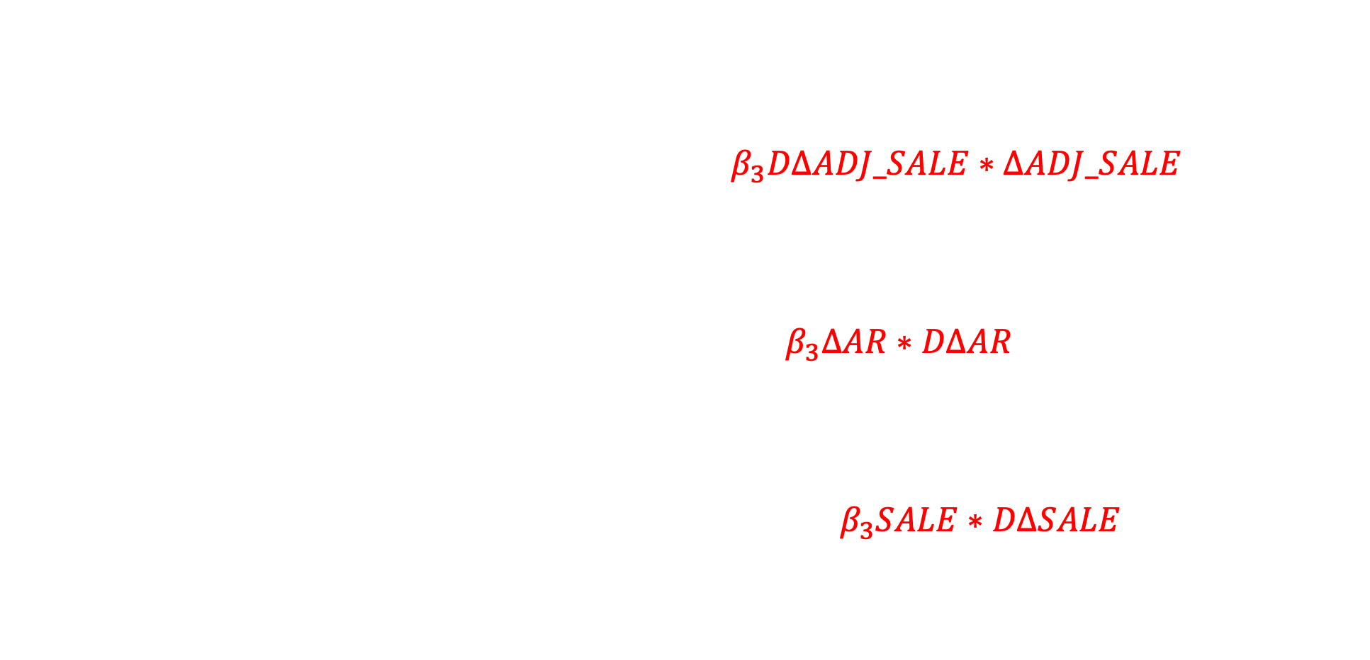
Modeling Bad Debt Expense
BCCL 2022 (Mod. Jones):
  Symmetrical: $BDE=β_{1}ΔADJ_SALE+ω+ε$
  Asymmetrical:
  $$BDE=β_{1}ΔADJ_SALE+β_{2}DΔADJ_SALE+β_{3}DΔADJ_SALE∗ΔADJ_SALE+ω+ε$$
BCCL 2022 (BS):
  Symmetrical: $BDE=β_{1}ΔAR+β_{2}WO+ω+ε$
  Asymmetrical: $BDE=β_{1}ΔAR+β_{2}DΔAR+β_{3}ΔAR∗DΔAR+β_{4}WO+ω+ε$
BCCL 2022 (IS):
  Symmetrical: $BDE=β_{1}SALE+ω+ε$
  Asymmetrical: $BDE=β_{1}SALE+β_{2}DΔSALE+β_{3}SALE∗DΔSALE+ω+ε$
Also include write-offs in the Modified Jones and IS models

Slide 4
What makes a good accrual model?
Accurate description of normal accruals
Parsimonious, easy to operationalize
General (broadly applicable)
The focus: Accuracy.
Cost: Ease of execution (collection of data)
Cost: Generalizability
Should we have a model for all types of accruals?
Larson, Sloan, and Zha Giedt (2018, RAST) provide a general asymmetric model of accruals

Slide 5

Other model considerations
$$BDE=β_{1}ΔAR+β_{2}WO+ω+ε$$
Are changes in AR and Sales symmetric with news?
  The possibility exists they are asymmetric like BDE or earnings
    If so: $β_{3}ΔAR∗DΔAR$ will not load
    If so: $β_{3}SALE∗DΔSALE$ will not load (!)
Write-offs are 93% correlated with BDE. Including them in the model is naturally an improvement.
  But is there a good reason in the Income Statement and Modified Jones models?
Demonstration of the usefulness of abnormal BDE accruals?

Slide 6

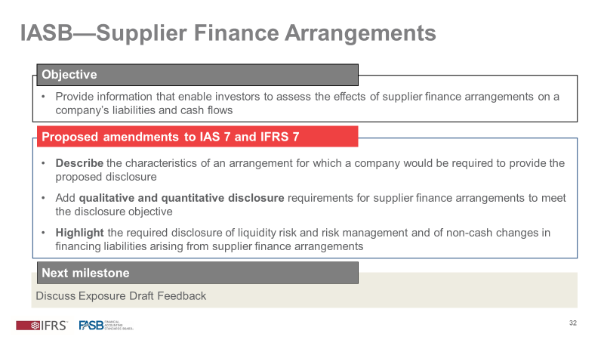
Real activity: Supply Chain Financing

Slide 7

Real activity: Supply Chain Financing
$$BDE=β_{1}ΔAR+β_{2}DΔAR+β_{3}ΔAR∗DΔAR+β_{4}ΔAR∗SCF+β_{5}DΔAR∗SCF$$
$$+β_{6}ΔAR∗DΔAR∗SCF+β_{7}WO+ω+ε$$
Supply chain financing reduces asymmetry in BDE
  Should this actually improve the models with a symmetrical assumption (Modified Jones model)?
Is the 10% industry benchmark sufficient? Is the PwC measure based on AR or AP? Can the changes in AR actually be cross-industry?
Do firms with SCF reap benefits from the reduction of asymmetry?
  Analyst forecast error/dispersion (Mensah et al. 2004)
  Resolution of uncertainty/disagreement at earnings announcement? (Barth et al. 2020)

Slide 8
Thank you

