Slide 1
Is the Profitability Anomaly Distinct from the Mispricing of Earnings Beyond Operating Profit?
Discussion
Vivek Raval

Slide 2
Different levels of profit predict returns
Rev
COGS
GP
SGA
OP
RD
Depr, amort
Int
Tax
Non oper
SPI
MI
NI
Gross Profit (Rev – COGS)
+ future returns
Oper. Profit (GP – SGA)
++ future returns
Same?
Corr = -0.47
EBOP (NI - OP)
?
(- future returns)
NI
+ future returns

Slide 3
Do we know this already?
Burgstahler et al. 2002 (special items): returns around the EA
Thomas and Zhang 2011 (tax expense): one quarter of return
Chan 2002 (R&D): 3-year returns
Lev et al. 2005 (R&D): reversing returns
Non-uniform approach
No connection to the profitability anomaly

Slide 4
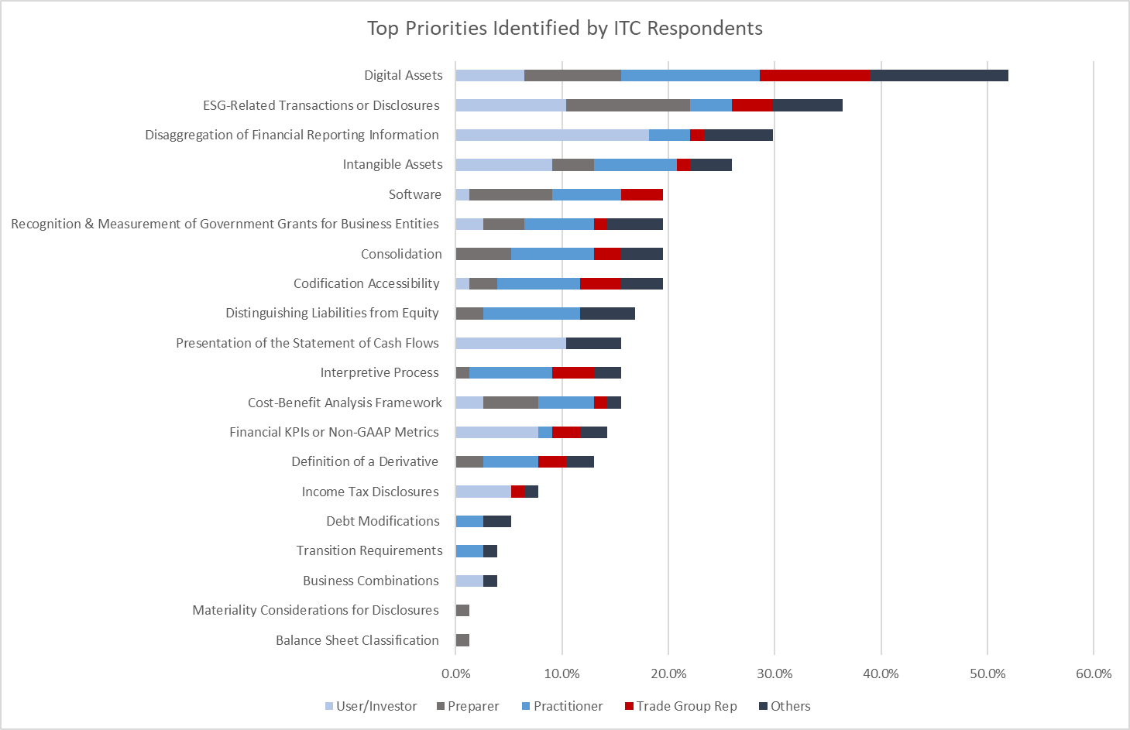
FASB—Top Priorities by Respondent Type

Slide 5
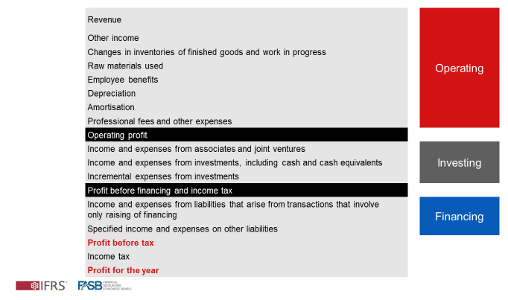
IASB—Subtotals: New subtotals and categories?

Slide 6
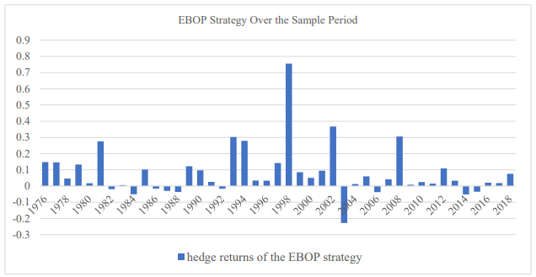
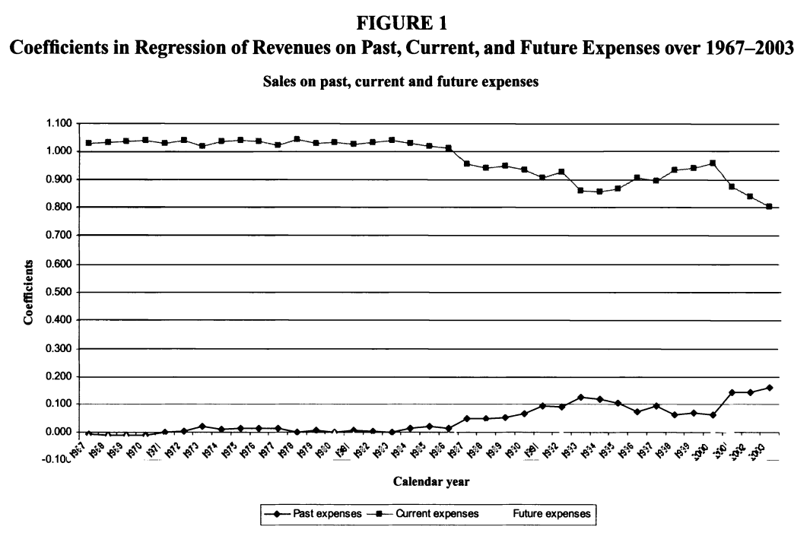
The idea of matching is interesting
Rev
COGS
GP
SGA
OP
RD
Depr, amort
Int
Tax
Non oper
SPI
MI
NI
Matched
Partially Unmatched (Advertising, Marketing, Engineering, Indirect costs)
Unmatched
Matched?
Matched
Matched
Matched
Unmatched
Matched
Dichev and Tang (2008)

Slide 7
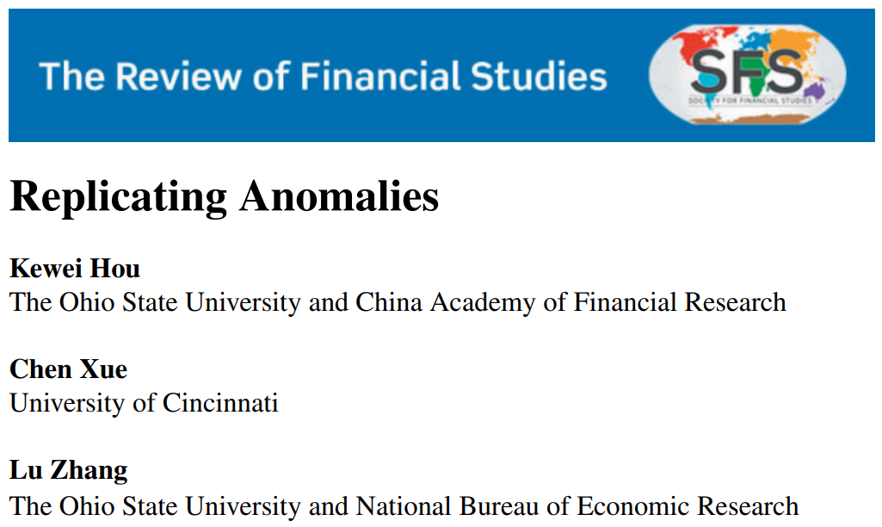
Is the Daniel et al. (1997) Portfolio Adjustment sufficient?
This study largely relies on controlling for expected returns by using a portfolio matched on size, BTM, and momentum
Fama & French (2015) does not replicate well
Removing microcaps
Weighting regressions by MVE
Using similar procedure as in Hou, Xue, Zhang (2020)

Slide 8
Thank you

