Slide 1
Emotional Media Content, Investor Sentiment, and Long-term Return Reversals
Discussion
Vivek Raval, AAA Annual Meeting 2022

Slide 2
What this paper does conceptually
All tone is not created equal
Papers conclude that media tone matters for predicting returns and earnings (e.g., Tetlock, Saar-Tsechansky, MacKassy, 2008)
Hillert, Jacobs, Müller (RFS, 2014) provide evidence that media coverage is partially creating return momentum, and that tone enhances the effect.
DST: “…it is, therefore, necessary to separate tone with factual antecedents from tone based on emotional content.”

Slide 3
A cool measure and a market response
Risk-adjusted returns related to tone
Emotion vs Fact
α

Slide 4
A cool measure and a market response
Risk-adjusted returns related to tone
Emotion vs Fact
α
Where do articles come from?
Discussion of ‘Emotion’
Discussion of the alpha

Slide 5
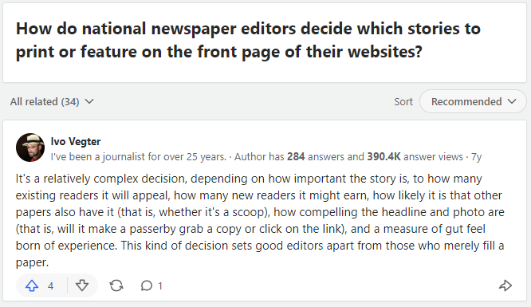
Media needs to meet demand
“push”
model
Firm generates information
Media gathers the information
A news report is provided to investors
Investors have uncertainty about a topic/firm
Non-news content is provided to investors
“pull”
model
Media wants to get more readers
https://www.quora.com/How-do-national-newspaper-editors-decide-which-stories-to-print-or-feature-on-the-front-page-of-their-websites
Is ‘Emotion’ separating these article types?

Slide 6
The Intuition of Emotion-vs-Fact
Does Emotional = not fact-based?
Facts
Emotions
If our friend/partner/baby is crying, our first instinct is not to conclude they are delusional
Could ‘emotion-vs-fact’ instead be trying to separate categories of articles?
News
Non-news
Reflects information from firms
Reflects uncertainty (a lack of information)

Slide 7
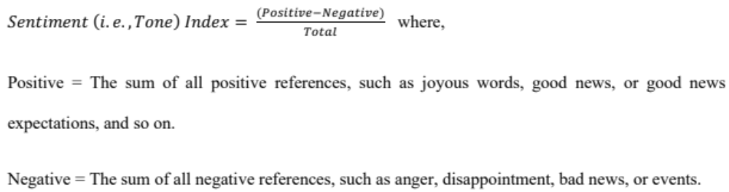
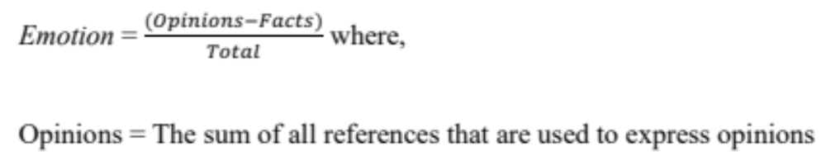
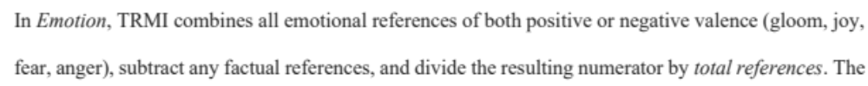
‘Emotion’ is a black box
It’s pretty black
Thomson-Reuters
“Tone”
Text Processing Machine
News articles
“Emotion” (vs Fact)

Slide 8
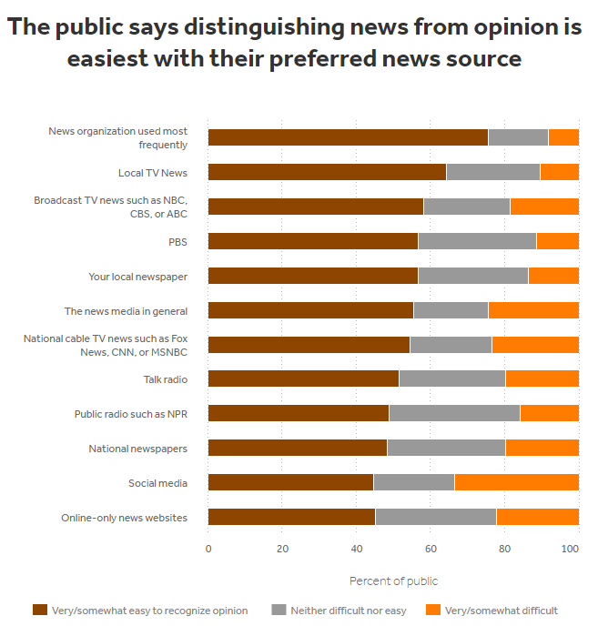
The inefficiency problem
Are investors unable to separate facts from opinion? Does the explanation make sense?
Instead of reflecting irrational sentiment, could the media be reflecting uncertainty or a lack of information?
82% of anomalies do not pass a 5% p-value hurdle, and returns are less than expected. (Hou, Xue, Zhang, RFS 2020)
This paper involves a lot of computational processing and transactions (lots of articles to analyze, patented algorithms, idiosyncratic tone, weekly trading, 3-year holding periods, overlapping returns…). How much return is enough? Does consistency of return matter?
https://www.americanpressinstitute.org/publications/reports/survey-research/public-expects-from-press/

Slide 9
Thank you

