Slide 1
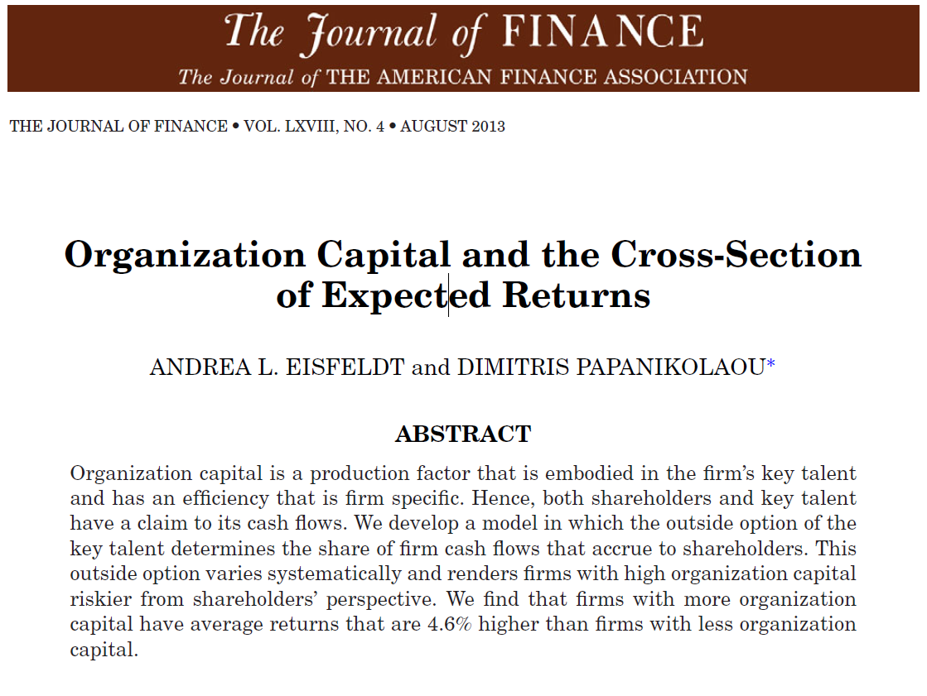

Slide 2

Why this is an important paper
Does not provide an obvious answer
Generates structure for a squishy topic
  The paper does not depend on much anecdote and intuition
Provides a fairly understandable basic model
Matches theory with empirical tests
Smith-Breeden Prize Winner & Dimensional Fund Advisors 1st place award

Slide 3
Organizational Capital
Owned by
shareholders
Technology
Key talent
Owned by
key talent
Organizational Capital (OC) is firm-specific human capital
  It is generated by the matching of key talent (managers, engineers, etc.) with processes of the firm
  It is “embodied” in Key Talent (KT) and therefore movable
Because OC requires both the firm and KT, both have a claim to its cash flows
KT will get cash flows equal to their outside option (what they would be paid elsewhere) and shareholders get the residual
Therefore, the shareholders cash flows are subject to the overall change in what KT are paid outside the firm
Because the price firms are willing to pay for KT is correlated across firms (because of technology shocks), the firm’s shareholders are subject to systematic risk
That risk is priced, and the price premium is empirically observable.

Slide 4
Basic model setup
The model looks at value from the shareholder’s perspective
The firm is endowed with OC and physical capital
The firm can upgrade their technology once
The form of the upgrade doesn’t matter. They KT can either form a new firm and buy physical capital, or they can just restructure the existing firm
We will look for outcomes in stock prices

Slide 5
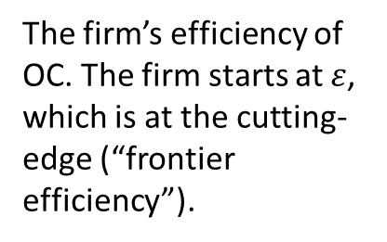

Firm output
The firm output function:
$$y_{i,t}=θ_{t}K_{i}+θ_{t}e^{ε_{i}}O_{i}$$
Firm output
The firm’s efficiency of OC. The firm starts at $ε$, which is at the cutting-edge (“frontier efficiency”).
Total factor productivity (common productivity for physical and organizational capital)
Endowed OC
Endowed physical capital

Slide 6


Value of a firm
  The value of a firm (eq: 5)
$$V_{i,t}=V_{i,t}^{K}+V_{i,t}^{O}$$
Value of the firm
Value of organizational capital
Value of physical capital (discounted productivity of endowed asset K)
$$V^{k}=\frac{θ_{t}}{\overline{r}}K_{i}$$
Discount rate

Slide 7
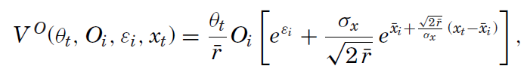

Value of OC
The option value of upgrading OC
The value of operating at $ε$
Discounted productivity of OC
Productivity of OC after upgrading at the optimal time
Quantity of OC
The frontier level of OC productivity
Endowed efficiency of OC
The value of OC is increasing in x, the frontier level of OC productivity
Discount factor

Slide 8
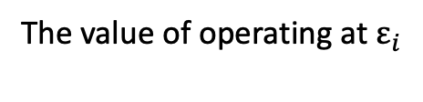
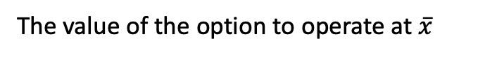

Graphically, in terms of x
Value of OC
The value of the option to operate at $\overline{x}$
The value of operating at $ε_{i}$
x = $ε_{i}$
Frontier efficiency of OC = x

Slide 9
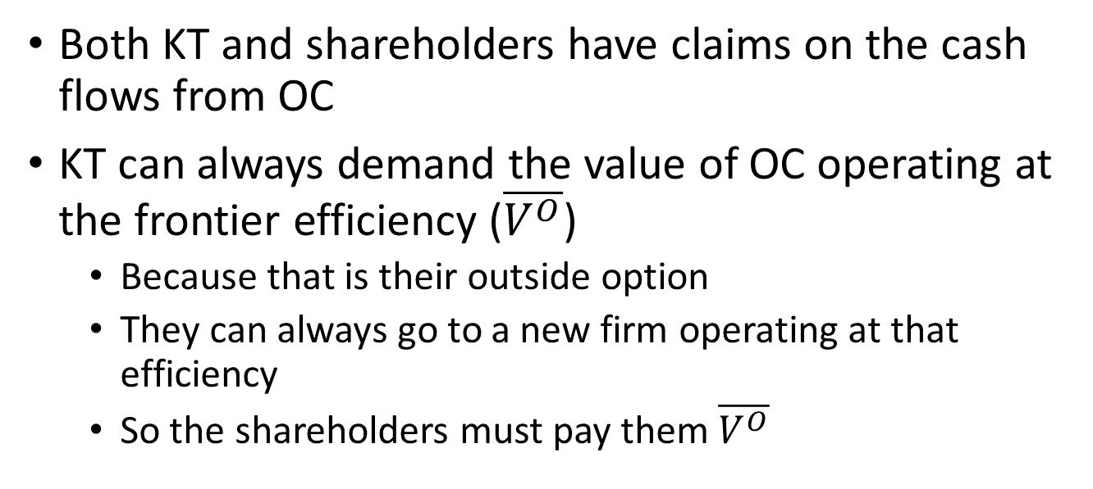
Splitting the value of OC
Owned by
shareholders
Technology
Key talent
Owned by
key talent
Both KT and shareholders have claims on the cash flows from OC
KT can always demand the value of OC operating at the frontier efficiency ($\overline{V^{O}}$)
  Because that is their outside option
  They can always go to a new firm operating at that efficiency
  So the shareholders must pay them $\overline{V^{O}}$

Slide 10
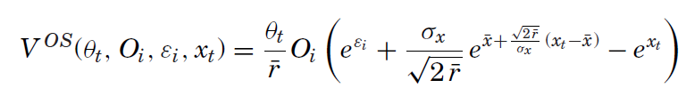

What is left for shareholders?
The same as the last equation = the value of OC
The value of operating at $ε$
The option value of upgrading OC
The value they key talent capture = the value of operating at the frontier efficiency (x).

Slide 11


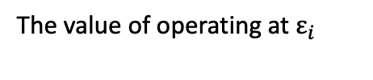



Graphically, in terms of x
Value of OC
The value of the option to operate at $\overline{x}$
The space in between the lines = value to shareholders
$e^{x}$= value to KT
The value of operating at $ε_{i}$
x = $ε_{i}$
Frontier efficiency of OC = x
x = $\overline{x}$

Slide 12
Takeaways from the model
Compensation to key talent is increasing in the frontier efficiency of OC (x)
Shareholder value in OC is decreasing in x, creating risk for shareholders
  Because x is an aggregate shock (the frontier technological efficiency affects all firms), shareholder risk in OC is undiversifiable (systematic)
The effect of the shock to frontier efficiency is increasing in the quantity of OC
When the frontier efficiency exceeds the firm’s efficiency by a certain amount, the firm needs to restructure around more efficient technology

Slide 13
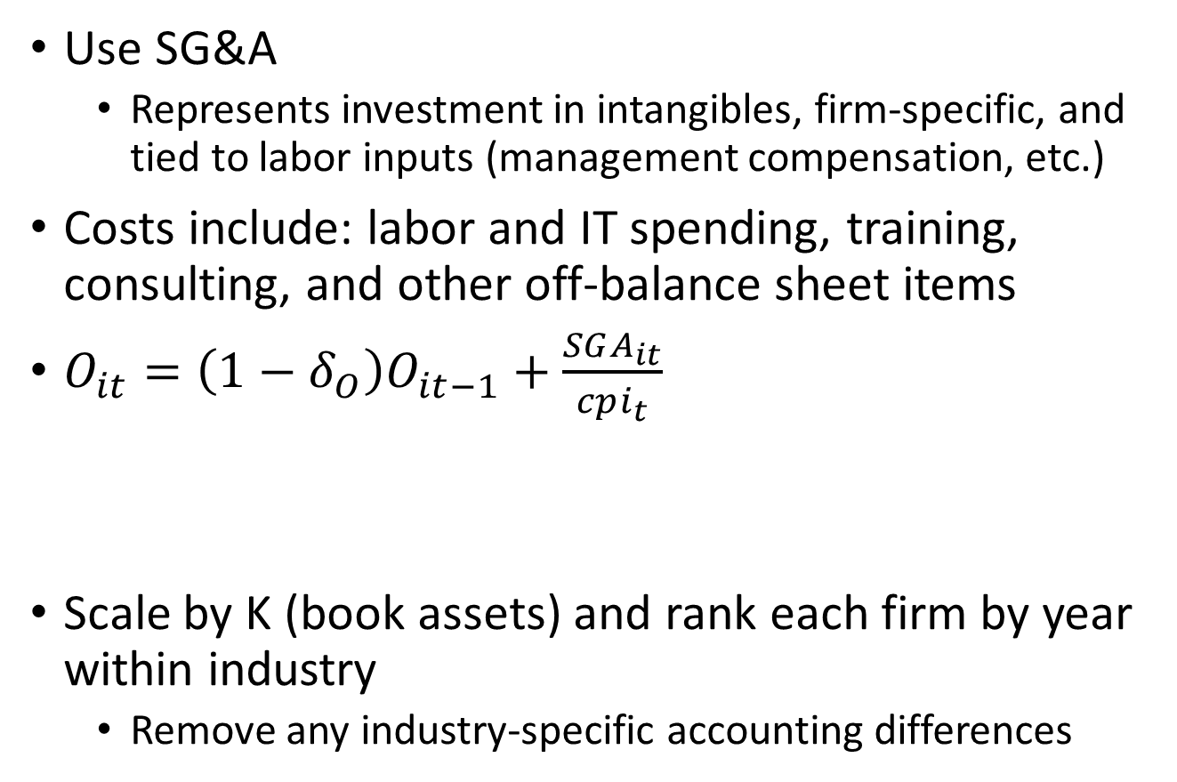
Measuring OC
Use SG&A
  Represents investment in intangibles, firm-specific, and tied to labor inputs (management compensation, etc.)
Costs include: labor and IT spending, training, consulting, and other off-balance sheet items
$O_{it}=\left(1−δ_{O}\right)O_{it−1}+\frac{SGA_{it}}{cpi_{t}}$
Scale by K (book assets) and rank each firm by year within industry
  Remove any industry-specific accounting differences
15%
Depreciate the base
Add the current expense

Slide 14
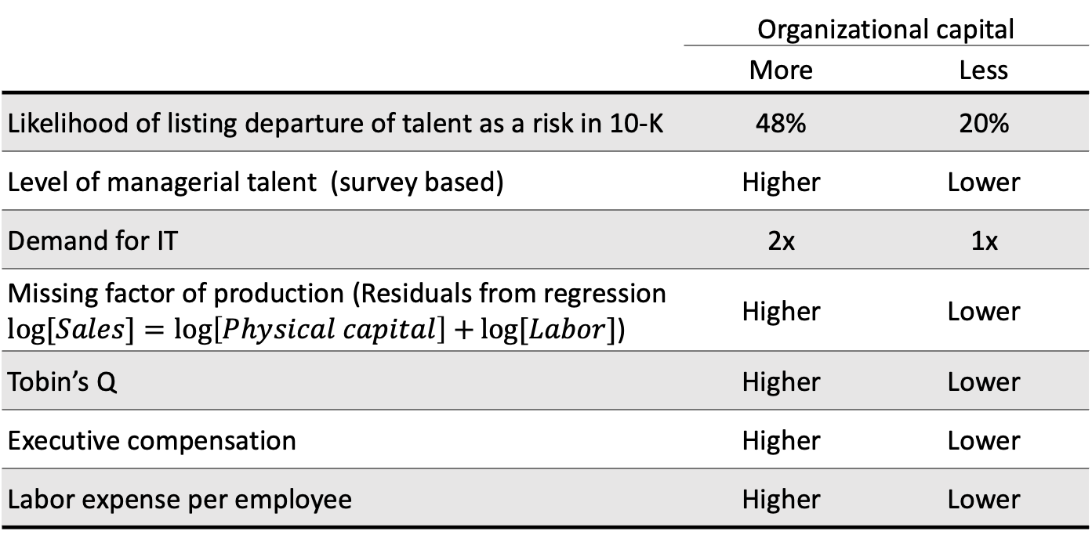
Validating the measure of OC
 | Organizational capital
 | More | Less
Likelihood of listing departure of talent as a risk in 10-K | 48% | 20%
Level of managerial talent (survey based) | Higher | Lower
Demand for IT | 2x | 1x
Missing factor of production (Residuals from regression $\log{[Sales]}=\log\left[Physical capital\right]+\log{[Labor]}$) | Higher | Lower
Tobin’s Q | Higher | Lower
Executive compensation | Higher | Lower
Labor expense per employee | Higher | Lower

Slide 15
Creating the OMK portfolio
Organizational capital quintile
5 (high) | Industry 1 | Industry 2 | Industry 3 | … | = Long
1 (low) | Industry 1 | Industry 2 | Industry 3 | … | = Short
OMK
Aggregate Return to Organizational Capital
Industry balanced on long and short side
Reflects industry distribution in economy
If OC creates systematic risk for shareholders, then the returns for high OC firms should be higher than for low OC firms

Slide 16
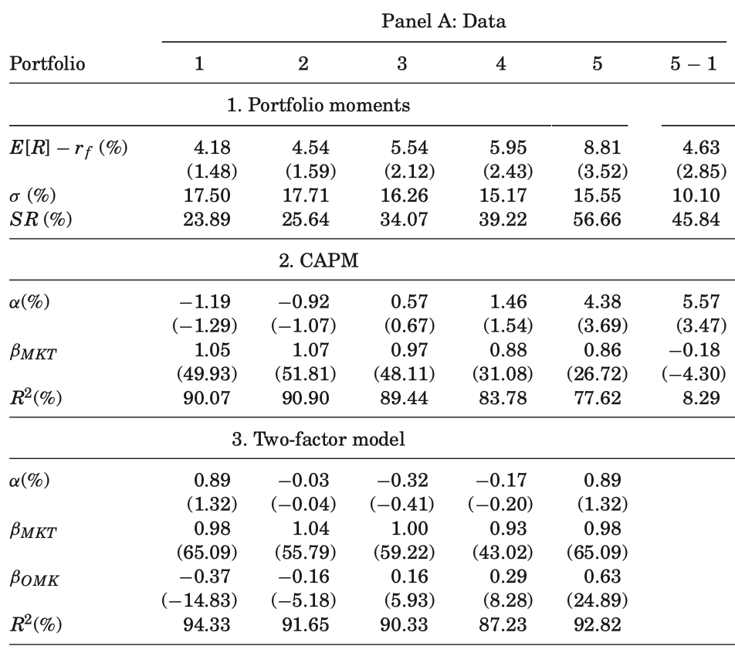
Evidence of systematic risk

Slide 17
Identifying technology shocks
Generally, high OC firms should have higher returns than low OC firms (compensation for risk)
But, from the model, we know that shareholder value is decreasing when the frontier (x) moves out
So, times when the OMK portfolio demonstrates low return are times of technology shock
Return
Technology shock
Time

Slide 18
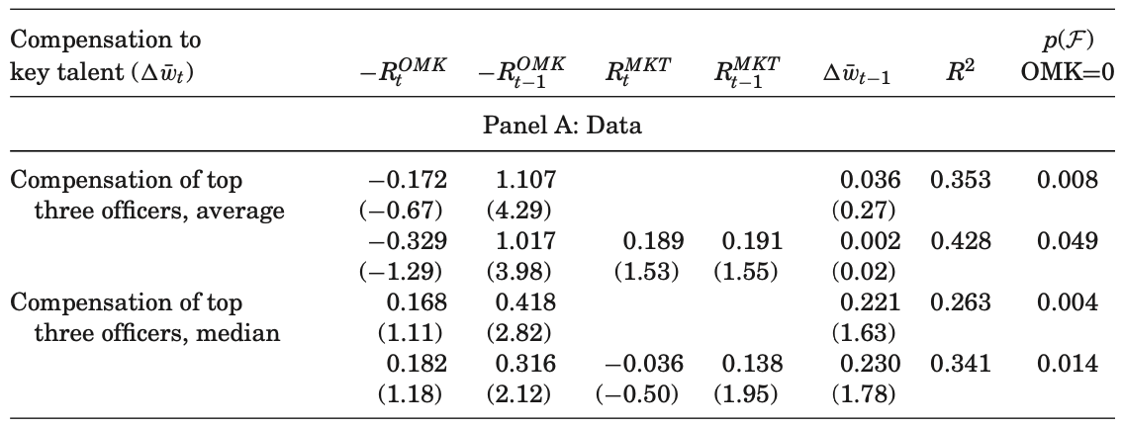
Increases to executive compensation

Slide 19
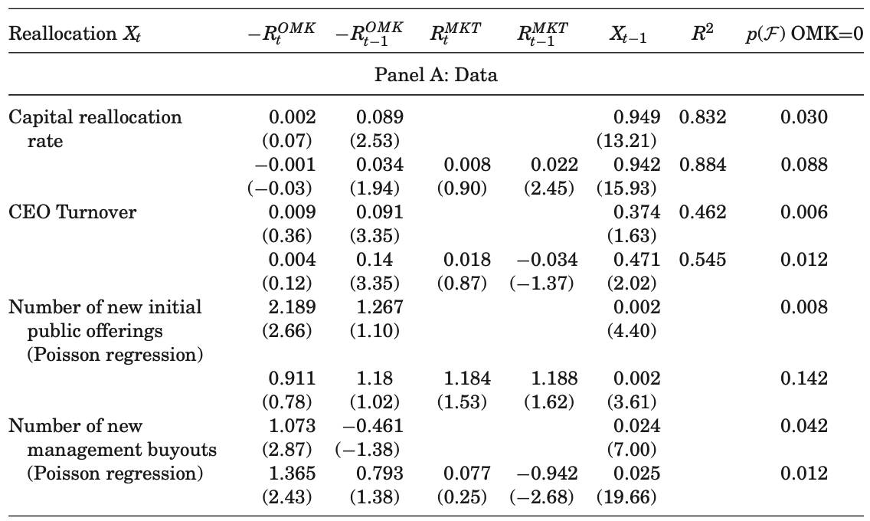
Capital reallocation

Slide 20
Takeaways from E&P
Increases in industry organizational capital efficiency does not mean that all firms benefit
Retaining KT is risky because you are committing to uncertain payments to them in the future
When your firm is not operating at the frontier efficiency, the shocks to the industry may force you to restructure

Slide 21
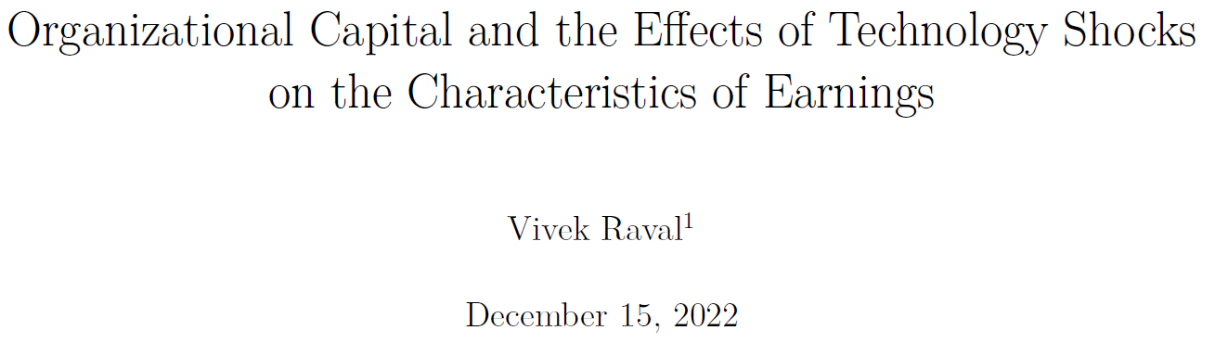
Organizational Capital and the Effects of Technology Shocks on the Characteristics of Earnings
Raval 2016

Slide 22
New technology affects characteristics of earnings
Objective:
Introduction of new technology
?
Characteristics of earnings
Findings:
lower
Timeliness of earnings
Economy-wide technology shocks
higher
Goodwill impairments
higher
Restructuring charges
Contribution:
Aggregate economic dynamics
✓
Characteristics of earnings
Investment in intangible assets
✓
Exposure to
economic shocks
✓
Lower
earnings quality

Slide 23
Recall E&P
Technology shocks are measured as low returns to the OMK portfolio
Measure OC and OMK just like E&P
Also use an indicator for low returns
  SHOCK = percent of months that are in the lowest 25% of OMK returns over the sample period
Return
Technology shock
Time

Slide 24
OMK and SHOCK vary over time
Annual averages of SHOCK and OMK
OMK
SHOCK
Non-trending
Average SHOCK = 0.25, OMK = 0.05

Slide 25
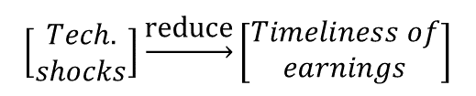
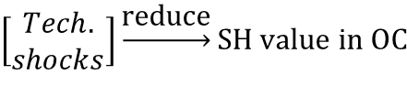
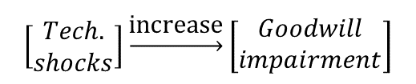
Three main hypotheses
Theorized relation
Accounting implication
Hypothesis
$$\left[\begin{matrix}Tech. \\ shocks\end{matrix}\right]\underset{→}{\text{reduce}}SH value in OC$$
Technology shocks change value of off-B/S asset (org. cap.)
No asset to write down
$$\left[\begin{matrix}Tech. \\ shocks\end{matrix}\right]\underset{→}{\text{reduce}}\left[\begin{matrix}Timeliness of \\ earnings\end{matrix}\right]$$
Stronger in high organizational capital firms
Increasing in the amount of operational capital investment
In special case of M&A, org. cap. might appear on B/S as goodwill
Lower value of org. cap. will result in lower goodwill value
$$\left[\begin{matrix}Tech. \\ shocks\end{matrix}\right]\underset{→}{\text{increase}}\left[\begin{matrix}Goodwill \\ impairment\end{matrix}\right]$$

Slide 26

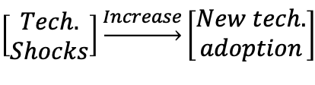
Three main hypotheses
Theorized relation
Accounting implication
$$\left[\begin{matrix}Tech. \\ Shocks\end{matrix}\right]\underset{→}{Increase}\left[\begin{matrix}New tech. \\ adoption\end{matrix}\right]$$
Adopting a new technology requires re-organizing processes, relocating employees and physical capital
Introduce a more efficient way of doing business
$$\left[\begin{matrix}Tech. \\ Shocks\end{matrix}\right]\underset{→}{increase}\left[\begin{matrix}Restructuring \\ charges\end{matrix}\right]$$
Less for more
efficient firms
Less likely for more efficient firms

Slide 27
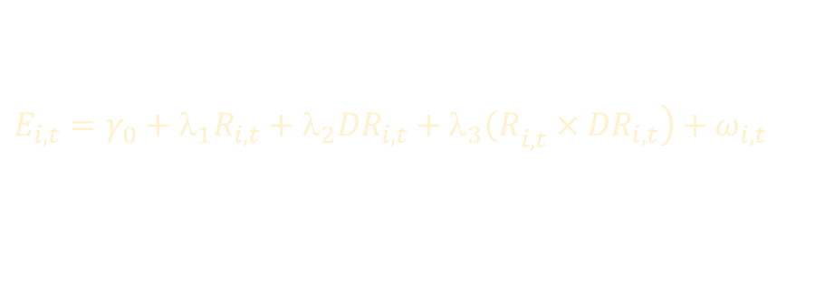

Technology shocks reduce timeliness
Earnings
Returns
Neg. returns indicator
$R^{2}$ from regression:
$$E_{i,t}=γ_{0}+λ_{1}R_{i,t}+λ_{2}{DR}_{i,t}+λ_{3}{\left(R\right.}_{i,t}×\left.{DR}_{i,t}\right)+ω_{i,t}$$
Basu (1997)
Ball et al. (2000)
Bushman et al. (2004)
Indicator for low OMK
Controls
$${TIME}_{t}=$$ | $$α$$ | $$+β_{1}{SHOCK}_{t}$$ | $$+β_{2}{MKT}_{t}$$ | $$+β_{3}{SMB}_{t}$$ | $$+β_{4}{HML}_{t}$$ | $$+β_{5}{UMD}_{t}$$ | $$+ε_{t}$$
Expectation: |  | negative | H1: Technology shocks reduce earnings timeliness
Coefficient: | 0.08*** | -0.06* | -0.03 | 0.16 | 0.09 | 0.05
T-Stats: | (4.35) | (-2.00) | (-0.31) | (1.02) | (0.08) | (0.88)
5% significance (1-sided)
N=43, Newey-West standard errors

Slide 28
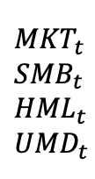
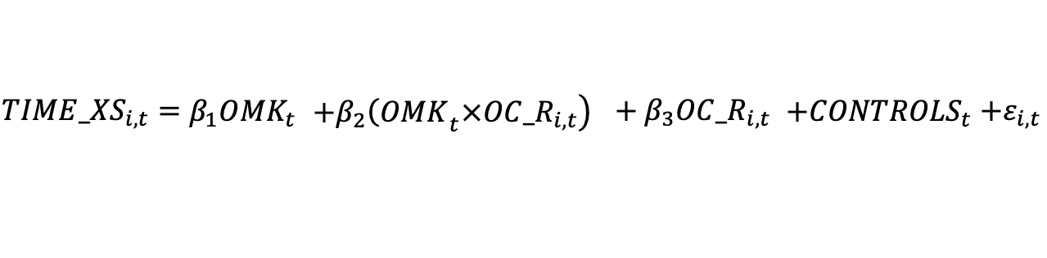
Moreso for firms with high OC
Cross-sectionally and time-varying measure of timeliness
$${MKT}_{t}$$
$${SMB}_{t}$$
$${HML}_{t}$$
$${UMD}_{t}$$
Continuous measure of technology shock
(lower = shock)
Org. cap. rank
$${TIME_XS}_{i,t}=$$ | $$β_{1}{OMK}_{t}$$ | $$+β_{2}\left.{{\left(OMK\right.}_{t}×OC_R}_{i,t}\right)$$ | $${+ β}_{3}{OC_R}_{i,t}$$ | $$+{CONTROLS}_{t}$$ | $$+ε_{i,t}$$
Expectation: |  | positive | H1a: Technology shocks reduce timeliness more for firms with more organizational capital
Coefficient: | -0.11 | 0.02*** | -0.01***
T-Stats: | (-1.25) | (2.83) | (-5.78)
Includes firm fixed effects, cluster by time
N=78,484
Robust to inclusion of firm returns (idiosyncratic returns)

Slide 29
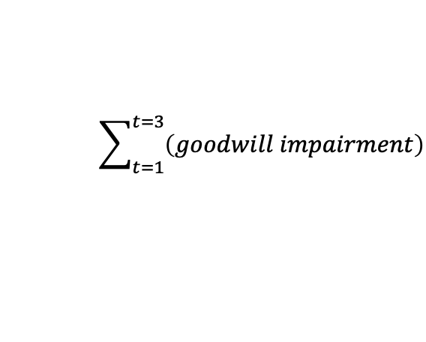
Tech shocks and goodwill impairment
$$\sum_{t=1}^{t=3}{\left(goodwill impairment\right)}$$
Continuous measure of technology shock (lower = shock)
Firm returns
Controls
$${FUTIMP}_{i,t}=$$ | $$β_{1}{OMK}_{t}$$ | $$+β_{2}R_{i,t}$$ | $$+β_{3}{MKT}_{t}$$ | $$+β_{4}{SMB}_{t}$$ | $$+β_{5}{HML}_{t}$$ | $$+β_{6}{UMD}_{t}$$ | $$+ε_{i,t}$$
Expectation: | negative | H2: Technology shocks increase goodwill impairment
Coefficient: | -0.85** | -0.19*** | -0.06 | 0.26 | 0.19 | 0.28**
T-Stats: | (-2.04) | (-4.88) | (-0.32) | (0.69) | (0.78) | (2.28)
Tobit estimation, cluster by time
N=17,254
Industry and cohort fixed effects

Slide 30

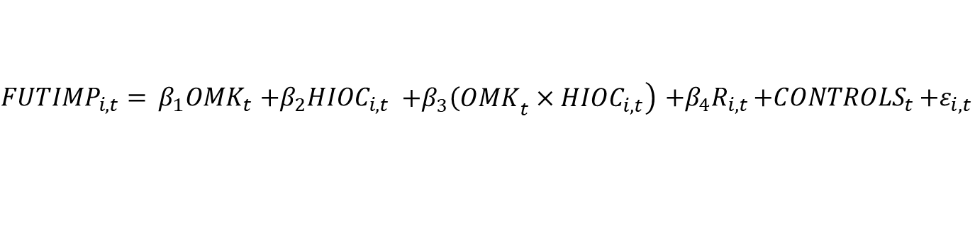
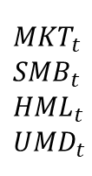
Tech shocks and goodwill impairment
$$\sum_{t=1}^{t=3}{\left(goodwill impairment\right)}$$
$${MKT}_{t}$$
$${SMB}_{t}$$
$${HML}_{t}$$
$${UMD}_{t}$$
Continuous measure of technology shock
Indicator for org. cap. in top quintile
Returns
$${FUTIMP}_{i,t}=$$ | $$β_{1}{OMK}_{t}$$ | $$+β_{2}{HIOC}_{i,t}$$ | $$+β_{3}\left.{{\left(OMK\right.}_{t}×HIOC}_{i,t}\right)$$ | $$+{β_{4}R}_{i,t}$$ | $$+{CONTROLS}_{t}$$ | $$+ε_{i,t}$$
Expectation: |  | negative | H2a: Techn. shocks is increase goodwill impairment more for firms with more org. capital
Coefficient: | -0.80* | -0.05*** | -0.05*** | -0.19***
T-Stats: | (-1.90) | (-4.88) | (-2.54) | (-4.86)
Tobit estimation, cluster by time
N=17,254
Industry and cohort fixed effects

Slide 31

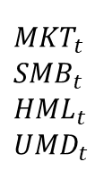
Tech shocks and restructuring
$$\sum_{t=1}^{t=3}{\left(restructuring\right)}$$
Continuous measure of technology shock (lower = shock)
$${MKT}_{t}$$
$${SMB}_{t}$$
$${HML}_{t}$$
$${UMD}_{t}$$
Org. cap. rank
Returns
$${FUTRESTR}_{i,t}=$$ | $$β_{1}{OMK}_{t}$$ | $$+β_{2}{OC_R}_{i,t}$$ | $$+{β_{3}R}_{i,t}$$ | $$+{CONTROLS}_{t}$$ | $$+ε_{i,t}$$
Expectation: | negative | H3: Technology shocks increase restructuring charges
Coefficient: | -0.03** | 0.34*** | -0.01***
T-Stats: | (-2.45) | (6.99) | (-4.78)
Tobit estimation, cluster by time
26,403
Industry and cohort fixed effects

Slide 32
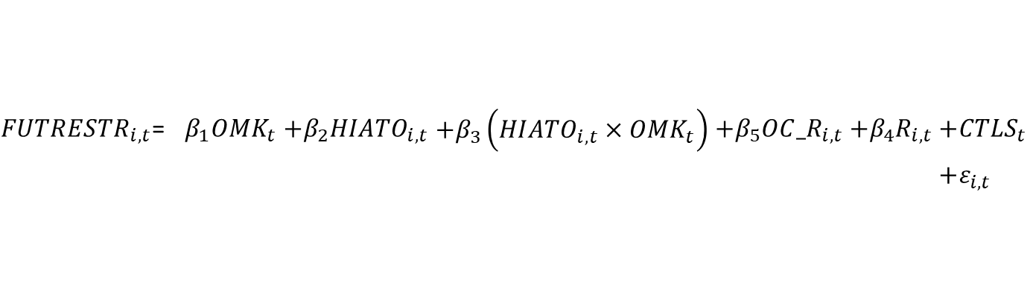
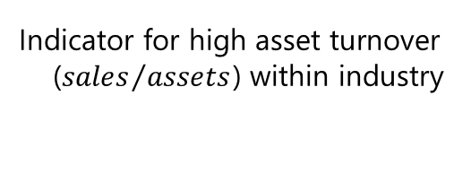
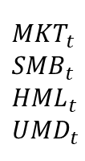

Tech shocks and restructuring
$$\sum_{t=1}^{t=3}{\left(restructuring\right)}$$
$${MKT}_{t}$$
$${SMB}_{t}$$
$${HML}_{t}$$
$${UMD}_{t}$$
Continuous measure of technology shock (lower = shock)
Indicator for high asset turnover (${sales}/{assets}$) within industry
Org. capital rank
Returns
${FUTRESTR}_{i,t}$= | $$β_{1}{OMK}_{t}$$ | $$+β_{2}{HIATO}_{i,t}$$ | $$+β_{3}\left.{\left({HIATO}_{i,t}\right.×OMK}_{t}\right)$$ | $$+{β_{5}OC_R}_{i,t}$$ | $$+{β_{4}R}_{i,t}$$ | $$+{CTLS}_{t}$$
 |  |  |  |  |  | $$+ε_{i,t}$$
Expectation: | negative |  | positive | H3a: Techn. shocks increase restructuring charges less for more efficient firms
Coefficient: | -0.03** | -0.01*** | 0.02* | 0.44*** | -0.01***
T-Stats: | (-2.50) | (-9.68) | (1.70) | (9.29) | (-4.73)
Tobit estimation, cluster by time
N=26,403
Industry and cohort fixed effects

Slide 33
Takeaways
The E&P theory seems to be supported by accounting data
Because human capital is not capitalized, in times of technology shocks, earnings are less useful.
However, technology shocks generate goodwill and restructuring charges, so not all is lost

Slide 34
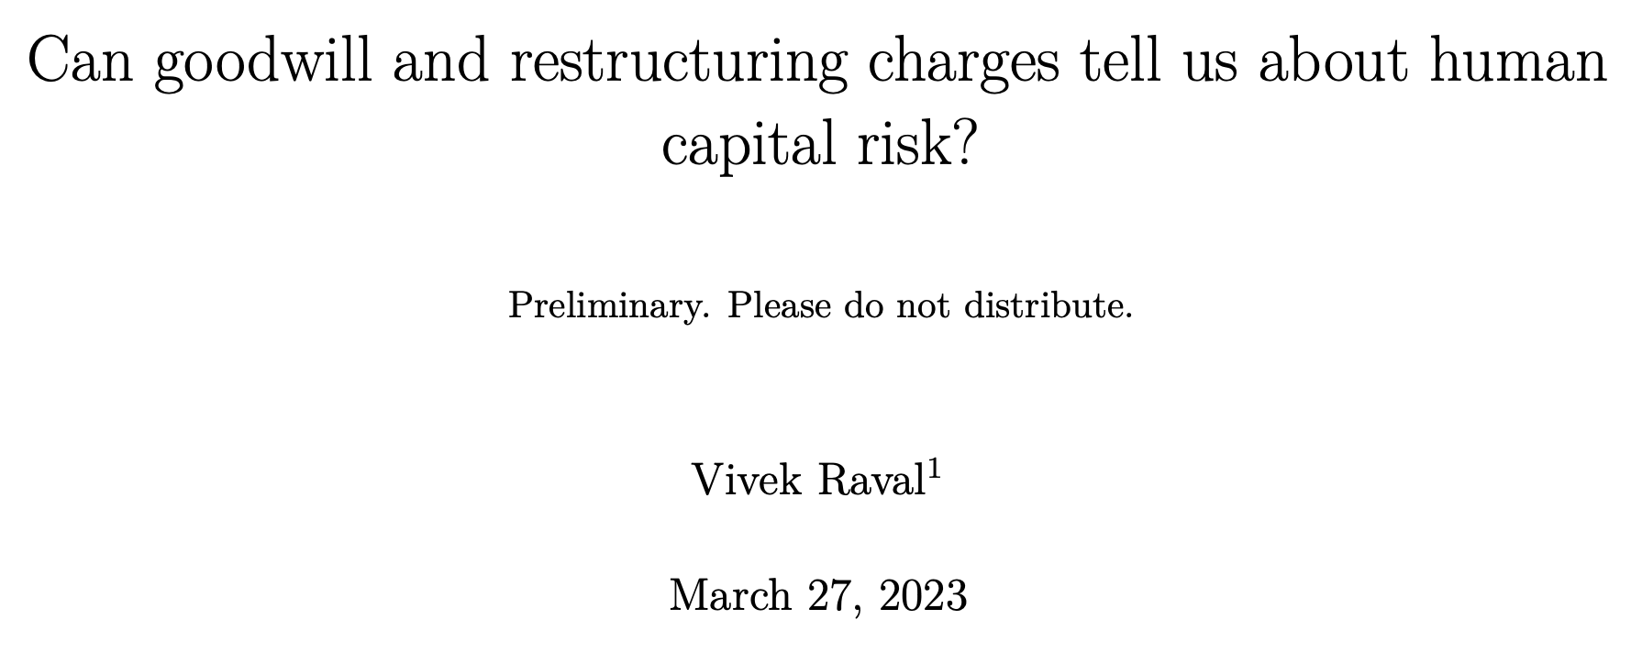
Raval 2023

Slide 35
Human capital is risky
Human capital (HC) = firm-specific human capital = organizational capital
HC is systematically risky
  See E&P
Do the financial statements offer any clues about this risk?
  Perhaps not – HC is not capitalized on the BS
  Perhaps so – goodwill and restructuring charges are HC-related charges
    Their timing can help us determine the HC risk exposure of the firm

Slide 36
Why is human capital risky
Specialized tasks require specialized talent (KT)
Obtaining/keeping this talent is expensive
It’s not clear ahead of time that the employees will be productive (i.e., how long the firm can operate at current efficiency before restructuring)
If your highly paid employees are not producing at a high enough level, the firm will need to restructure
Because firms tend to invest in new technologies and specialists at the same time, human capital investment and rationalization is correlated across firms
  The risk is systematic

Slide 37
How do investors identify the risk?
The financial statements are intended to provide relevant information about the firm, including risk
  Barth, 2018 calls for research on risk disclosure in financial statements
  Ellahie, 2021 measures systematic risk using earnings
The information may be available in other ways, but the information that falls in the scope of the FASB and auditors has specific importance
Can the information provided by firms in the income statement help investors identify systematic risk related to human capital?

Slide 38
How can financial statements help?
The financial statements do not provide much information about HC
  Employees not capitalized
  SG&A spending is not capitalized
But there is goodwill impairment
  Goodwill is comprised of intangible assets that can not be specifically identified
  It is not unusual for firms to pay for acquired human capital (Ranft and Lord, 2000; Uhlenbruck, Hitt, and Semadeni, 2006)
However, goodwill impairment has been under scrutiny
  Earnings management (K. K. Li and Sloan, 2017; Z. Li et al., 2011; Ramanna and Watts, 2012)
  The FASB was considering re-introducing an amortization model (project has since been removed from the agenda)
  So it may be totally worthless

Slide 39
Any other information?
Restructuring charges can also provide information
Restructuring charges are comprised of:
  Involuntary termination benefits
  Costs to terminate a contract
  Costs to consolidate facilities
For many firms, the termination benefits will be the largest component of restructuring cost
However, these costs have also come under scrutiny (Bens and Johnston, 2009)
Restructuring may also tell us nothing

Slide 40
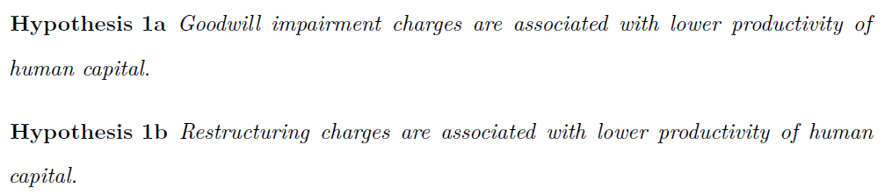
Hypothesis 1
Providing evidence that goodwill and restructuring charges are related to labor productivity

Slide 41
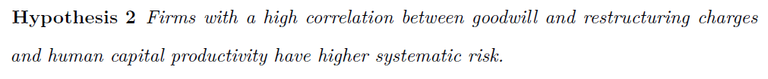
Human capital risk
If goodwill and restructuring are useful for assessing the labor productivity in the firm, then they can also indicate exposure to systematic human capital risk
If the goodwill and restructuring charges occur simultaneously with aggregate labor productivity shocks, then the firm is subject to systematic risk

Slide 42
Human capital productivity measure
Percent change in the annual industry labor productivity provided by the BLS
  Output index divided by hours worked
  Output index is unaffected by changes in sales prices
  Number of hours worked is based on the BLS National Compensation Survey and Current Population Survey.
  Not based on accounting data

Slide 43
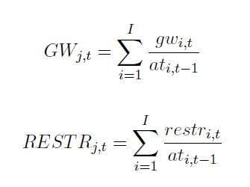
Goodwill and restructuring measures
Annual goodwill or restructuring charge scaled by lagged assets
Goodwill charges are missing if the firm has no goodwill on their prior annual balance sheet
Aggregate by industry-year:

Slide 44
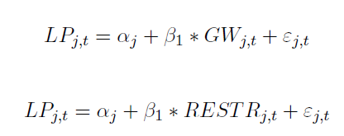
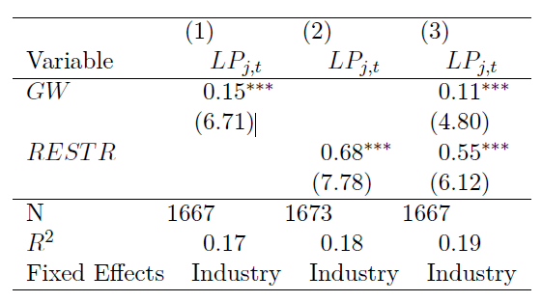
Do the charges reflect changes in aggregate labor productivity?
Similar results with industry and time fixed effects

Slide 45
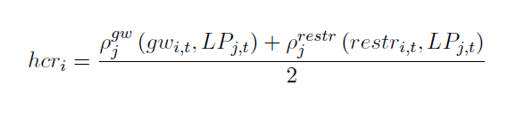
The correlation between charges and labor productivity
Measure correlation at the firm level in the time-series
  Require more than 10 observations
Measure for goodwill, restructuring and calculate the average

Slide 46
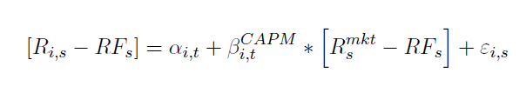
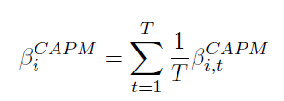
Measure CAPM beta
Estimate for each firm-year on a rolling 60 month basis
Then average across all years for a firm

Slide 47
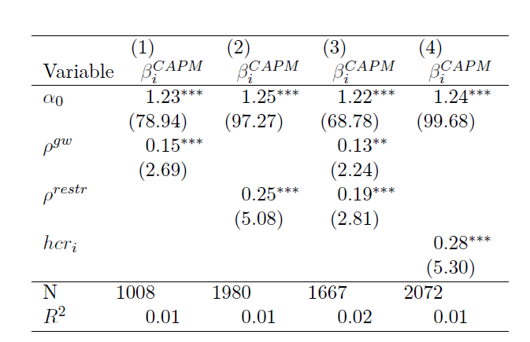
GW/Restructuring charges and risk

Slide 48
Not yet tabulated results
Robustness:
  Robust to including HML, SMB, and UMD, the FF & Carhartt factors when determining Beta
  Robust to including the correlation with pretax earnings excluding goodwill and restructuring charges
Preliminary Risk results:
  No correlation with OMK
  No correlation with HML^{INT} from Eisfeldt, Kim, and Papanikolaou (2022)
    Both OMK and HML^{INT} use capitalized SGA as the measure of OC. I do not use any measure of OC.
    I’m looking at reversals of investment in OC, while those measures look at investments in OC.

Slide 49
Contribution
Human capital information is in demand. Can investors get anything from earnings information?
Despite their flaws, Goodwill and Restructuring charges appear to correlate with aggregate changes in labor productivity
Goodwill and Restructuring charges are not persistent, but they can still be useful for assessing firm risk
  Lack of persistence is not equal to lack of value relevance

Slide 50
Thank you.

Slide 52
OMK has been validated
Theory suggests: | Findings:
Decreasing shareholder value to organizational capital, increasing rent for key talent
Decreasing shareholder value to organizational capital leads to more adoption of new technology
More organizational capital exposes firm to risk of new technology shocks
Intuition suggests: Technology shocks occur around the introduction or new, important technologies
Unexpected increases in executive compensation (top 3 or CEO only)
Eisfeldt and Papanikolaou (2013)
Lower returns to OMK
Higher wage growth: Silicon Valley, and Professional/Scientific/Technical Svcs.
This study
Lower returns to OMK
More IPOs, management buy-outs, physical capital allocations
Eisfeldt and Papanikolaou (2013)
High organizational capital firms
5% higher returns than low organizational capital firms
This study, Eisfeldt and Papanikolaou (2013)
Lower returns to OMK
Subsequent increase in books published on computer and networking This study

