Slide 1
Can goodwill and restructuring charges tell us about systematic risk?
Vivek Raval
May 5, 2023

Slide 2
Can goodwill and restructuring charges tell us about human capital?
Motivation
Regulators/Std. Setters
Academic Research
SEC: Amended item 101 of Reg. S-K.
Human capital is value relevant
Measurement largely uses non-accounting information or capitalizes SG&A
Companies
“Human capital is our most important asset.”
but
Provide little information
Thus far has not investigated the effectiveness of extant reporting standards around goodwill impairments and restructuring in providing information about human capital
FASB: Researching accounting for intangibles, drafting a standard on disaggregation of expenses
(esp. not fair value)
This study
Proposes that goodwill and restructuring charges can provide information about when and by how much the fair value of human capital decreases
This study attempts to determine if the timing of goodwill and restructuring charges provides information about firm exposure to labor market cycles and therefore systematic risk
This is not the same information as the fair value of human capital. The information is about changes, is sporadic, and is only in one direction
But the timing of goodwill and restructuring charges may be useful for determining firm exposure to labor market cyclicality, and therefore systematic risk
Notes:
The logic behind selecting goodwill. It could be more than just HC. Also, goodwill is criticized for being untimely (Li and Sloan; Li, Shroff, Venkataraman, Zhang; Ramanna and Watts).

Slide 3

Where on the financial statements is there human capital?
Goodwill
Purchase price
less
Identifiable assets
Physical assets
IP, patents, trademarks, copyrights
Grants
Customer lists
Rights and licenses
Brands
Goodwill
Human capital
Overpayment
“Synergies”
In-place workforce
Technological capabilities
Market knowledge
(Ranft & Lord, 2000; Uhlenbruck, Hitt, & Semadeni, 2006.)
Decreases in human capital value
Decreases in goodwill
possible
Notes:
The logic behind selecting goodwill. It could be more than just HC. Also, goodwill is criticized for being untimely (Li and Sloan; Li, Shroff, Venkataraman, Zhang; Ramanna and Watts).

Slide 4

Where on the financial statements is there human capital?
Restructuring
Involuntary termination benefits
Costs to relocate employees
Costs to terminate non-lease contracts
Costs to close facilities
Human capital-related
ASC 420
Recognized upon communication to the employees
Decreases in human capital value
Increases in restructuring
possible
Notes:
The logic behind restructuring. It could be more than just HC. Restructuring also is criticized for EM (Bens and Johnston).

Slide 5
Measuring the value of human capital
Aggregate labor productivity
Output ÷ Hours Worked
Output is real non-farm business sector output excluding intra-industry transfers (BEA).
Hours worked is employee hours worked and is adjusted for vacation, sick, and holiday hours (BLS).
By NAICS 4-digit industry
Source: BLS detailed industries labor productivity report
More goodwill impairments
Declines in labor productivity
Lower value of human capital
More restructuring
Notes:
Perhaps the least familiar variable, LP.

Slide 6

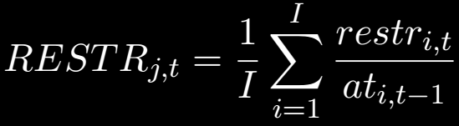
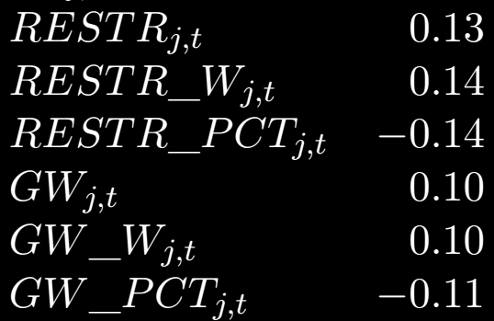
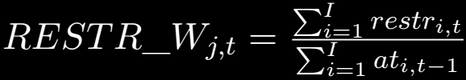
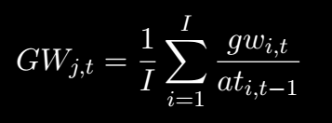
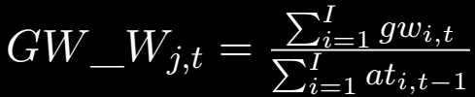
Goodwill and Restructuring charges move with aggregate productivity
Correlations
BLS Labor Productivity
***
***
***
Number of firms taking restructuring charges ÷ Total number of firms
***
***
***
Number of firms taking goodwill impairments ÷ Total number of firms
N = 1624 industry-year observations

Slide 7
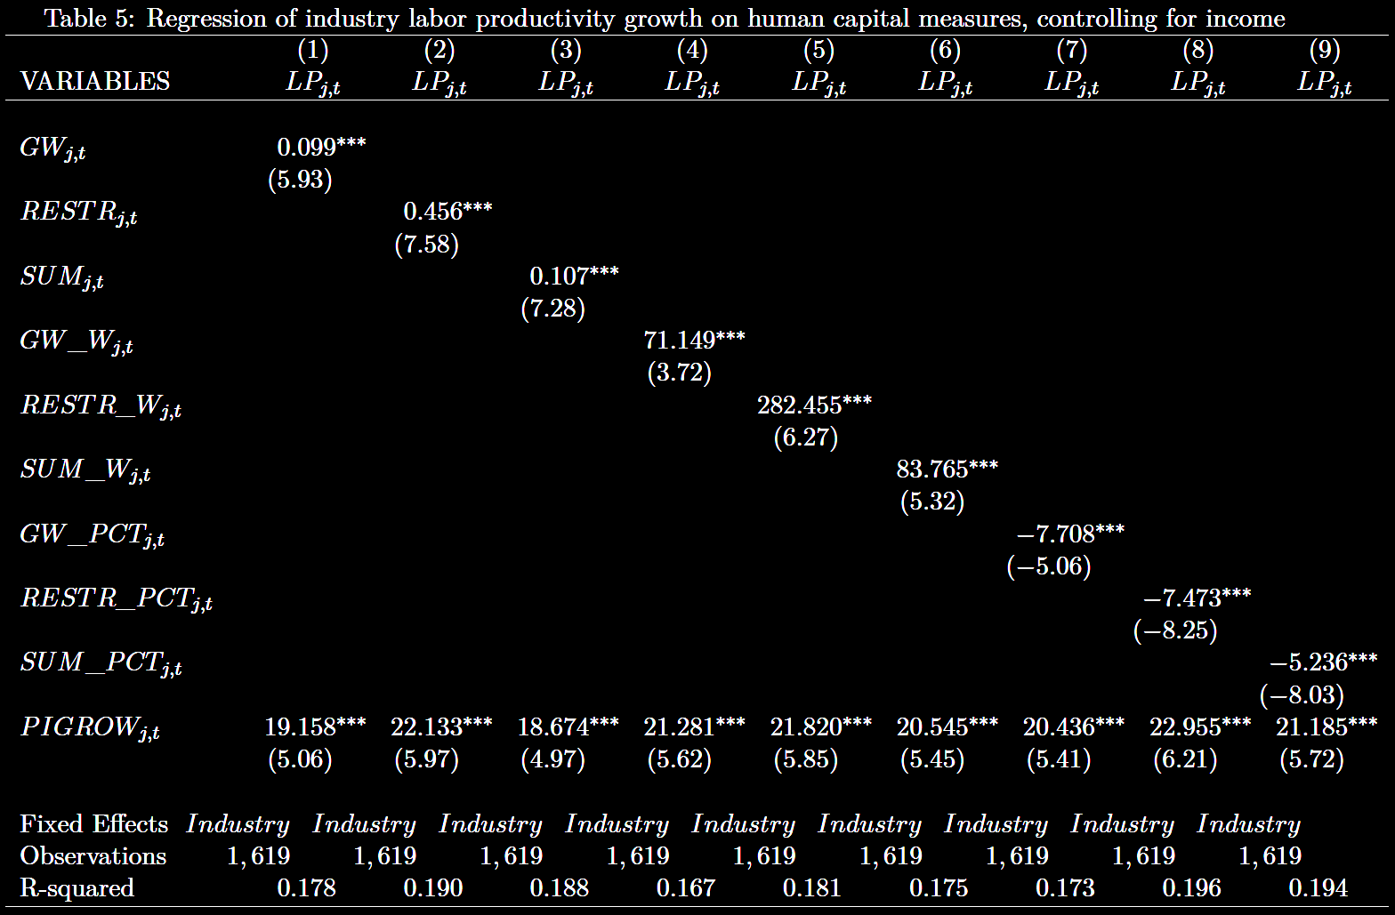

Goodwill and Restructuring charges move with aggregate productivity
Regressions
(
)
$$Δ$$
Pretax income + goodwill impairments + restructuring charges
Beginning of year total assets

Slide 8
When the value of human capital correlates with aggregate trends, this can indicate systematic risk
Systematic risk
Exposure to labor productivity can contribute to firm systematic risk.
Labor productivity is an important part of the business cycle.
Exposure to the business cycle is a systematic risk.
Aggregate labor productivity
Quantity
Value of firm human capital
Time

Slide 9

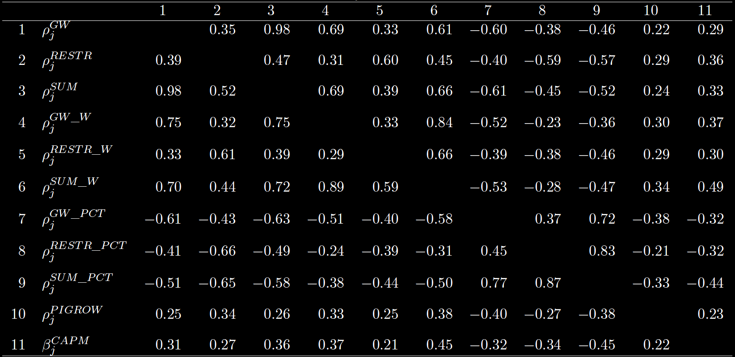




When the value of human capital correlates with aggregate trends, this can indicate systematic risk
Systematic risk by industry
Estimated annually by firm using prior 60 months of returns and averaged by industry using all firm-year observations in the industry
$$β_{j}^{CAPM}$$
Spearman correlations
$$ρ(GW_{j,t},LP_{j,t})$$
**
Correlation calculated by industry
$$ρ({RESTR}_{j,t},LP_{j,t})$$
***
$$ρ({GW_{j,t}+RESTR}_{j,t},LP_{j,t})$$
***
***
**
***
***
***
***
***
N = 69 industries

Slide 10
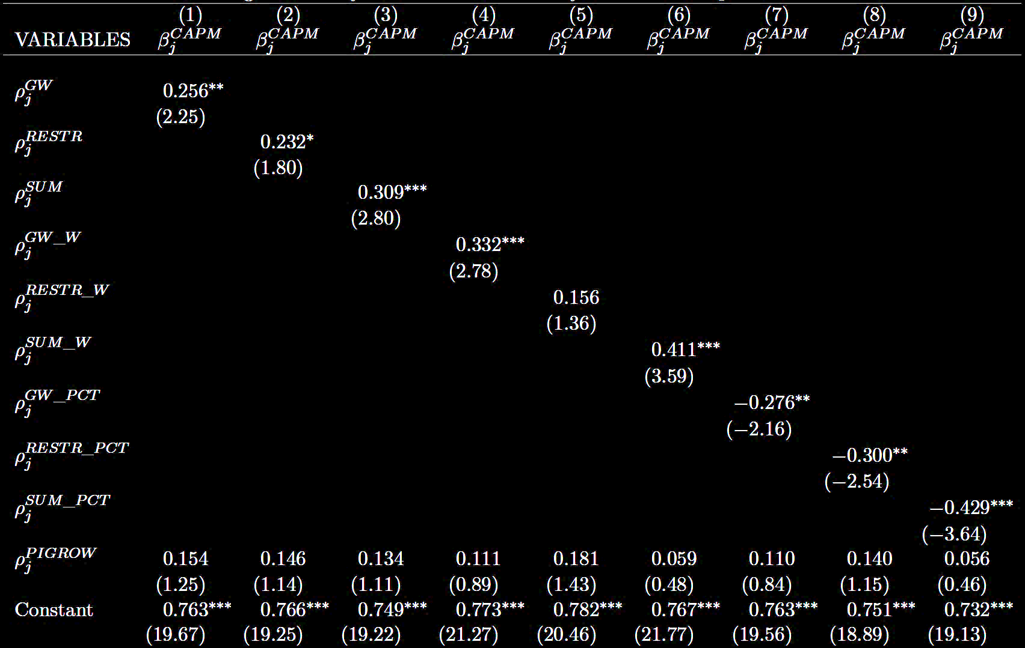
When the value of human capital correlates with aggregate trends, this can indicate systematic risk
Systematic risk by industry
N = 69 industries

Slide 11
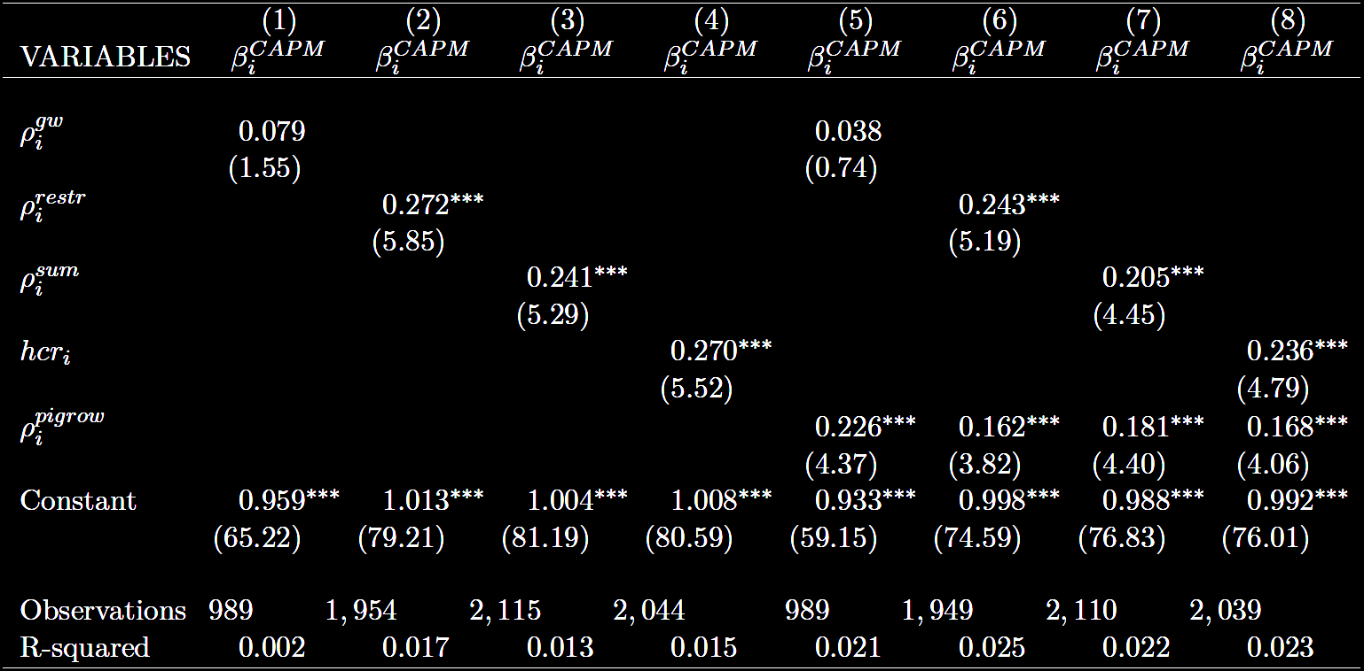

When the value of human capital correlates with aggregate trends, this can indicate systematic risk
Systematic risk by firm
The average of $ρ_{i}^{gw}$ and $ρ_{i}^{restr} by firm$

Slide 12
When the value of human capital correlates with aggregate trends, this can indicate systematic risk
Systematic risk by portfolio
CAPM beta
Tercile of correlation
Sum
Ave_corr
GW
Restr
Low
1.16
1.19
1.20
1.20
Medium
1.27
1.23
1.21
1.23
High
1.30
1.32
1.29
1.32

Slide 13
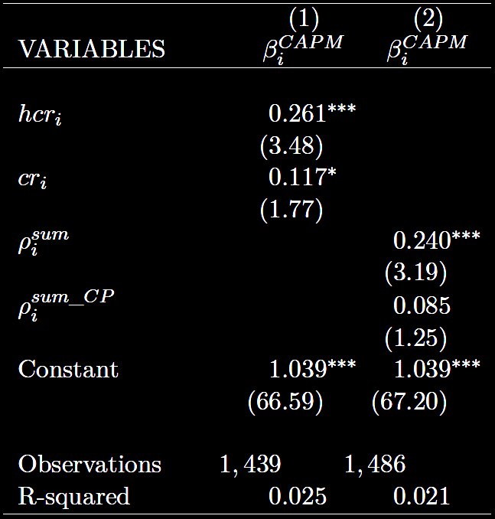
When the value of human capital correlates with aggregate trends, this can indicate systematic risk
Is it capital productivity?
Average of the correlations of goodwill impairment and restructuring charges with Capital Productivity (BLS)
Correlation of goodwill impairment + restructuring charges with Capital Productivity (BLS)

Slide 14
Thank you.

