Slide 1


Discussion: The bright side of career concern: CEO tenure and narrative disclosure complexity
Vivek Raval
August 9, 2023

Slide 2







Premise
I’m a new CEO
The bright side of career concerns!
I’m worried about my job
On a conference call
Obfuscate?
Transparent?

Slide 3



From the other point of view
I’m a new CEO
I’m an old CEO
I’m worried about my job
I’m not that worried about my job
On a conference call
Obfuscate?
Transparent?
Obfuscate?
Transparent?

Slide 4



When there is bad news
I’m a new CEO
I’m an old CEO
I’m worried about my job
I’m not that worried about my job
On a conference call
Obfuscate?
Transparent?
Obfuscate?
Transparent?

Slide 5


When there is bad news
I’m a new CEO
I’m an old CEO
I’m worried about my job
I’m not that worried about my job
On a conference call
Obfuscate?
Transparent?
Obfuscate?
Transparent?

Slide 6



When there is good news
I’m a new CEO
I’m an old CEO
I’m worried about my job
I’m not that worried about my job
On a conference call
Obfuscate?
Transparent?
Obfuscate?
Transparent?

Slide 7
When there is good news
I’m a new CEO
I’m an old CEO
I’m worried about my job
I’m not that worried about my job
On a conference call
Obfuscate?
Transparent?
Obfuscate?
Transparent?

Slide 8


Interpretation is challenging
Is one interpretation that longer-tenured CEOs are obfuscating good news?
Is another interpretation that less-tenured CEOs are over-emphasizing good news?

Slide 9
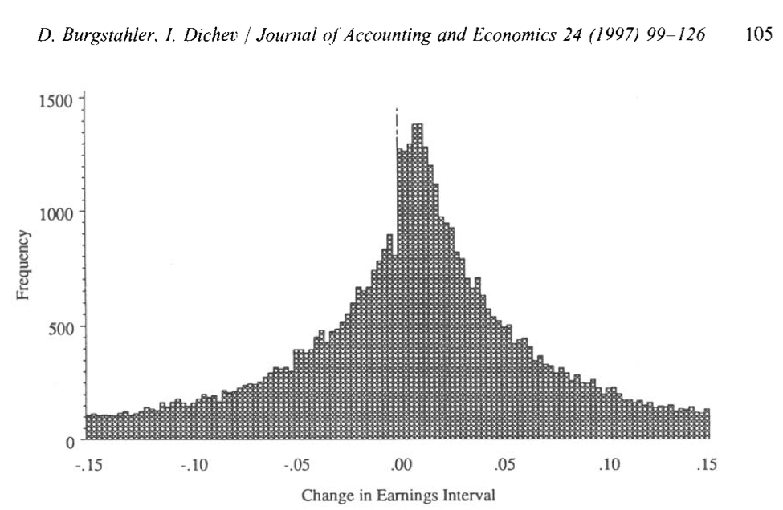


Obfuscation is usually conditional on having something to obfuscate

Slide 10


Obfuscation is usually conditional on having something to obfuscate
To clarify the interpretation of the results, start by telling me what CEOs are obfuscating.
Make the main results conditional on a situation where CEOs have a questionable decision to deal with on the call.
Then show a difference in obfuscation based on tenure.

Slide 11
Some other things to consider
Are less-tenured CEOs obfuscating less because they are more likely to get caught in the future?
Earnings management is only a short-term solution
Are less-tenured CEOs just building rapport with the analysts by being direct?
Who is the audience for the obfuscation? Is it really the board of directors, or analysts?
Are the coefficients in the subsamples significantly different from each other?
How does survival bias affect your results? Not all CEOs will have the same tenure.

Slide 12


Thank you.

