Slide 1
Discussion: Establishment-level life cycle and analysts’ forecasts
Vivek Raval
August 8, 2023

Slide 2
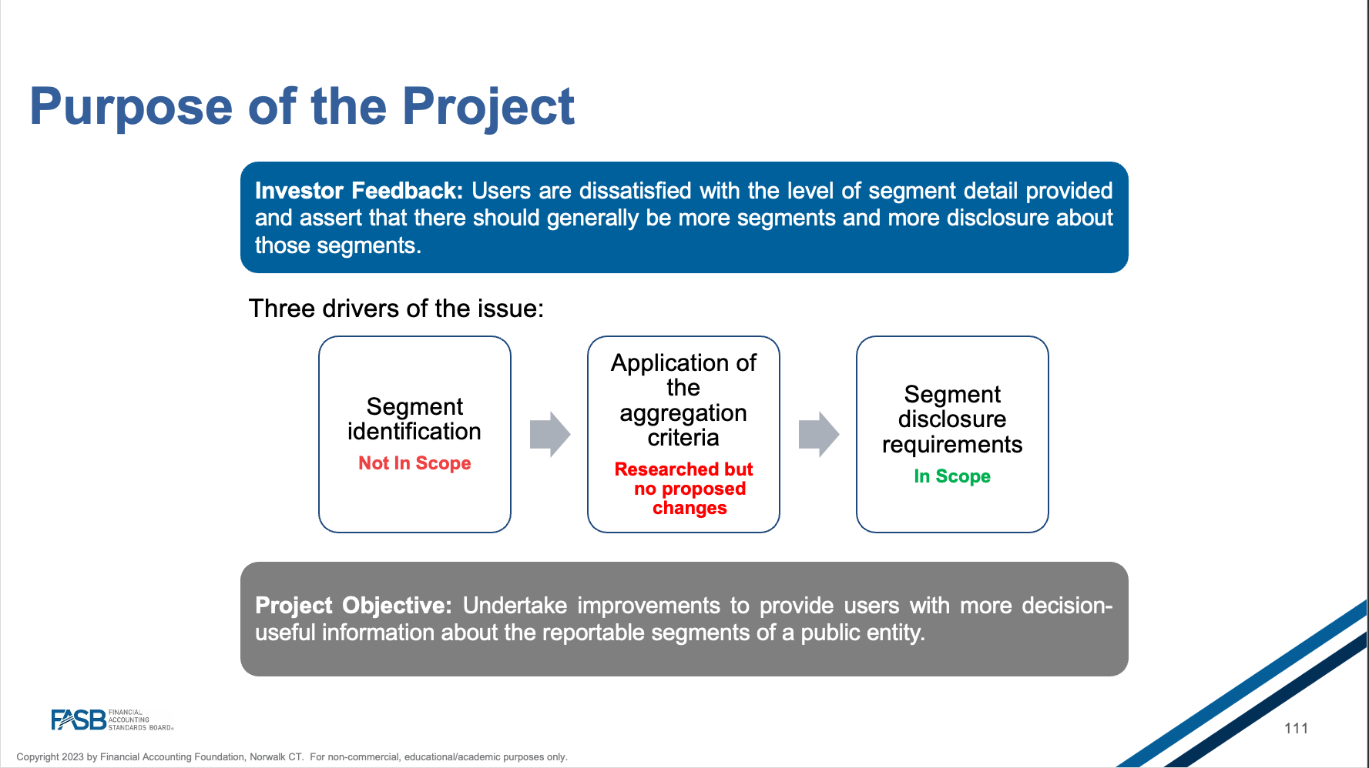
Segment reporting matters
From the FASB/IASB Update on Sunday afternoon.

Slide 3
The problem
The firm
Some financial information reported by the firm
S1
S2
S3
Segments
E1
E5
Establishments (factories)
Limited transparency
E2
E3
E4
Low-growth
Does this variation in growth affect analyst forecast accuracy?
High-growth
Does having high-growth (early-stage) establishments affect analyst forecast accuracy?

Slide 4
The questions
Does this variation in growth affect analyst forecast accuracy?
Does having high-growth (early-stage) establishments affect analyst forecast accuracy?
The firm
S1
S2
S3
E1
E5
Variance
Mean
E2
E3
E4
High-growth
Low-growth
There is (some) evidence supporting both, but which one is more important?
Providing some economic significance would provide this texture
There is evidence that having high-growth segment information makes forecasts less accurate. Is the establishment-level data still needed?

Slide 5

The data
Census data

Slide 6

The data
Census data
SAMELC5 = 1 if all establishments are the same life-cycle stage
Headcount growth x hours worked growth
Total value of shipments growth
Capital expenditures
Can the data provide insights about the kind of growth that is difficult to forecast?
Is there a reason for input growth (headcount, capex) to be harder to forecast than output growth (shipments)?

Slide 7
Are managers getting enough data?
The firm
Segment results are reviewed by the chief operating decision maker (FASB)
S1
S2
S3
E1
E5
But Table 9 suggests that if segments are comprised of high-growth establishments, then management has difficulty forecasting earnings
E2
E3
E4
High-growth
Low-growth
Would managers be better off with establishment-level data?
This question is prompted by the analyses and is an opportunity for further research
Adding the gap between the number of establishments and segments to the regression would be a first step
Also, consider the variance between life-cycle stages at the establishment level relative to the segment level (the information that is lost in aggregation).

Slide 8
Thank you.

