Slide 1
The risk relevance of restructuring
Vivek Raval
November 4, 2023

Slide 2
The literature motivating this study
Future firm cash flows
What can the financial statements tell us about cash flows?
Countless studies
Value of the firm
Function of:
Riskiness of the cash flows
What can the financial statements tell us about risk? ^{(Barth, 2018)}
Earnings: Ball, Sadka, Tseng (2022); Ellahie (2021); Barth & So (2014)
Specific expense: Restructuring
THIS STUDY

Slide 3
Demand shocks and employment fluctuations
In aggregate (macroeconomic)
At the firm (microeconomic)
Expected demand shock
Expected demand shock
Aggregate labor demand response ^{(Gali, 1999)}
Firm labor demand response
Correlation: Systematic Risk?
Actual aggregate demand shock
Actual firm demand shock
Correlation: Systematic Risk
Restructuring

Slide 4
Restructuring expense is the object of this study
The human capital side of restructuring
The financial reporting side restructuring
Restructuring includes:
Often excluded from non-GAAP earnings ^{(Laurion, 2020)}
Excluded from Compustat operating earnings
More than just labor costs
Part of “big bath” manipulations ^{(Bens & Johnson, 2009)}
Conservative: asymmetrically informative (only labor dis-investment)
Involuntary termination benefits
Costs to relocate employees
Costs to terminate a contract that is not a lease
Costs to consolidate or close facilities
Expensed immediately when announced
Comprised of committed costs
Reported quarterly
Reported in dollars (not people)
Restructuring has the potential to be useful, but is generally seen as not useful

Slide 5
Restructuring as labor dis-investment
Is restructuring expense correlated with other measures of human capital dis-investment?
Negative firm-year restructuring
Firm-year change in number of employees
Correlations
Pearson: 0.07
Spearman: 0.15
(Restructuring reflects only one side of the change)
Restructuring correlates negatively with firm-level employment

Slide 6
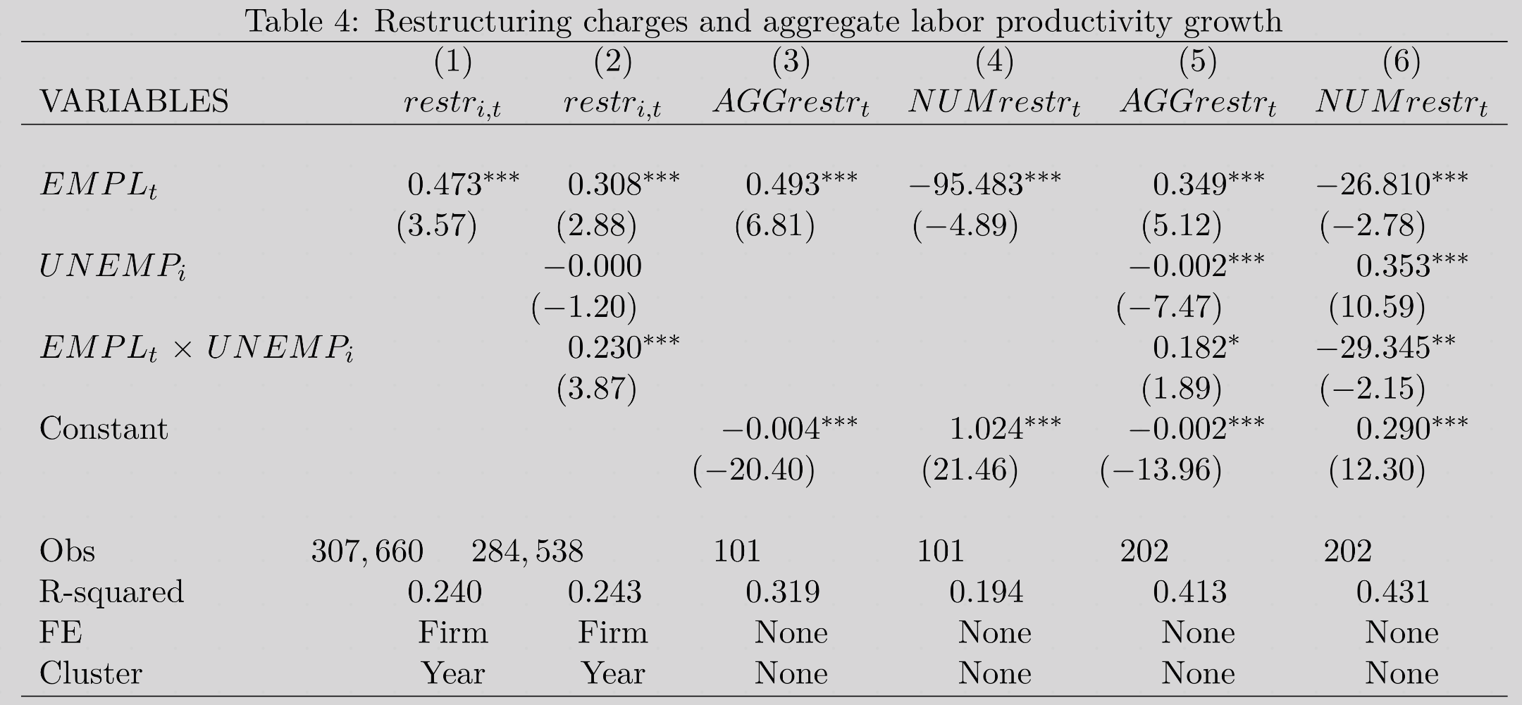
Restructuring as labor dis-investment
Does restructuring expense have an aggregate component?
Quarterly cross-sectional average of restructuring*
Restructuring correlates with aggregate employment, particularly when adjustment costs are lower.
Firm-year restructuring* as a fraction of beginning total assets
Quarterly number of firms taking restructuring
* Restructuring is a negative number
% change in aggregate employment from the same quarter in the prior year ^{(source: BLS)}
***
***
***
***
***
***
***
*
**
Indicator for firms in industries with high unemployment ^{(source: BLS)}
Measure of lower labor adjustment costs

Slide 7
The restructuring-based measure of systematic risk
Firm returns
Market returns
CAPM:
$$\left[R_{i,s}−RF_{s}\right]=α_{i}+β_{i}^{CAPM}∗\left[R_{s}^{mkt}−RF_{s}\right]+ε_{i,s}$$
Restructuring-based measure:
$$restr_{i,t}=α_{i}+β_{i}^{EMPL}∗EMPL_{t}+ε_{i}$$
(Higher is more systematic risk)
Negative firm-year restructuring
Aggregate annual employment growth
Operating income measure:
$$oigrow_{i,t}=α_{i}+β_{i}^{OI}∗EMPL_{t}+ε_{i}$$
(As a control)
Operating income growth scaled by beginning assets
Caveat: Non-zero restructuring required at some point during the sample period (1996-2020)

Slide 8
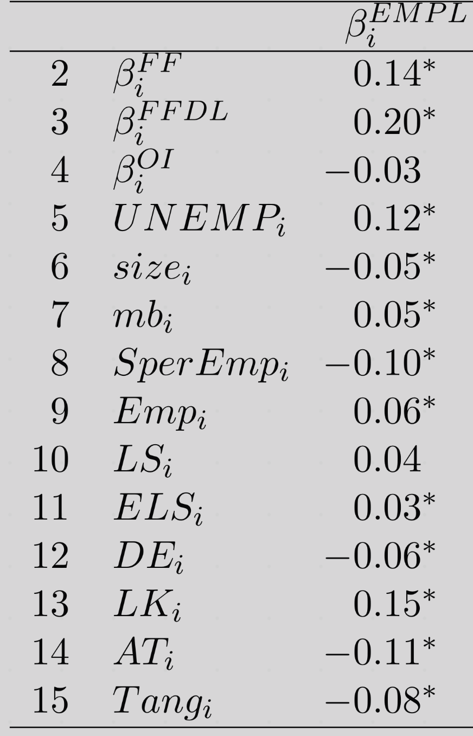
Correlations for the restructuring-based measure
Restructuring-based measure
Returns-based risk measure (market beta from FF-4 factor model)
*
De-levered version of the returns-based measure of risk
*
Operating-earnings-based control
Measures of labor leverage (dependence on labor)
Number of employees
*
Extended labor share
*
Labor-to-capital ratio
*
Tangibility of assets
*

Slide 9
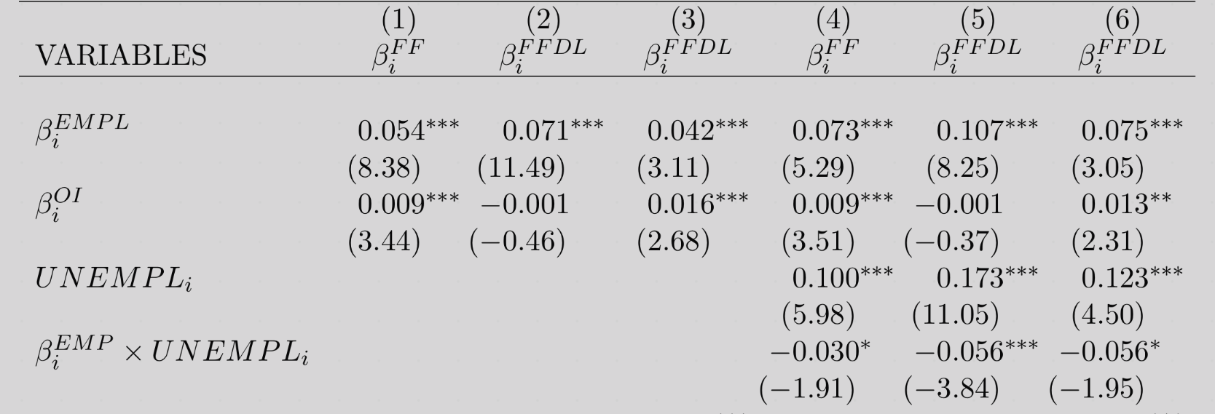
Firm-specific systematic risk test
Returns-based risk measures
Restructuring-based risk
***
***
***
***
***
***
Operating-income based risk
Difference for firms with low adjustment costs (high unemployment)
*
***
*
Obs (firms)
3,309
3,309
737
3,308
3,308
736
R-squared
0.024
0.039
0.396
0.034
0.073
0.413
Labor leverage controls
No
No
Yes
No
No
Yes
The restructuring-based measure of systematic risk is associated with higher levels of conventional returns-based measures of systematic risk.
The relation is stronger for firms with higher adjustment costs

Slide 10
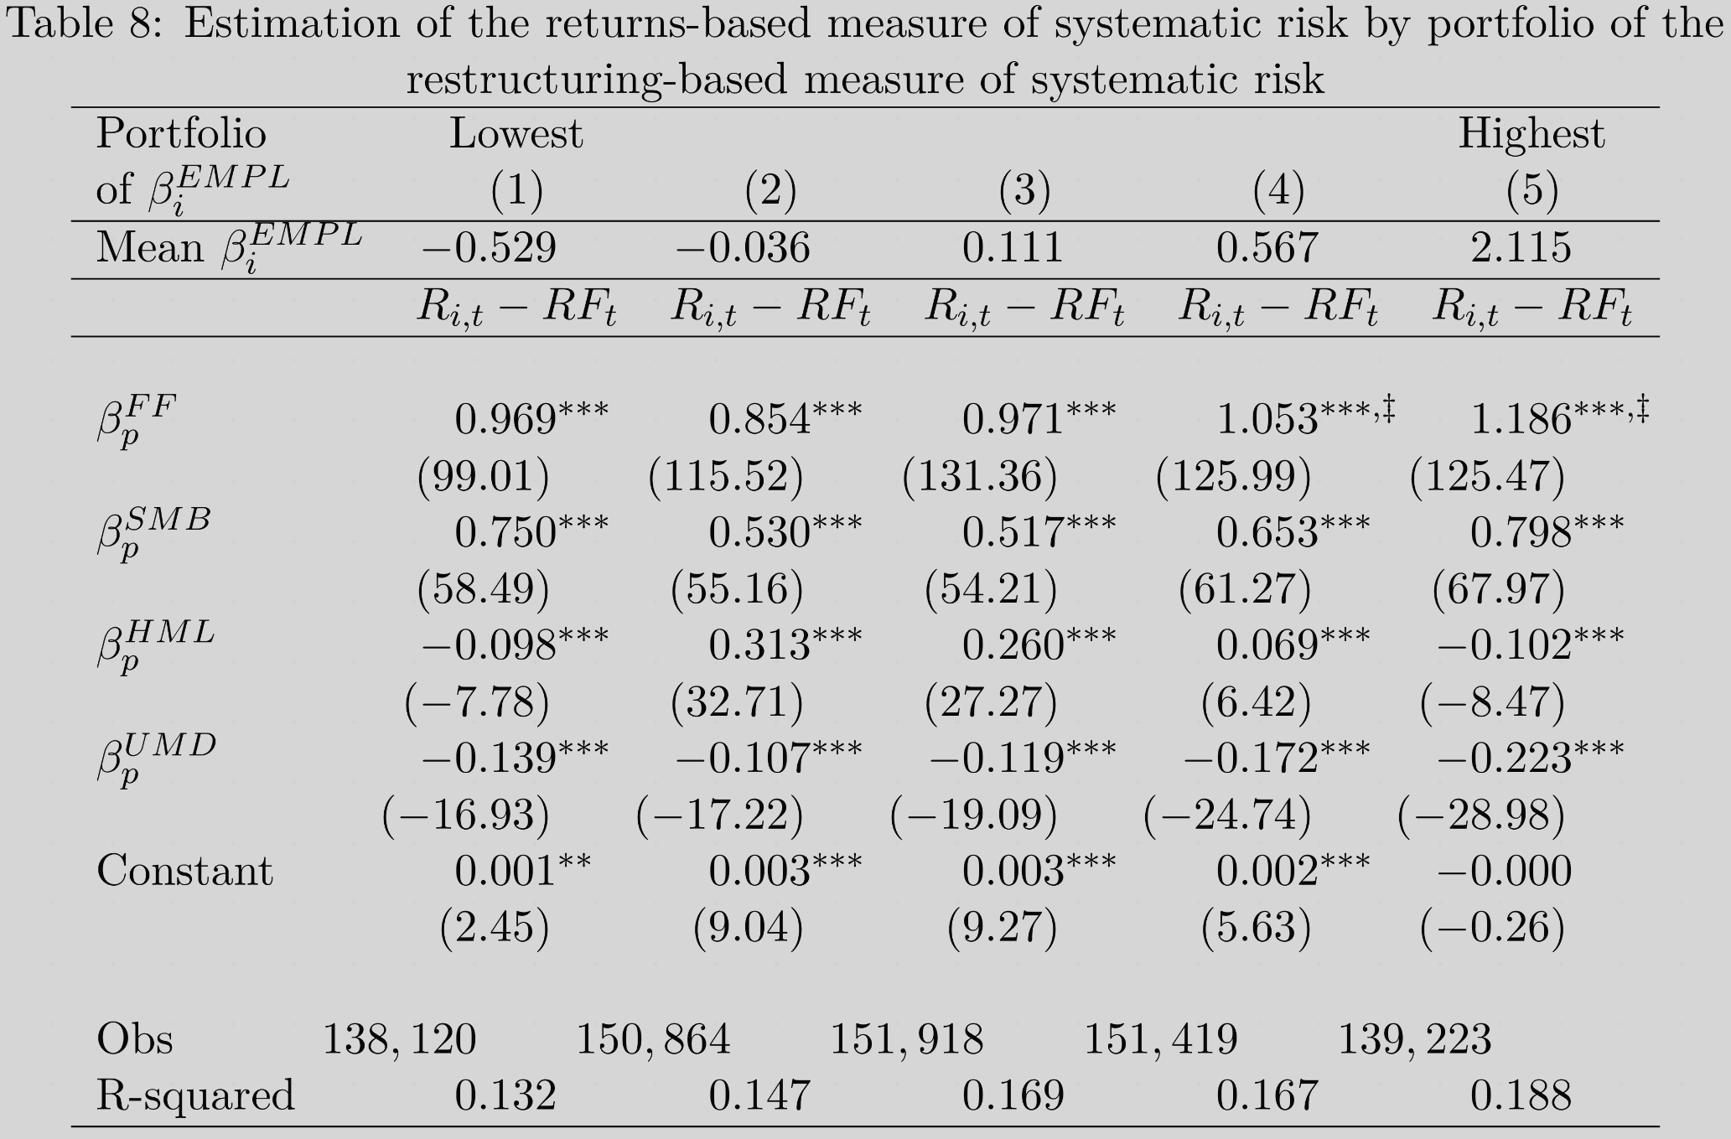
Portfolio systematic risk test
Restructuring-based risk portfolio
Counter-cyclical portfolio
Systematic risk exposure to the market
‡
‡
Increasing (monotonically from portfolio 2)
Highest two portfolios are significantly different from the lowest
Fama-French-Carhart factor betas

Slide 11
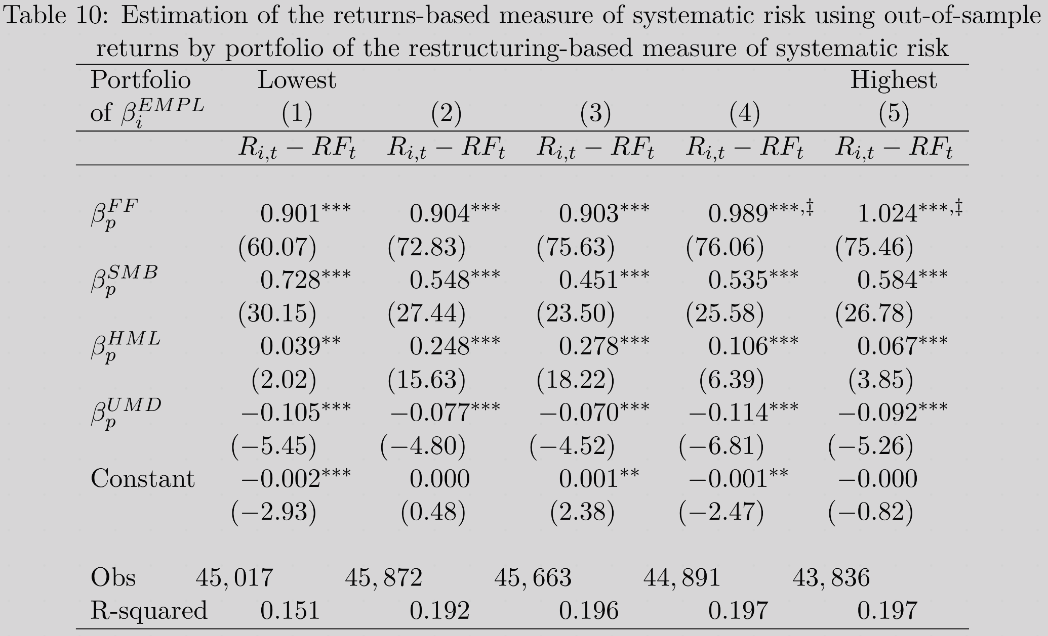

Out-of-sample portfolio systematic risk test
Restructuring-based risk portfolio, based on estimates of $β_{i}^{EMPL}$ prior to estimation of FF factor loadings
‡
‡
Increasing, highest two portfolios are significantly different from the lowest

Slide 12
Do risky firms realize firm and aggregate demand shocks?
In aggregate (macroeconomic)
At the firm (microeconomic)
Expected demand shock
Expected demand shock
Correlation: Systematic Risk
Aggregate labor demand response ^{(Gali, 1999)}
Firm labor demand response (restructuring)
Do firms that demonstrate labor dis-investment patterns consistent with the aggregate market actually realize firm and aggregate demand shocks?
Actual aggregate demand shock
Actual firm demand shock

Slide 13



Do risky firms realize firm and aggregate demand shocks?
Post-restructuring firm sales growth
Post-restructuring aggregate sales growth
Post-restructuring GDP growth
Sig. diff
Sig. diff
Significant difference
Significant difference
Significant difference
Significant difference
Significant difference
Non-restructuring years
Restructuring years
Non-restructuring years
Restructuring years
Non-restructuring years
Restructuring years
Portfolio of $β_{i}^{EMPL}$
Portfolio of $β_{i}^{EMPL}$
Portfolio of $β_{i}^{EMPL}$

Slide 14





Counter-cyclical labor demands
Conventional returns-based measure of systematic risk $β_{i}^{FF}$
Firms with the lowest (most negative) levels of $β_{i}^{EMPL}$ may be demonstrating exposure to industry-level employment shocks which are counter-cyclical to aggregate shocks
$β_{i}^{EMPL}$ based on industry employment
$β_{i}^{EMPL}$ based on aggregate employment
Portfolio of $β_{i}^{EMPL}$

Slide 15
Conclusion
There is evidence that restructuring costs, taken in context of aggregate labor shocks, can provide systematic risk information.

Slide 16
Thank you.

