Slide 1
The risk relevance of restructuring
Vivek Raval
March 15, 2024

Slide 2
The literature motivating this study
Future firm cash flows
What can the financial statements tell us about cash flows?
Countless studies
Value of the firm
Function of:
Riskiness of the cash flows
What can the financial statements tell us about risk? ^{(Barth, 2018)}
Earnings: Ball, Sadka, Tseng (2022); Ellahie (2021); Barth & So (2014)
Specific expense: Restructuring
THIS STUDY

Slide 3
Restructuring expense is the object of this study
The human capital side of restructuring
The aggregate side restructuring
The financial reporting side restructuring
Restructuring includes:
Reflects aggregate economic shocks ^{(John, Lang, and Netter, 1992)}
Informative about GDP ^{(Abdalla and Carabias, 2022)}
Informative about job destruction ^{(Hann, Li, and Ogneva, 2021)}
Not persistent
Often excluded from non-GAAP earnings ^{(Laurion, 2020)}
Excluded from Compustat operating earnings
Excluded from earnings used in compensation (Dechow, Huston, and Sloan, 1994)
More than just labor costs
Part of “big bath” manipulations ^{(Bens & Johnson, 2009)}
Conservative: asymmetrically informative (only labor dis-investment)
Involuntary termination benefits
Costs to relocate employees
Costs to terminate a contract that is not a lease
Costs to consolidate or close facilities
Expensed immediately when announced
Comprised of committed costs
Reported quarterly
Reported in dollars (not people)
Restructuring has the potential to be useful, but is generally seen as not useful

Slide 4
Demand shocks and employment fluctuations
In aggregate (macroeconomic)
At the firm (microeconomic)
Expected demand shock
Expected demand shock
Aggregate labor demand response ^{(Gali, 1999)}
Firm labor demand response
Correlation: Systematic Risk?
Actual aggregate demand shock
Actual firm demand shock
Correlation: Systematic Risk
Restructuring

Slide 5
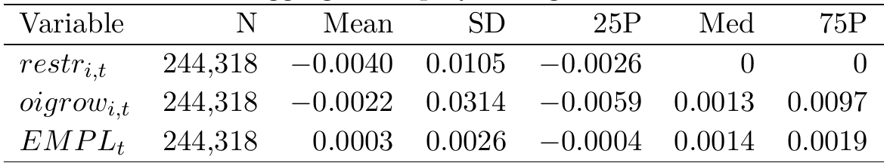
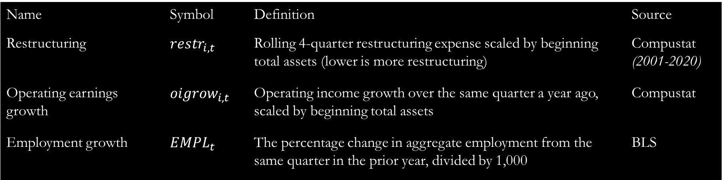
Data, measurement, and sample
Name | Symbol | Definition | Source
Restructuring | $$restr_{i,t}$$ | Rolling 4-quarter restructuring expense scaled by beginning total assets (lower is more restructuring) | Compustat (2001-2020)
Operating earnings growth | $${oigrow}_{i,t}$$ | Operating income growth over the same quarter a year ago, scaled by beginning total assets | Compustat
Employment growth | $$EMPL_{t}$$ | The percentage change in aggregate employment from the same quarter in the prior year, divided by 1,000 | BLS
Firms with some restructuring between 2001 and 2020 (# obs)
No
Yes (63%)

Slide 6
Restructuring as labor dis-investment
Negative firm-year restructuring
Firm-year growth in number of employees
(Restructuring reflects only one side of the change)
Correlations
Pearson: 0.05
Spearman: 0.22
Restructuring is a censored variable.
Consistent with:
John, Lang, and Netter (1992): restructuring relates to a departure of 5% of employees
Hann, Li, and Ogneva (2021): Restructuring, via SPI, is informative about cutting labor
Tobit regression:
$$restr_{i,t}=α+β×Employee Growth_{i,t}+ ε_{i,t}$$
Restructuring correlates negatively with firm-level employment
0.38
(13.98)

Slide 7
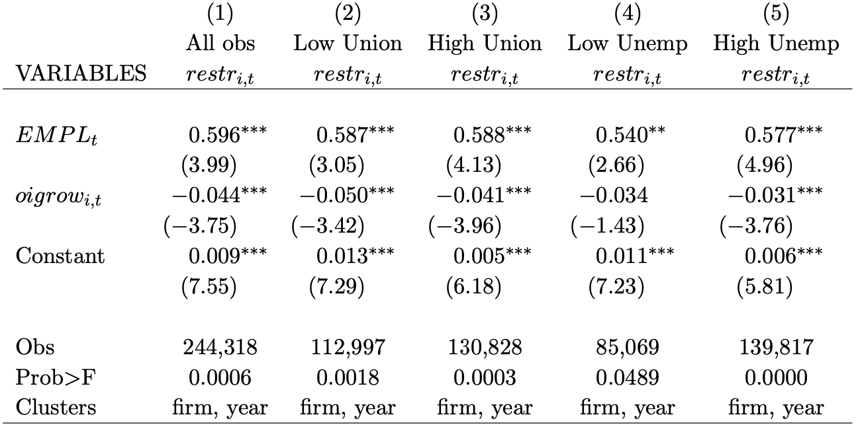
Aggregate component of restructuring
Low adjustment costs
Firm restructuring
High adjustment costs
Split sample by adjustment costs
Aggregate employment growth
***
***
***
**
***
Firm-year observations
(Tobit regression)
Restructuring correlates with aggregate employment, even when adjustment costs are higher.

Slide 8
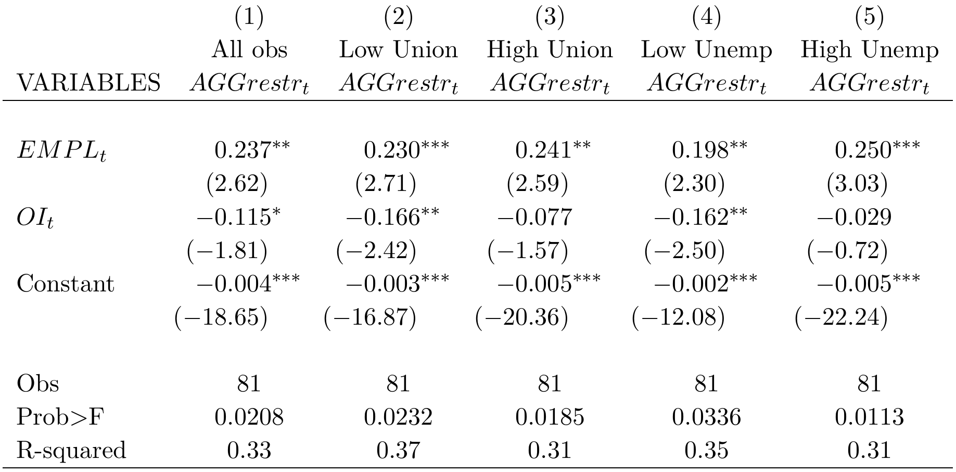
Aggregate component of restructuring
Aggregate restructuring (cross-sectional mean)
Low adjustment costs
High adjustment costs
Separate timeseries based on adjustment costs
Aggregate employment growth
**
***
**
**
***
Quarterly observations
(OLS regression, Newey-West (4) errors)
Restructuring correlates with aggregate employment, even when adjustment costs are higher.

Slide 9
The restructuring-based measure of systematic risk
Firm returns
Market returns
CAPM:
$$\left[R_{i,s}−RF_{s}\right]=α_{i}+β_{i}^{CAPM}×\left[R_{s}^{mkt}−RF_{s}\right]+ε_{i,s}$$
OLS
Restructuring-based measure:
$$restr_{i,t}=α_{i}+β_{i}^{EMPL}×EMPL_{t}+ε_{i}$$
Tobit
(Higher is more systematic risk)
Negative firm restructuring
Aggregate annual employment growth
Operating income measure:
$$oigrow_{i,t}=α_{i}+β_{i}^{OI}×EMPL_{t}+ε_{i}$$
OLS
(As a control)
Operating income growth scaled by beginning assets

Slide 10
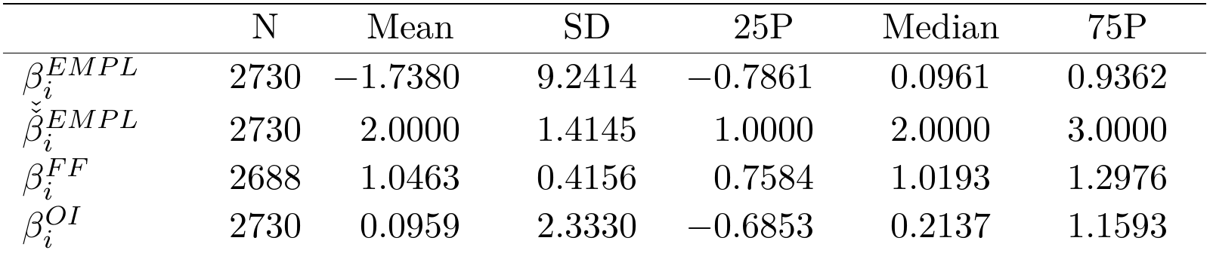
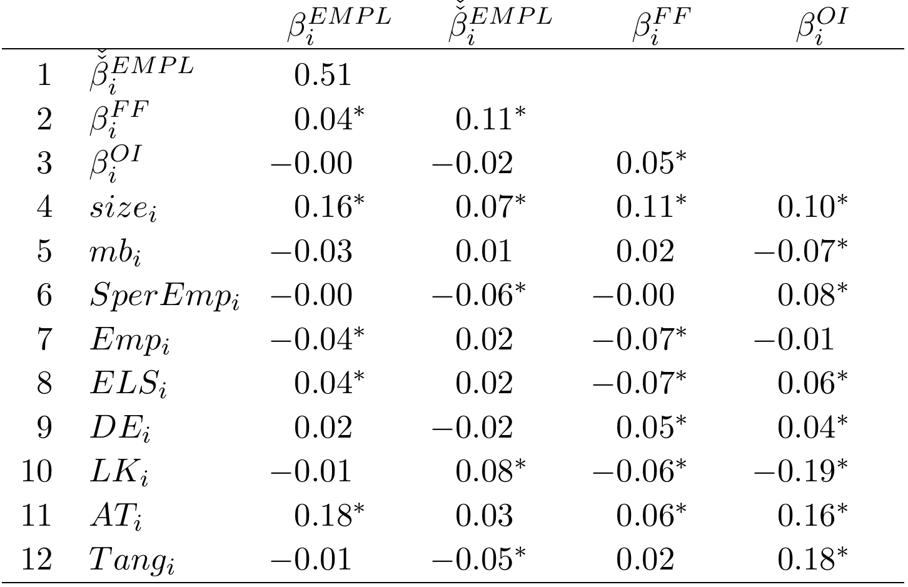
The restructuring-based measure of systematic risk
Restructuring-based measure of systematic risk
Ranked restructuring-based measure of systematic risk
Conventional market beta
Alternative operating earnings-based measure
Highly skewed
Number of firms
Positive correlation with systematic risk
*
*
Sales per empl.
*
Higher dependence on labor, higher $β_{i}^{EMPL}$
# employees
(More significant Spearman correlations)
Ext. labor share
Debt/equity
Labor/capital
*
Total assets
PPE/AT
*

Slide 11
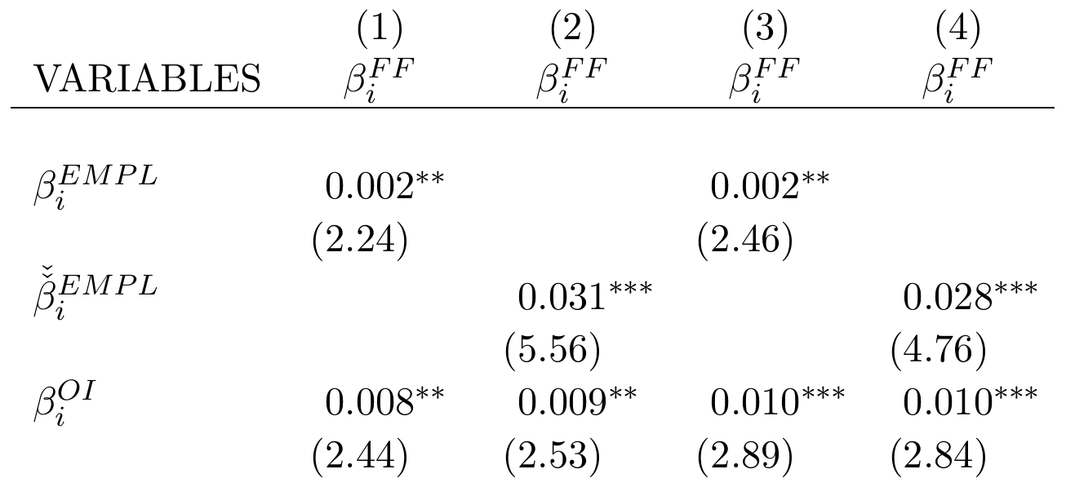
Firm-specific systematic risk test
Returns-based systematic risk
Restructuring-based risk
**
**
Ranked restructuring-based risk
***
***
Operating-income based risk
Labor leverage controls
No
No
Yes
Yes
Obs (firms)
2,688
2,688
2,495
2,495
R-squared (OLS)
0.004
0.014
0.050
0.057
The restructuring-based measure of systematic risk is associated with higher returns-based measures of systematic risk.
The relation is not explained alternatively by operating earnings or labor leverage

Slide 12
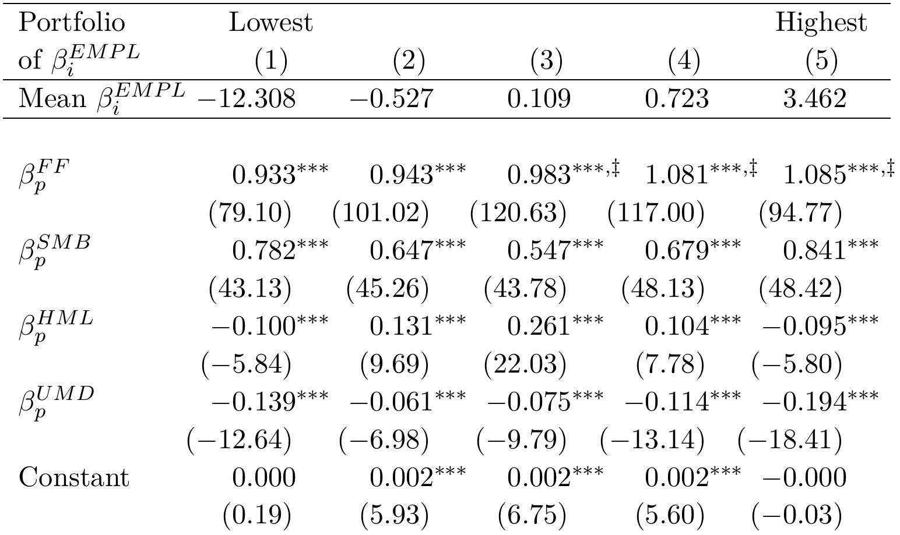
Portfolio systematic risk test
Restructuring-based risk portfolio
Systematic exposure to the market
‡
‡
‡
Monotonically increasing
Highest three portfolios are significantly higher than the lowest
Fama-French-Carhart factor betas
OLS (similar results using Fama-MacBeth)
The restructuring-based measure of systematic risk is associated with higher returns-based measures of systematic risk.

Slide 13
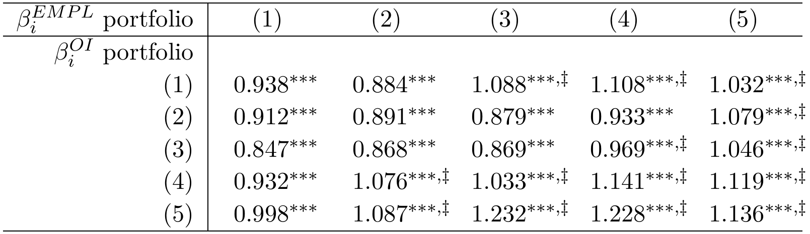

Double-sort portfolio systematic risk test
Restructuring-based risk portfolio
$$β_{p}^{FF}$$
Operating earnings-based alternative portfolio
‡
‡
‡
Risk is increasing in restructuring-based measure at all levels of OI-based measure
‡
‡
‡
‡
‡
‡
‡
‡
‡
‡
‡
The restructuring-based measure of systematic risk is associated with higher returns-based measures of systematic risk.
The increase is not explained by information in operating earnings

Slide 14
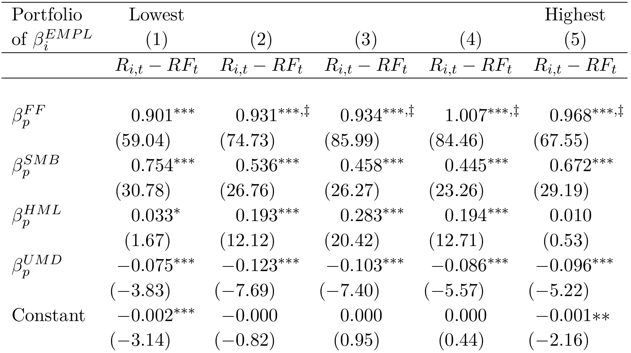

Out-of-sample portfolio systematic risk test
Restructuring-based risk portfolio, based on estimates of $β_{i}^{EMPL}$ prior to estimation of FF factor loadings
‡
‡
‡
‡
Increasing, monotonically through portfolio 4.
Highest 4 portfolios are significantly higher than the lowest portfolio.
The restructuring-based measure of systematic risk is associated with higher returns-based measures of systematic risk.
The increase is not explained by overlapping beta calculations.

Slide 15
Do risky firms realize firm and aggregate demand shocks?
In aggregate (macroeconomic)
At the firm (microeconomic)
Expected demand shock
Expected demand shock
Correlation: Systematic Risk
Aggregate labor demand response ^{(Gali, 1999)}
Firm labor demand response (restructuring)
Do firms that demonstrate labor dis-investment patterns consistent with the aggregate market actually realize firm and aggregate demand shocks after restructuring?
Actual aggregate demand shock
Actual firm demand shock

Slide 16



Do risky firms realize firm and aggregate demand shocks?
Post-restructuring firm sales growth
(2-year growth starting year t)
Post-restructuring aggregate sales growth
(2-year growth starting year t)
Post-restructuring GDP growth
(4-quarter starting after year t)
Sig. diff
Sig. diff
Sig. diff
Sig. diff
Significant difference
Significant difference
Significant difference
Significant difference
Significant difference
Significant difference
Non-restructuring years
Restructuring years
Non-restructuring years
Restructuring years
Non-restructuring years
Restructuring years
Portfolio of $β_{i}^{EMPL}$
Portfolio of $β_{i}^{EMPL}$
Portfolio of $β_{i}^{EMPL}$

Slide 17


Do risky firms reverse more restructuring?
In aggregate (macroeconomic)
At the firm (microeconomic)
Expected demand shock
Expected demand shock
For high $β_{i}^{EMPL}$ firms, the expected demand shock is macroeconomic
Aggregate labor demand response ^{(Gali, 1999)}
Firm labor demand response (restructuring)
Firms know less about macroeconomic shocks versus firm-specific shocks ^{(Hutton, Lee, Shu, 2012)}
Firms are operating with more uncertainty about the macroeconomic shock versus firm shocks
Firms restructuring because of aggregate shocks are more likely to mis-estimate and need to revise restructuring accruals
Actual aggregate demand shock
Actual firm demand shock
Higher $β_{i}^{EMPL}$ firms will reverse more of their restructuring

Slide 18
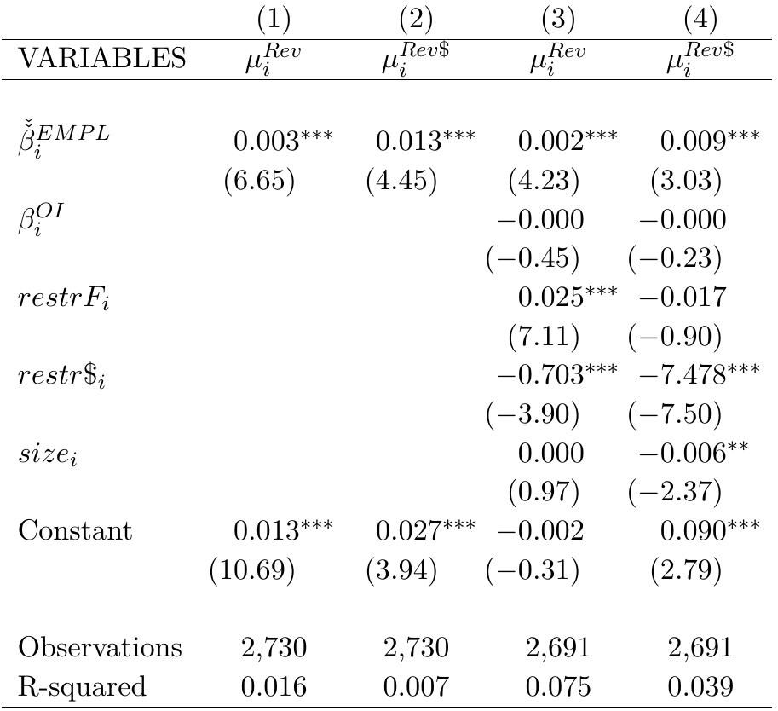

Do risky firms reverse more restructuring?
Average number of reversals
Average reversal amount (positive)
Ranked restructuring-based measure of systematic risk
***
***
***
***
Firms with higher levels of $β_{i}^{EMPL}$ have more frequent and bigger reversals of restructuring
Number of restructurings
Dollar value of restructurings

Slide 19

Alternative expected aggregate demand shock
In aggregate (macroeconomic)
At the firm (microeconomic)
Aggregate labor declines can be criticized as a measure of aggregate demand shocks (e.g., supply shocks, technology shocks)
Another macroeconomic effect of expected demand shocks is increased uncertainty about the aggregate market
VIX uses implied volatilities across the S&P 500 to construct an aggregate uncertainty index (“fear index”)
VIX is associated with aggregate demand shocks and lower growth (Foerster et al., 2014; Leduc and Liu, 2016)
Expected demand shock
Expected demand shock
Aggregate uncertainty (VIX)
Aggregate labor demand response ^{(Gali, 1999)}
Firm labor demand response (restructuring)
Actual aggregate demand shock
Actual firm demand shock
Do firms with higher $β_{i}^{EMPL}$ restructure during periods of high VIX?
Do firms that restructure during periods of higher VIX have higher systematic risk?

Slide 20
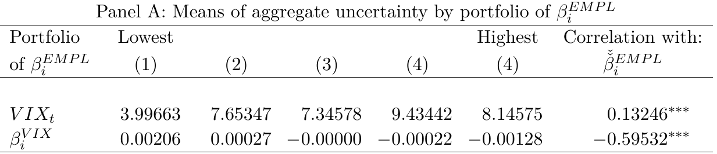
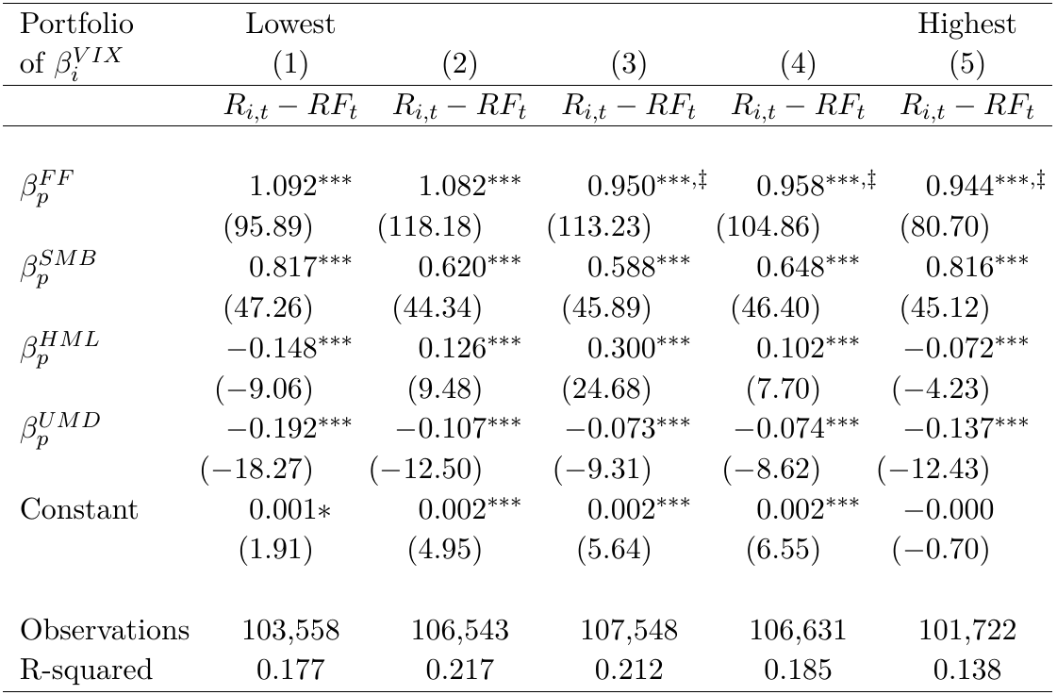





Alternative expected aggregate demand shock
Firms with higher $β_{i}^{EMPL}$ restructure when VIX is higher
VIX as of the period of restructuring
$$restr_{i,t}=α_{i}+β_{i}^{VIX}×VIX_{t}+ε_{i,t}$$
Firms with higher $β_{i}^{EMPL}$ have lower $β_{i}^{VIX}$
Tobit estimation by firm
Restructuring is negative, higher VIX is more uncertainty
Lower (more negative) $β_{i}^{VIX}$ means higher systematic risk and higher $β_{i}^{EMPL}$
‡
‡
‡
Firms with lower $β_{i}^{VIX}$ have higher systematic risk

Slide 21
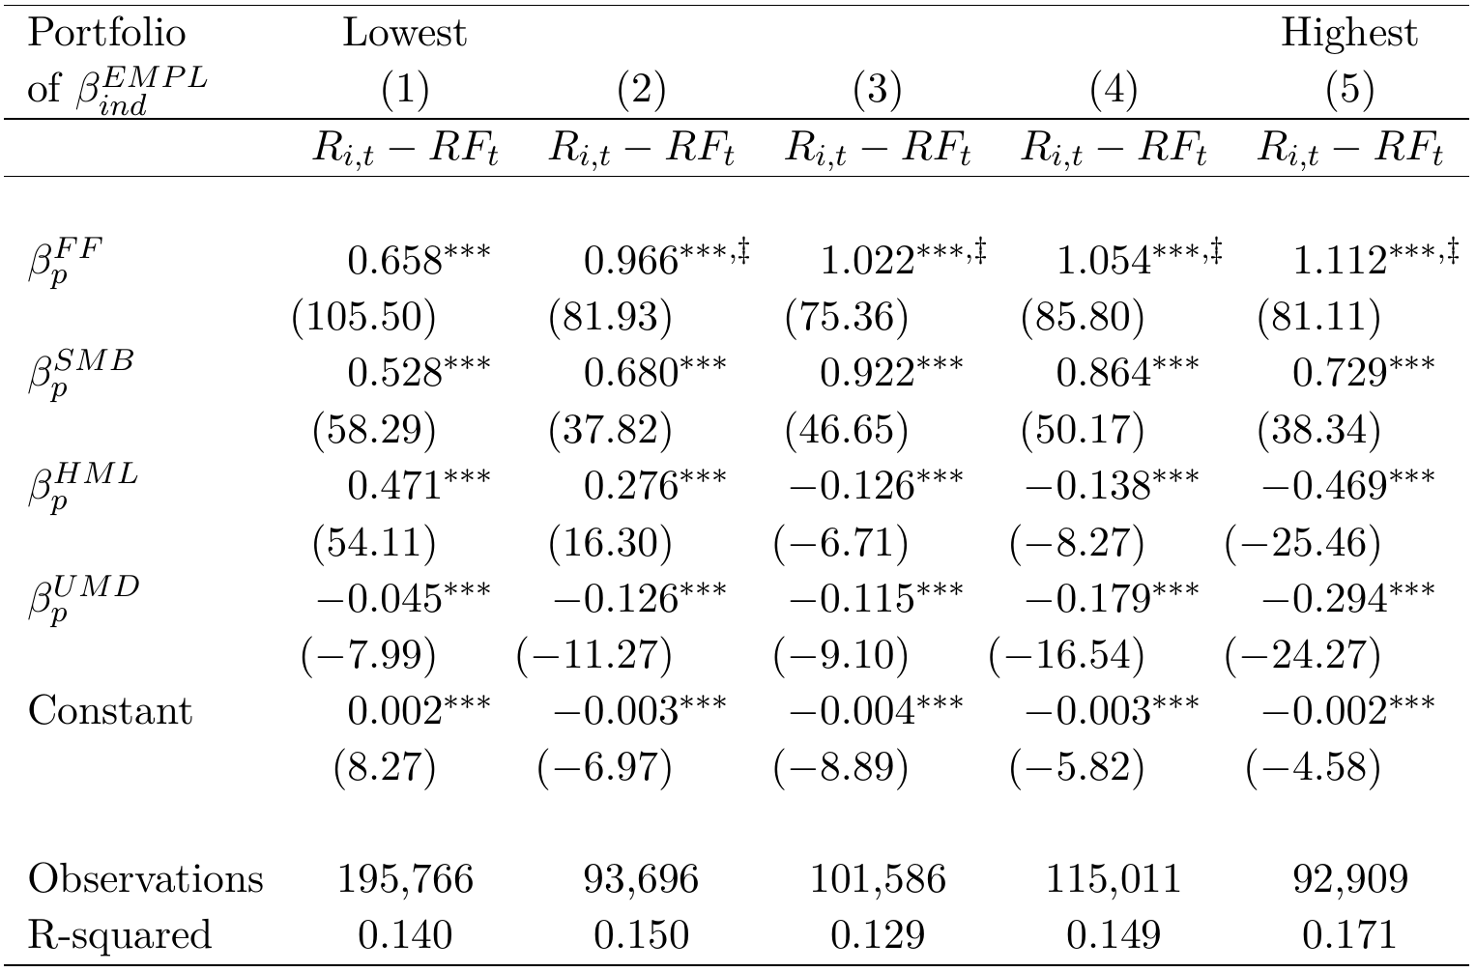

Industry-level $β_{i}^{EMPL}$
Firms with some restructuring between 2001 and 2020 (# obs)
No
Yes (63%)
$$restr_{ind,t}=α_{ind}+β_{ind}^{EMPL}×EMPL_{t}+ε_{ind,t}$$
$restr_{ind,t}$ is the cross-sectional average of $restr_{i,t}$ by NAICS2
$EMPL_{t}$ is still aggregate employment growth
All firms in the same industry have the same $β_{ind}^{EMPL}$ (ties create unbalanced portfolios)
Monotonically increasing
‡
‡
‡
‡
Only include the 37% of firms with no restructuring expense between 2001 and 2020

Slide 22
Conclusion
There is evidence that restructuring costs, taken in context of expected demand shocks, can provide systematic risk information.
Human capital information, even if limited, is useful in valuation

Slide 23
Thank you.

