Slide 1
Discussion:
Semantic progression in firm disclosure: The role of accounting conservatism
Vivek Raval
AAA Annual Meeting 2024

Slide 2

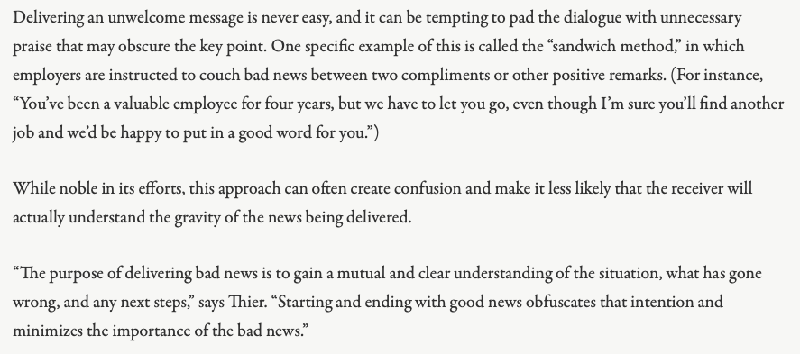
The way some folks learned to deliver bad news
This is a generally ineffective way to deliver bad news.
Unless you want your audience to not figure out what is really going on until later.
https://fullfocus.co/deliver-bad-news/
This may be an example of the type of obfuscation picked up by the measure of circuitousness.

Slide 3
The state of the art: Circuitousness
Guest & Yan, 2023 (working paper):
Circuitousness is bad:
Associated with:
Lower current earnings
Lower stock returns
Less persistent earnings
Analyst forecast error
Concentrated in firms with weak oversight:
Low CEO ownership
Short CEO tenure
Low board ownership
Short board tenure
Low analyst following
Low media coverage
Fewer 8Ks
Fewer management forecasts
More real earnings management
This paper:
Lower liquidity
Weak oversight + bad news
Circuitousness
Opacity

Slide 4
Conservatism is good. Can it help?
There is nothing better than conservatism:
Sources of conservatism:
Strong internal controls ^{(Goh & Li, 2011)}
CEO involvement ^{(García Lara et al., 2009)}
Board composition ^{(García Lara et al., 2009)}
Board effectiveness ^{(García Lara et al., 2009)}
Board governance ^{(Caskey & Laux, 2016)}
Reduce agency costs ^{(Jensen & Meckling 1976)}
Improves information asymmetry in debt markets ^{(Watts, 2003)}
  Private debt ^{(Beatty et al., 2008)}
  Public debt ^{(Nikolaev, 2010)}
  Syndicated debt ^{(Ball et al, 2008)}
Improves information asymmetry in equity markets
  Reduces conflicts with debt issuers ^{(Watts, 2003)}
  Reduces manipulation ^{(LaFond and Watts, 2008)}
  Reduces SEO cost ^{(Kim et al., 2013)}
  More efficient investment ^{(Louis et al., 2012)}
  Better financial crisis outcomes (Francis et al., 2013; Balakrishnan et al., 2016)
  Lower cost of equity ^{(García Lara et al., 2011)}
  Demand for it is increasing ^{(Beaver et al. 2012)}
Improves the 10K text
  Reduces upward tone management (D’Augusta & DeAngelis [D&D], 2020)
  Reduces circuitousness

Slide 5
So here is where we stand
Weak oversight + bad news
Circuitousness
Opacity
Less conservatism
Higher agency costs
Higher information asymmetry in debt markets
Higher information asymmetry in equity markets
Both factors likely matter.
Both factors are choices.
Is it possible to separate the effects of each on transparency?
Perhaps an interesting experiment (that may already have been conducted)

Slide 6
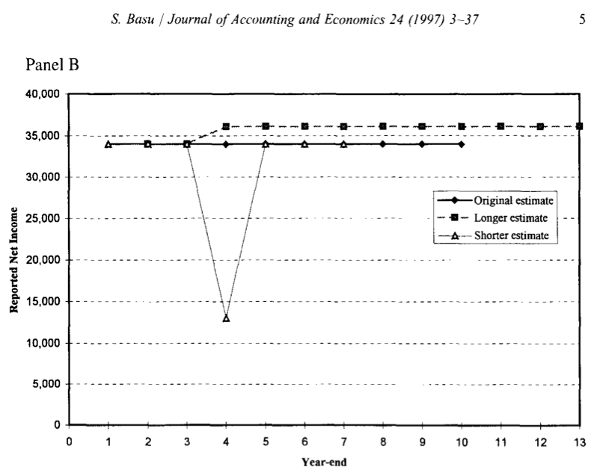
This paper in context of Guest & Yan, 2023
Guest & Yan, 2023
More persistent earnings are described with less circuitousness
Persistence
Less circuitousness
Moon, 2023
Conservatism
Less circuitousness
Less persistence
Less circuitousness
Also: Chen, Folsom, Paek, Sami (AH, 2015)

Slide 7
This paper in context of D&D and the sandwich
D&D, 2020
The results are similar, how much do they overlap?
The answer is interesting regardless of the outcome
Increases the impact of this paper
Conservatism constrains upward tone management
“good” & “bad”
Conservatism
“good” & “bad”
Moon, 2023
Can you get closer to what is actually going on in the text?
Can you measure tone volatility?
“good”
“bad”
“good”
“good”
“bad”
“good”
Conservatism
(Assuming this is what is going on)

Slide 8
Thank you.

