Slide 1
Discussion:
Under the radar? Discretionary impairments of finite and indefinite intangible assets
Vivek Raval
Fox and Haskayne Conference
August 16, 2024

Slide 2
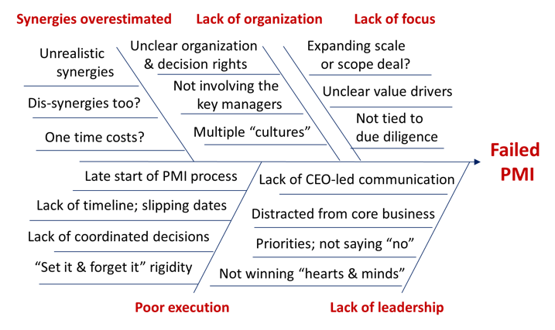
Post-merger integration is a messy process
http://consultantsmind.com/2017/11/05/what-is-post-merger-integration/

Slide 3
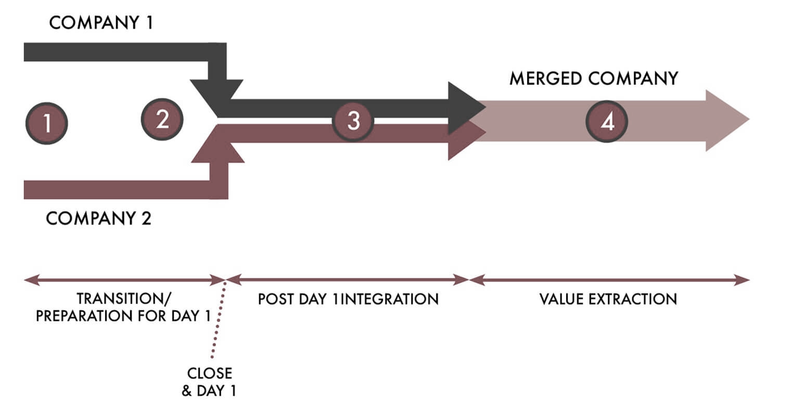
…and it takes a long time
Price
Goodwill Write-down
Integration fallout

Slide 4
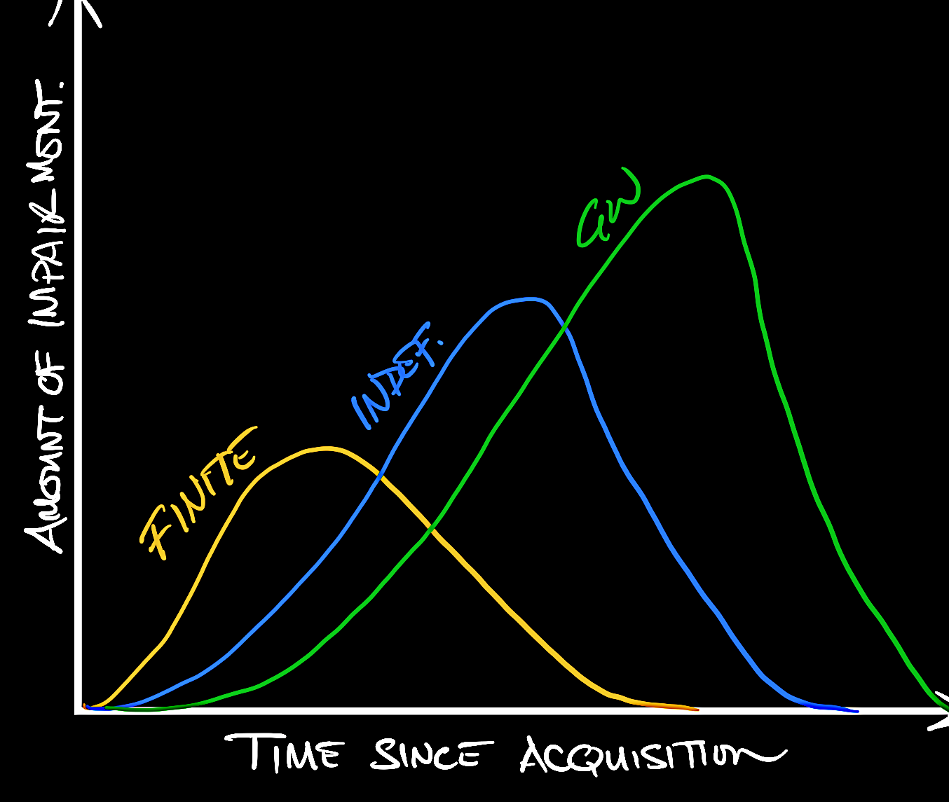
What this study does
Largest exploratory analysis of finite- and indefinite-lived acquired intangible impairment
Context:
Paper sits amongst a series of papers investigating goodwill impairment
Findings:
Finite, indefinite, and goodwill intangibles are impaired at different times
  But, they are also highly correlated
The frequency of impairment of all types is subject to earnings management
  Better governance helps ameliorate this activity
Analysts and the media seem to care less about the impairment of finite- and indefinite-lived intangible asset impairments (vs. goodwill)
Warning! Fake data. For illustration only.
😐
😱

Slide 5
Okay, so they don’t care. Should they?
Impair goodwill (acquired talent, organizational capital, synergies, overpayment)
Impair a patent (finite-lived)
Impair in-process R&D (indefinite-lived)
What is the process by which these get impaired?
Intangibles need investment from the firm to retain their value
  Customers need to be transitioned
  Research needs to be continued
  Markets need to be sustained
As the acquirer learns about the target, some of these investments become ‘fat’ to be cut
  Should be impaired faster
  Less related to business characteristics
These may be expected impairments

Slide 6
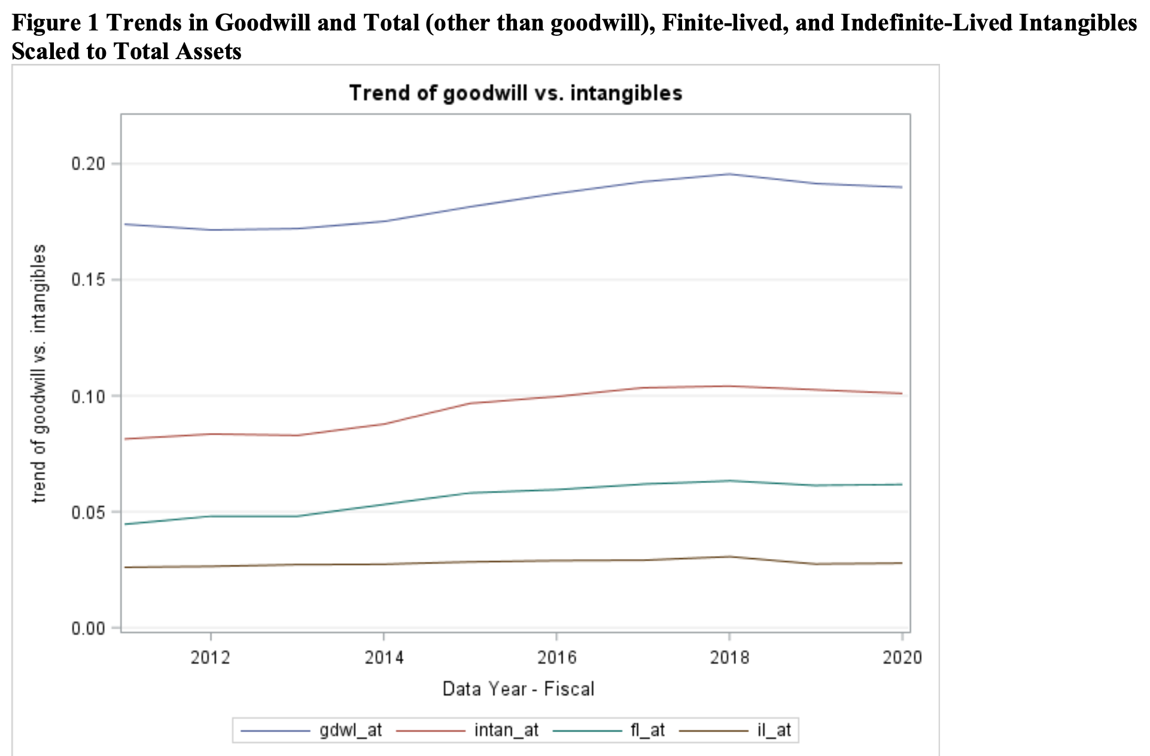
Okay, so they don’t care. Should they?
Impair goodwill (acquired talent, organizational capital, synergies, overpayment)
Impair a patent (finite-lived)
Impair in-process R&D (indefinite-lived)
What determines the value of the acquisition?
What is irreplicable by the acquirer?
  Joint-ventures, alliances, licensing are all alternatives for accessing identifiable intangible assets
  Acquisition is typically needed for the less identifiable stuff, like synergies, talent, and organizational capital
  If we are evaluating the M&A, goodwill holds the biggest signal of value
Where are the dollars?
  Likely more dollar value is tied up in goodwill
Goodwill
Finite-lived
Beatty, Liao, Weber, 2023
Indefinite-lived
What is the economic importance of finite- and indefinite-lived intangible impairment?

Slide 7
Perhaps we are all hung up on goodwill
Example: For many tests, we are trying to measure the fair value of the asset to see if it is impaired in a timely manner
Goodwill
Fair value of the business (reporting unit) associated with the GW
Patent
Value generated from the exclusive rights to manufacture a product
In-process R&D
Value generated from the future patents or secrets generated from R&D
Precedent makes it challenging, but benchmarking acquired intangibles against goodwill may not be treating other intangibles with enough care.
Book-to-Market
Industry sales growth?
Competition?
Post-acquisition investment?
This paper, as the largest investigation of intangible impairment, could change the way we think about intangibles in future research.

Slide 8
Thank you.

Slide 9
http://consultantsmind.com/2017/11/05/what-is-post-merger-integration/

Slide 10
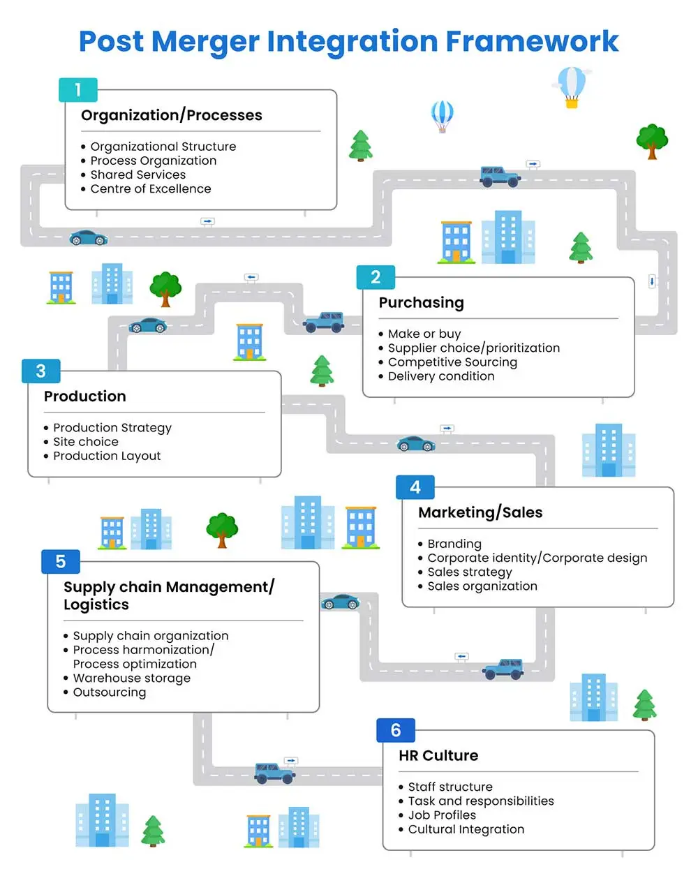

Slide 11
