Slide 1
The risk relevance of restructuring
Vivek Raval
September 19, 2024

Slide 2
The motivating idea for this study
Macroeconomic changes
Macroeconomic demand shocks
Can firm’s financial reporting tell us about this relation?
Firms
Firm project abandonment (restructuring)
Labor flows
Layoffs & related divestment
Lifetime wages
Aggregate pattern?
Employment
…
Which firms contribute the most?
(Those exposed to the macroeconomy)

Slide 3
The literature motivating this study
Future firm cash flows
What can the financial statements tell us about cash flows?
e.g., Dechow, Kothari, Watts (1998); Ball & Nikolaev (2022)
Value of the firm
Function of:
Riskiness of the cash flows
What can the financial statements tell us about risk? ^{(Barth, 2018)}
Restructuring is a managerial action taken in response to a change in expectations.
Provides insight into how firms exposed to systematic risk respond to aggregate shocks.
Provides more color to the mosaic used to assess systematic risk.
Earnings: Ball, Sadka, Tseng (2022); Ellahie (2021); Barth & So (2014)
Specific expense: Restructuring
THIS STUDY

Slide 4
Restructuring expense is the object of this study
The accounting for restructuring
The aggregate side restructuring
The criticisms of restructuring
Restructuring includes:
Reflects aggregate economic shocks ^{(John, Lang, and Netter, 1992)}
Informative about GDP ^{(Abdalla and Carabias, 2022)}
Informative about job destruction ^{(Hann, Li, and Ogneva, 2021)}
Not persistent
Often excluded from non-GAAP earnings ^{(Laurion, 2020)}
Excluded from Compustat operating earnings
Excluded from earnings used in compensation (Dechow, Huston, and Sloan, 1994)
Part of “big bath” manipulations ^{(Bens & Johnson, 2009)}
Conservative: asymmetrically informative (only divestment)
Involuntary termination benefits
Costs to terminate a contract that is not a lease
Costs to relocate employees or consolidate facilities
Expensed immediately when announced
Comprised of committed costs
Reported quarterly
Reported in dollars (not people)
Restructuring has the potential to be useful, but is generally seen as not useful

Slide 5
Demand shocks and employment fluctuations
The risk of the firm is driven by its projects
The firm has an abandonment option for each of the projects
To the extent that a project is subject to macroeconomic changes, so is the value of the abandonment option
If the firm tends to exercise the abandonment option (restructure) when aggregate growth expectations are low, the firm’s projects are likely exposed to macroeconomic (systematic) risk
In aggregate (macroeconomic)
At the firm (microeconomic)
Expected demand shock
Expected demand shock
Aggregate labor demand response ^{(Gali, 1999)}
Firm cuts inputs to production (ex. labor)
Correlation: Systematic Risk?
Actual aggregate demand shock
Actual firm demand shock
Correlation: Systematic Risk
Restructuring

Slide 6
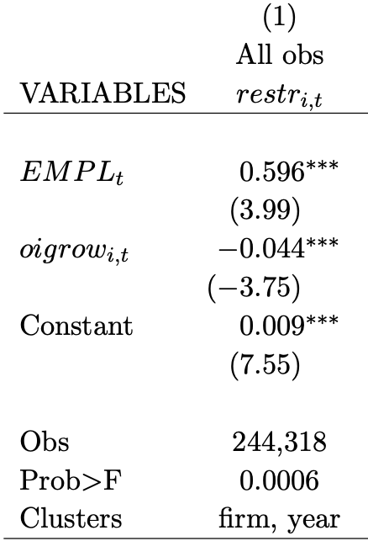
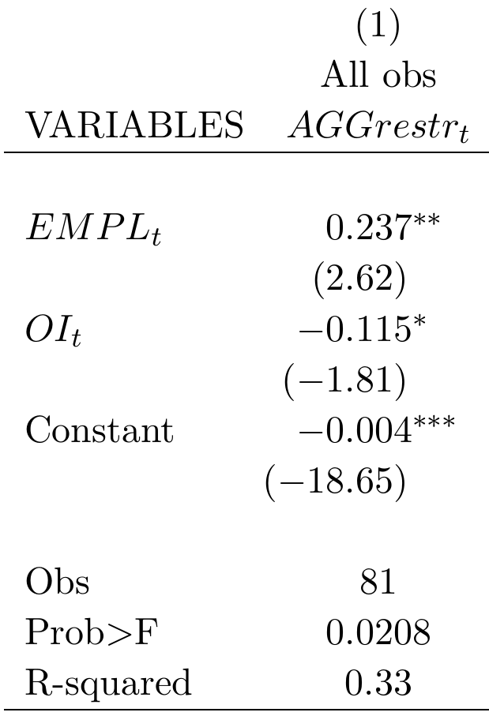
Aggregate component of restructuring
Aggregate restructuring (cross-sectional mean)
Firm restructuring
***
Aggregate employment growth
(a major input to production, correlated with aggregate demand shocks)
**
Firm-year observations
(Tobit regression)
Quarterly observations
(OLS regression, Newey-West (4) errors)
Restructuring has an aggregate component

Slide 7
The restructuring-based measure of systematic risk
Firm returns
Market returns
CAPM:
$$\left[R_{i,s}−RF_{s}\right]=α_{i}+β_{i}^{CAPM}×\left[R_{s}^{mkt}−RF_{s}\right]+ε_{i,s}$$
OLS
Restructuring-based measure:
$$restr_{i,t}=α_{i}+β_{i}^{EMPL}×EMPL_{t}+ε_{i}$$
Tobit
(Higher is more systematic risk)
Negative firm restructuring
Aggregate annual employment growth
Operating income measure:
$$oigrow_{i,t}=α_{i}+β_{i}^{OI}×EMPL_{t}+ε_{i}$$
OLS
(As a control)
Operating income growth scaled by beginning assets

Slide 8
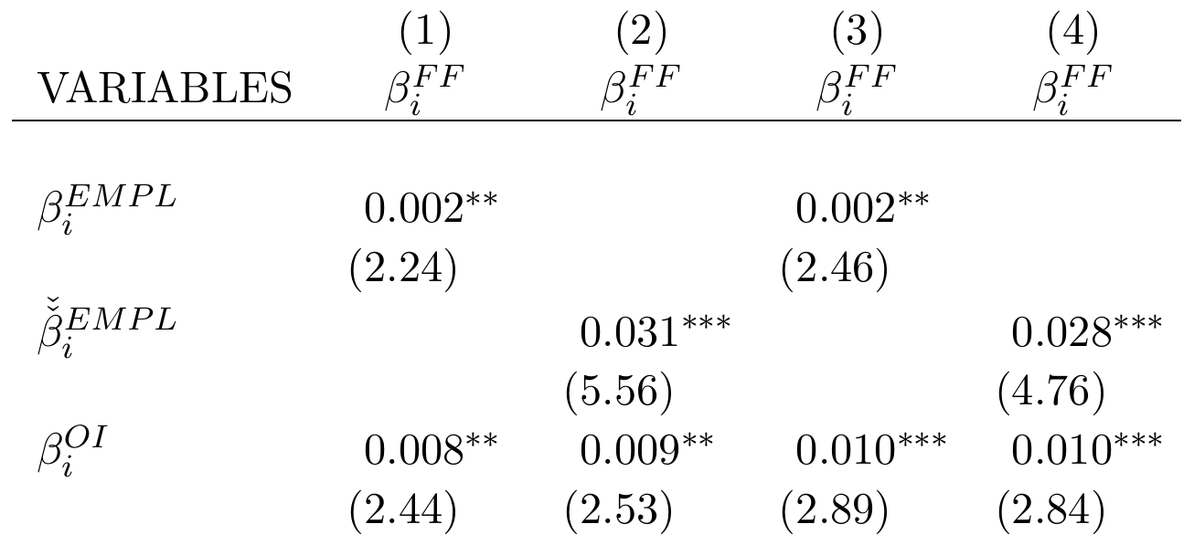
Firm-specific systematic risk test
Returns-based systematic risk
Restructuring-based risk
**
**
Ranked restructuring-based risk
***
***
Operating-income based risk
Labor leverage controls
No
No
Yes
Yes
Obs (firms)
2,688
2,688
2,495
2,495
R-squared (OLS)
0.004
0.014
0.050
0.057
The restructuring-based measure of systematic risk is associated with higher returns-based measures of systematic risk.
The relation is not explained alternatively by operating earnings.

Slide 9
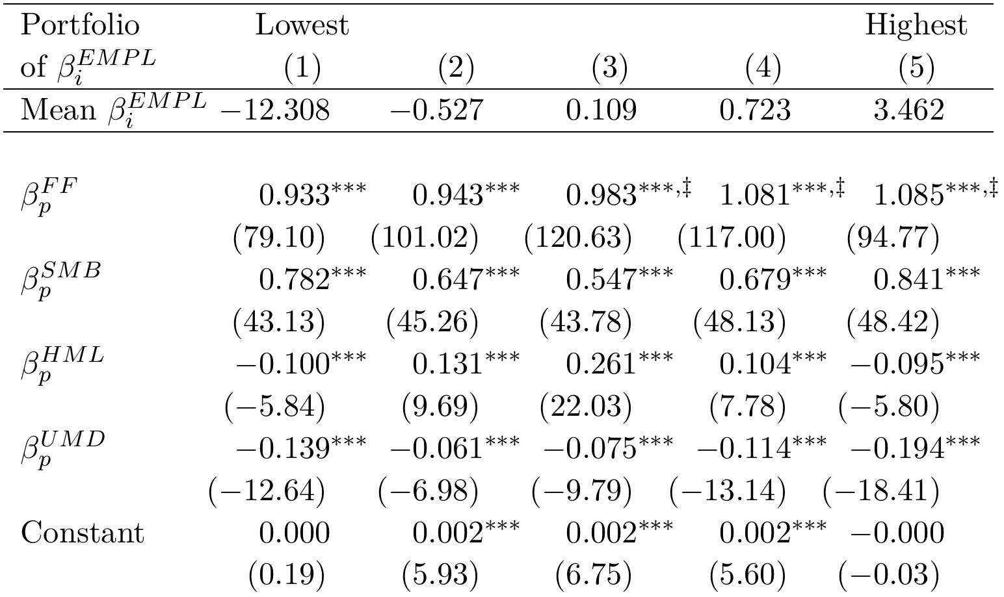
Portfolio systematic risk test
Restructuring-based risk portfolio
Systematic exposure to the market
‡
‡
‡
Monotonically increasing
Highest three portfolios are significantly higher than the lowest
Fama-French-Carhart factor betas
OLS (similar results using Fama-MacBeth)
The restructuring-based measure of systematic risk is associated with higher returns-based measures of systematic risk.

Slide 10
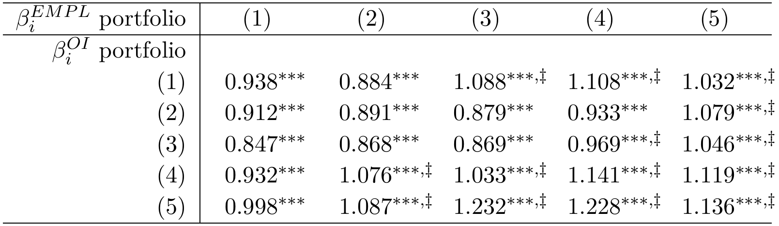

Double-sort portfolio systematic risk test
Restructuring-based risk portfolio
$$β_{p}^{FF}$$
Operating earnings-based alternative portfolio
‡
‡
‡
Risk is increasing in restructuring-based measure at all levels of OI-based measure
‡
‡
‡
‡
‡
‡
‡
‡
‡
‡
‡
The restructuring-based measure of systematic risk is associated with higher returns-based measures of systematic risk.
The increase is not explained by information in operating earnings

Slide 11
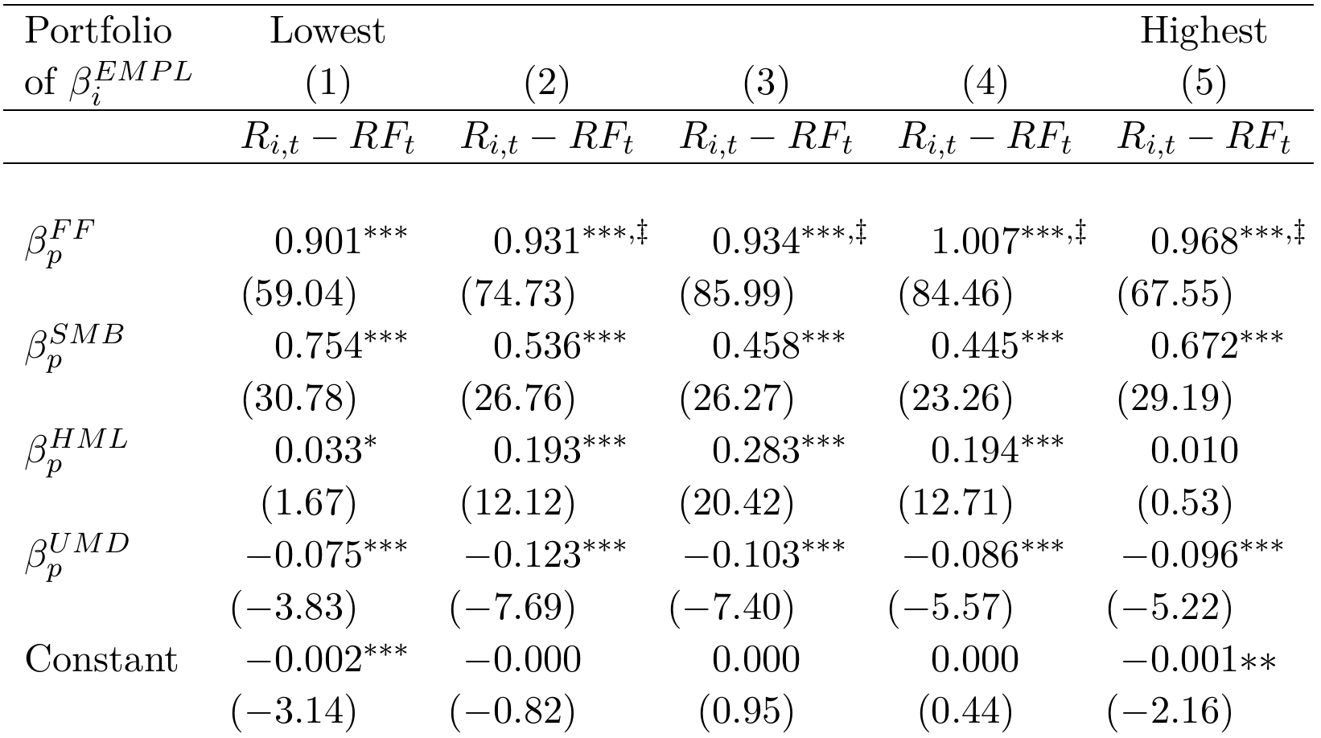

Out-of-sample portfolio systematic risk test
Restructuring-based risk portfolio, based on estimates of $β_{i}^{EMPL}$ prior to estimation of FF factor loadings
‡
‡
‡
‡
Increasing, monotonically through portfolio 4.
Highest 4 portfolios are significantly higher than the lowest portfolio.
The restructuring-based measure of systematic risk is associated with higher returns-based measures of systematic risk.
The increase is not explained by overlapping beta calculations.

Slide 12
Does risky firm restructuring predict aggregate demand shocks?
In aggregate (macroeconomic)
At the firm (microeconomic)
Expected demand shock
Expected demand shock
Correlation: Systematic Risk
Aggregate labor demand response ^{(Gali, 1999)}
Firm labor demand response (restructuring)
Do firms that demonstrate labor divestment patterns consistent with the aggregate market actually realize macroeconomic demand shocks after restructuring?
Actual aggregate demand shock
Actual firm demand shock

Slide 13

Do risky firms realize aggregate demand shocks?
***
***
***
***
$β_{i}^{EMPL}$ Portfolio
***
***
***
***
***
Significantly different smaller than portfolio 1. Figures x1000.

Slide 14



Other tests fill out the story
Further evidence restructuring is in response to aggregate shocks
Firms know less about the macroeconomy relative to the firm ^{(Hutton, Lee, Shu, 2012)}
Higher $β_{i}^{EMPL}$ firms reverse more of their restructuring accruals
Aggregate employment is not only a signal of expected demand shock
VIX is also a predictor of aggregate demand shocks (Foerster et al., 2014; Leduc and Liu, 2016)
Replacing aggregate employment growth with negative VIX provides the same results
Restructuring is more than just labor costs
Capital expenditure is also an important input to production
Forming $β_{i}^{EMPL}$ from both labor and capital expenditure growth provides the same results
Firms with no restructuring are left out
Systematic risk is also an industry characteristic ^{(Chan et al., 2007)}
Calculating industry $β_{i}^{EMPL}$ is effective for determining the systematic risk of non-restructuring firms

Slide 15
Conclusion
There is evidence that restructuring costs, taken in context of expected demand shocks, can provide systematic risk information.
Firms exposed to systematic risk need to restructure in response to expected aggregate demand shocks

Slide 16
Thank you.

