Slide 1
The risk relevance of restructuring
Vivek Raval
May 28, 2025

Slide 2
Assessing systematic risk
Inputs
Firm
Outputs
Sys. Risk
Labor
Project A
Returns
PP&E
Sys. Risk
Earnings
Labor: Schoar (2024)
Returns: Sharpe (1964); Fama & French (1992, 1993, 2015);
Both: This study
Restructuring
Project B
Project C
Earnings: Heflin et al. (2024); Ball, Sadka, Tseng (2022); Ellahie (2021); Ogneva et al. (2020); Heflin et al. (2024)
Sys. Risk
Sys. Risk
RQ: Does restructuring expense provide information about systematic risk?

Slide 3
Restructuring expense is the object of this study
The accounting for restructuring
The aggregate side restructuring
The criticisms of restructuring
Restructuring includes:
Reflects aggregate economic shocks ^{(John, Lang, and Netter, 1992)}
Informative about GDP ^{(Abdalla and Carabias, 2022)}
Informative about job destruction ^{(Hann, Li, and Ogneva, 2021)}
Not persistent
Often excluded from non-GAAP earnings ^{(Laurion, 2020)}
Excluded from Compustat operating earnings
Excluded from earnings used in compensation (Dechow, Huston, and Sloan, 1994)
Part of “big bath” manipulations ^{(Bens & Johnson, 2009)}
Conservative: asymmetrically informative (only divestment)
Involuntary termination benefits
Costs to terminate a contract that is not a lease
Costs to relocate employees or consolidate facilities
Expensed immediately when announced
Comprised of committed costs
Reported quarterly
Reported in dollars (not people)
Restructuring has the potential to be useful, but is generally seen as not useful

Slide 4
Restructuring
Macroeconomic Shock
Inputs
Firm
Outputs
Sys. Risk
Labor
Project A
Returns
PP&E
High
Sys. Risk
Earnings
E(CF) > Abandonment option
E(CF) > Abandonment option
Need to identify restructuring in the presence of macroeconomic shocks
Project B
Project C
Low
Sys. Risk
Sys. Risk
E(CF) > Abandonment option
E(CF) > Abandonment option
E(CF) > Abandonment option
Restructuring
Idiosyncratic Shock

Slide 5


The restructuring-based measure of systematic risk
Firm returns
Market returns
CAPM:
$$\left[R_{i,s}−RF_{s}\right]=α_{i}+β_{i}^{CAPM}×\left[R_{s}^{mkt}−RF_{s}\right]+ε_{i,s}$$
OLS
Restructuring-based labor measure:
$$restr_{i,t}=α_{i}+β_{i}^{RestrEmp}×EMP_{t}+ε_{i}$$
Tobit
(Higher is more systematic risk)
Negative firm restructuring
% change in employment for all non-farm workers (BLS)
$$β_{i}^{Restr}$$
Mean of the standardized Labor and Capital Restructuring Betas
Restructuring-based capital measure:
$$restr_{i,t}=α_{i}+β_{i}^{RestrCap}×CAP_{t}+ε_{i}$$
Tobit
(Higher is more systematic risk)
Negative firm restructuring
% change in all sector capital expense (Fed)
Operating income controls:
$$β_{i}^{OI}$$
$$oigrow_{i,t}=α_{i}+β_{i}^{OIemp(cap)}×EMP_{t}(CAP_{t})+ε_{i}$$
OLS
Mean of the standardized Labor and Capital OI Betas
Operating income growth scaled by beginning assets

Slide 6
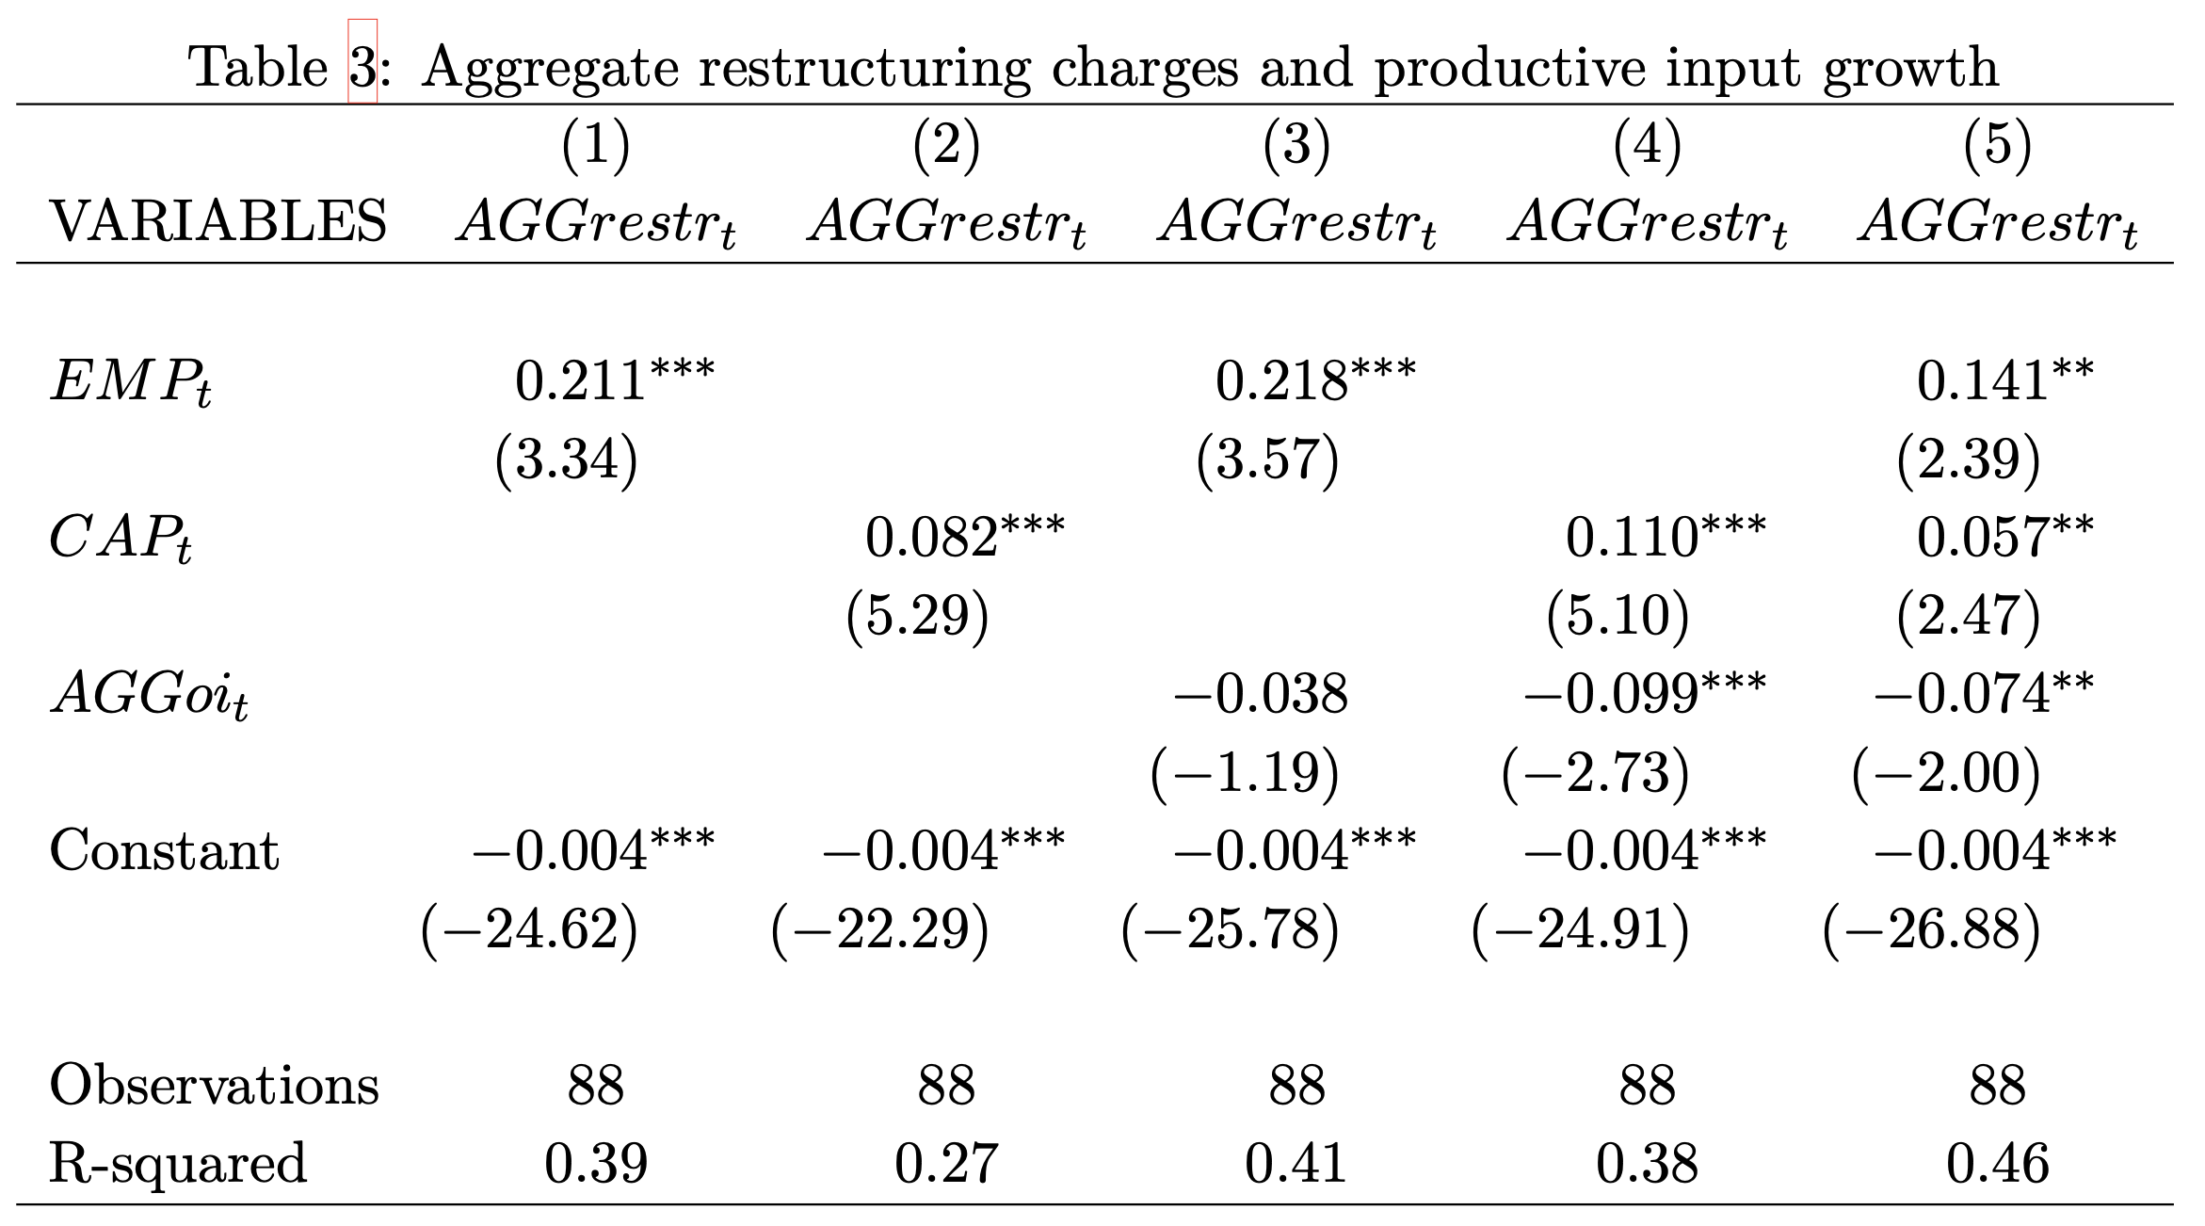
Aggregate component of restructuring
Aggregate restructuring (cross-sectional mean)
Aggregate employment growth
Restructuring has orthogonal aggregate labor and capital components that are not subsumed by information in operating income.
Aggregate capital growth
Aggregate OI growth
Time-series regression

Slide 7
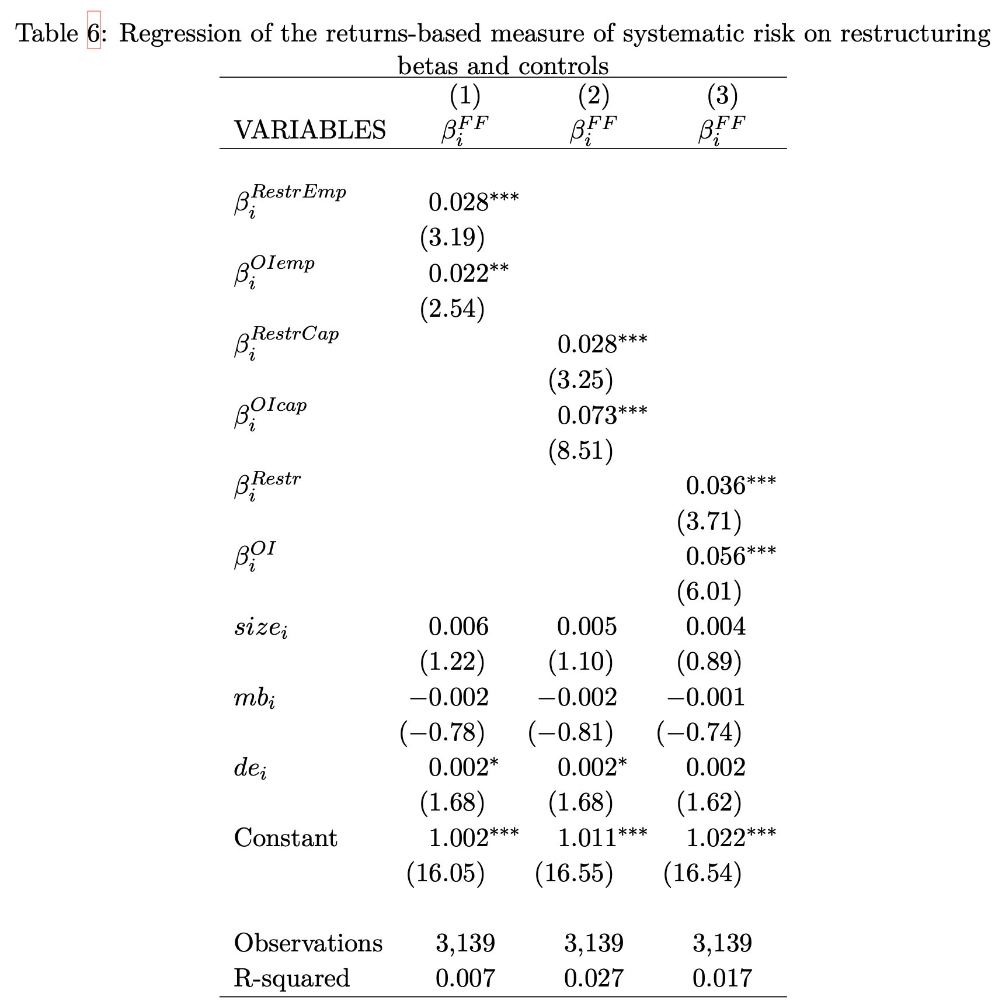
Firm-level systematic risk
Firm-level CAPM beta
Firm-level labor restructuring beta
Firm-level capital restructuring beta
Firms that restructure when aggregate labor and capital investment declines have higher systematic risk
Firm-level combined restructuring beta
Cross-sectional regression
Includes controls

Slide 8
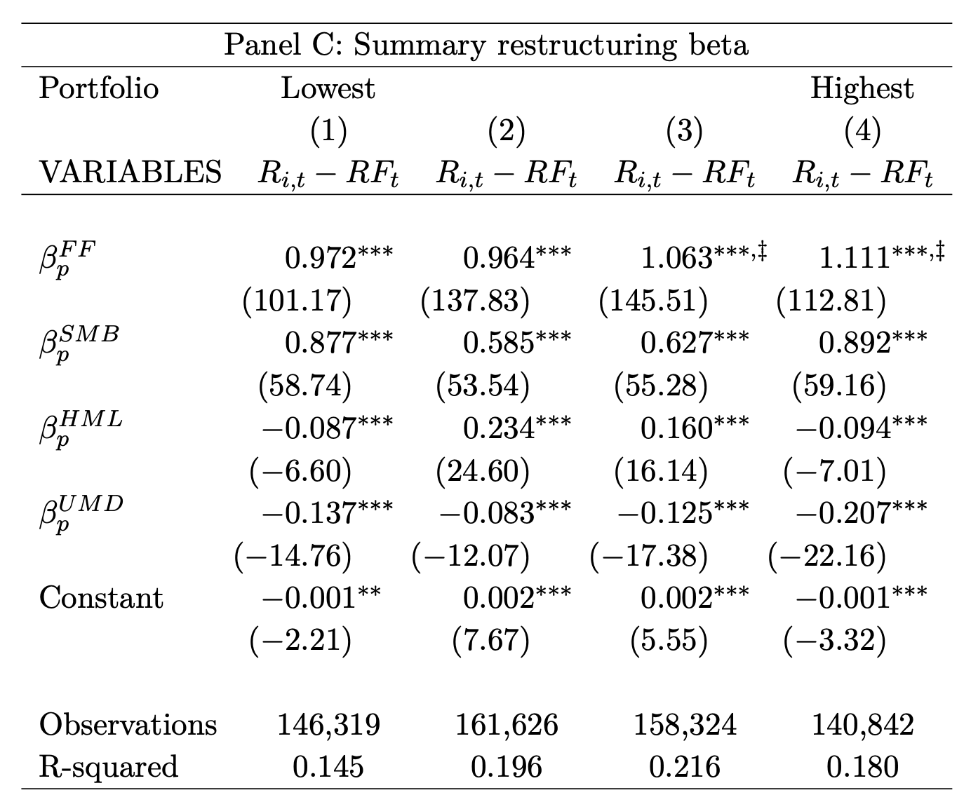




$β^{Restr}$ portfolio systematic risk
Sort by level of $β^{Restr}$ and estimate:
Conventional measure of systematic risk
${[R}_{i,s} −RF_{i,s}]=α_{p}+β_{p}^{FF}×[R_{s}^{mkt}−RF_{s}]+$ $β_{p}^{SMB}{×R}_{s}^{SMB}+β_{p}^{HML}{×R}_{s}^{HML}+β_{p}^{UMD}{×R}_{s}^{UMD}+ε_{i,s}$
Robustness:
Fama-MacBeth regression
Double-sort on $β^{OI}$ and $β^{Restr}$
Out-of-sample returns
Using VIX instead of Aggregate Employment and Aggregate Capital Investment growth
‡
‡
Increasing
Highest two portfolios are significantly higher than the lowest
Similar results for $β^{RestrEmp}$ and $β^{RestrCap}$

Slide 9
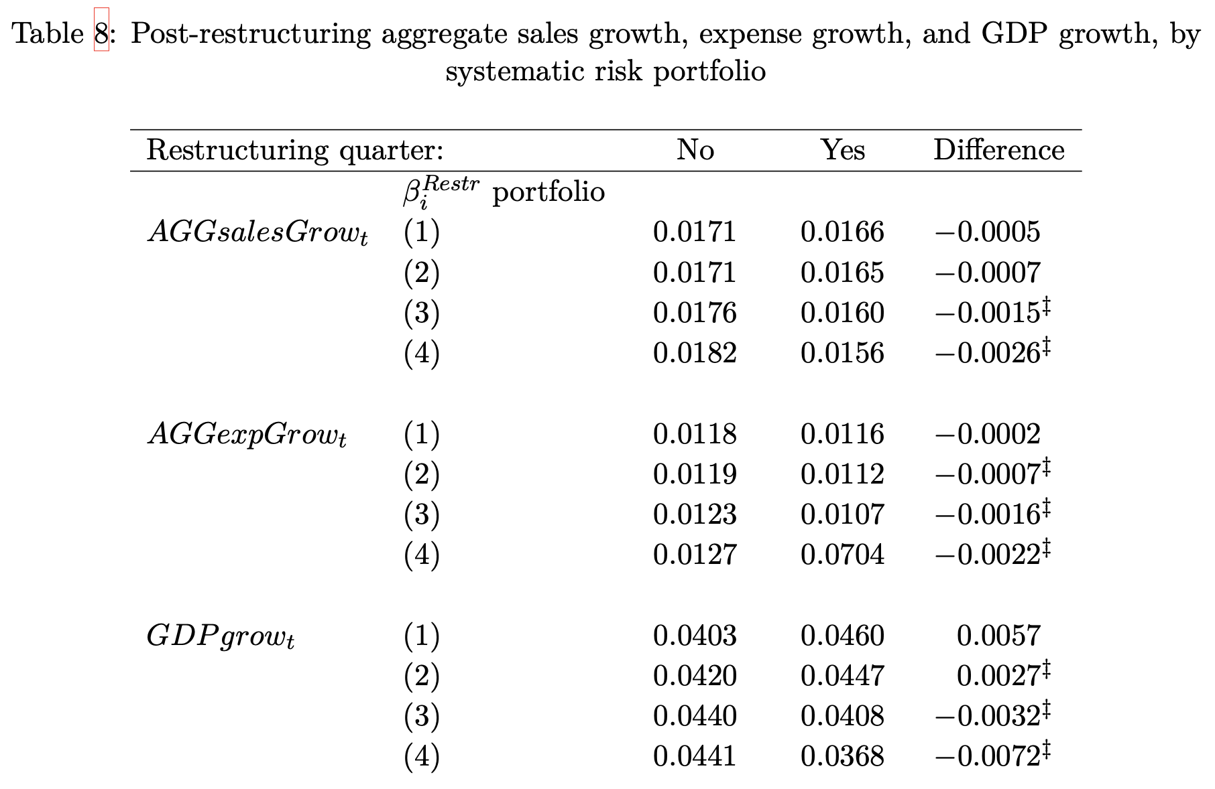




Do high $β^{Restr}$ firms restructure in advance of lower aggregate growth?
Does not
Does restructure
The risk of the firm is driven by its projects
The firm has an abandonment option for each of the projects
To the extent that a project is subject to macroeconomic changes, so is the value of the abandonment option
When aggregate growth expectations are low, the systematically risky firms are more likely to abandon projects
Systematically risky firms abandon projects in advance of lower macroeconomic growth
By level of $β^{Restr}$
Aggregate growth in the year after the firm…
Lower macro growth after restructuring by high $β^{Restr}$ firms

Slide 10
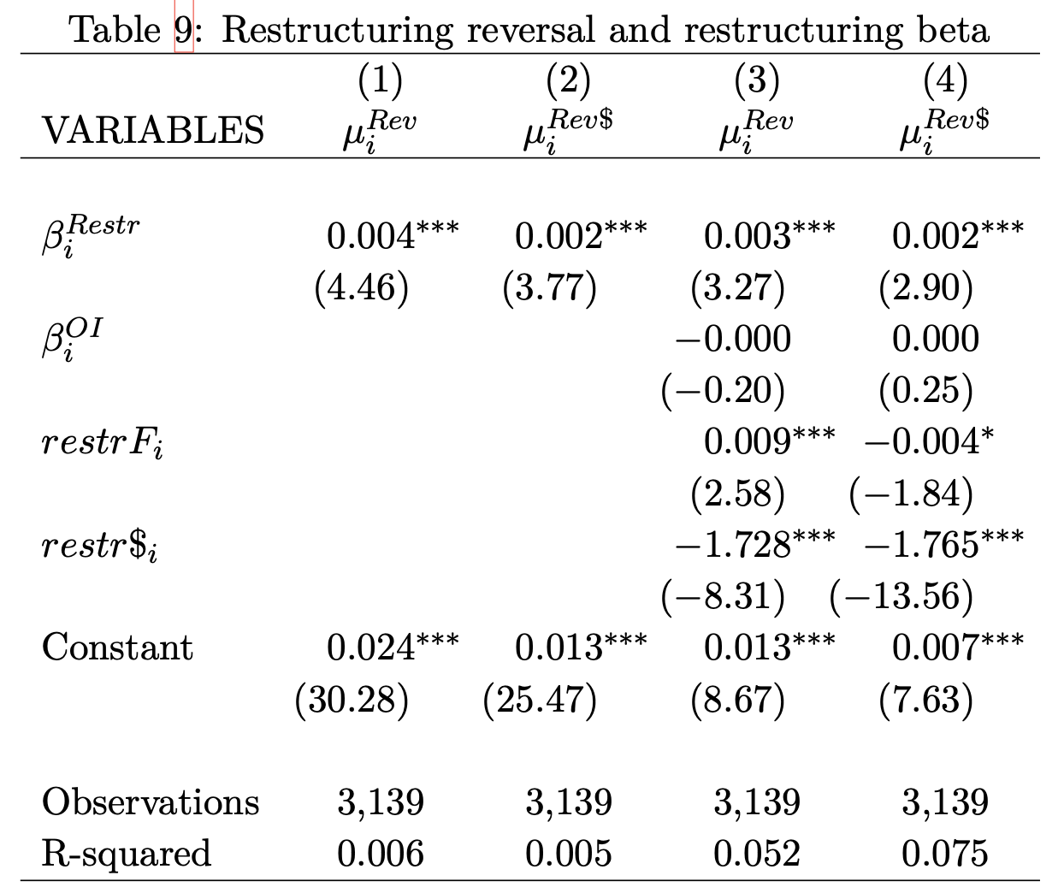

Do high $β^{Restr}$ firms reverse restructuring more?
Firms can reverse restructuring accruals
If restructuring accruals are made under more uncertain terms, they are more likely to be reversed
Managers are experts in their own firms have less information about the macroeconomy ^{(Hutton et al. 2012)}
High $β^{Restr}$ firms are more likely to make restructuring accruals based on macroeconomic expectations
Restructuring by high $β^{Restr}$ firms are more likely to be reversed
Restructuring reversals
Systematic risk

Slide 11
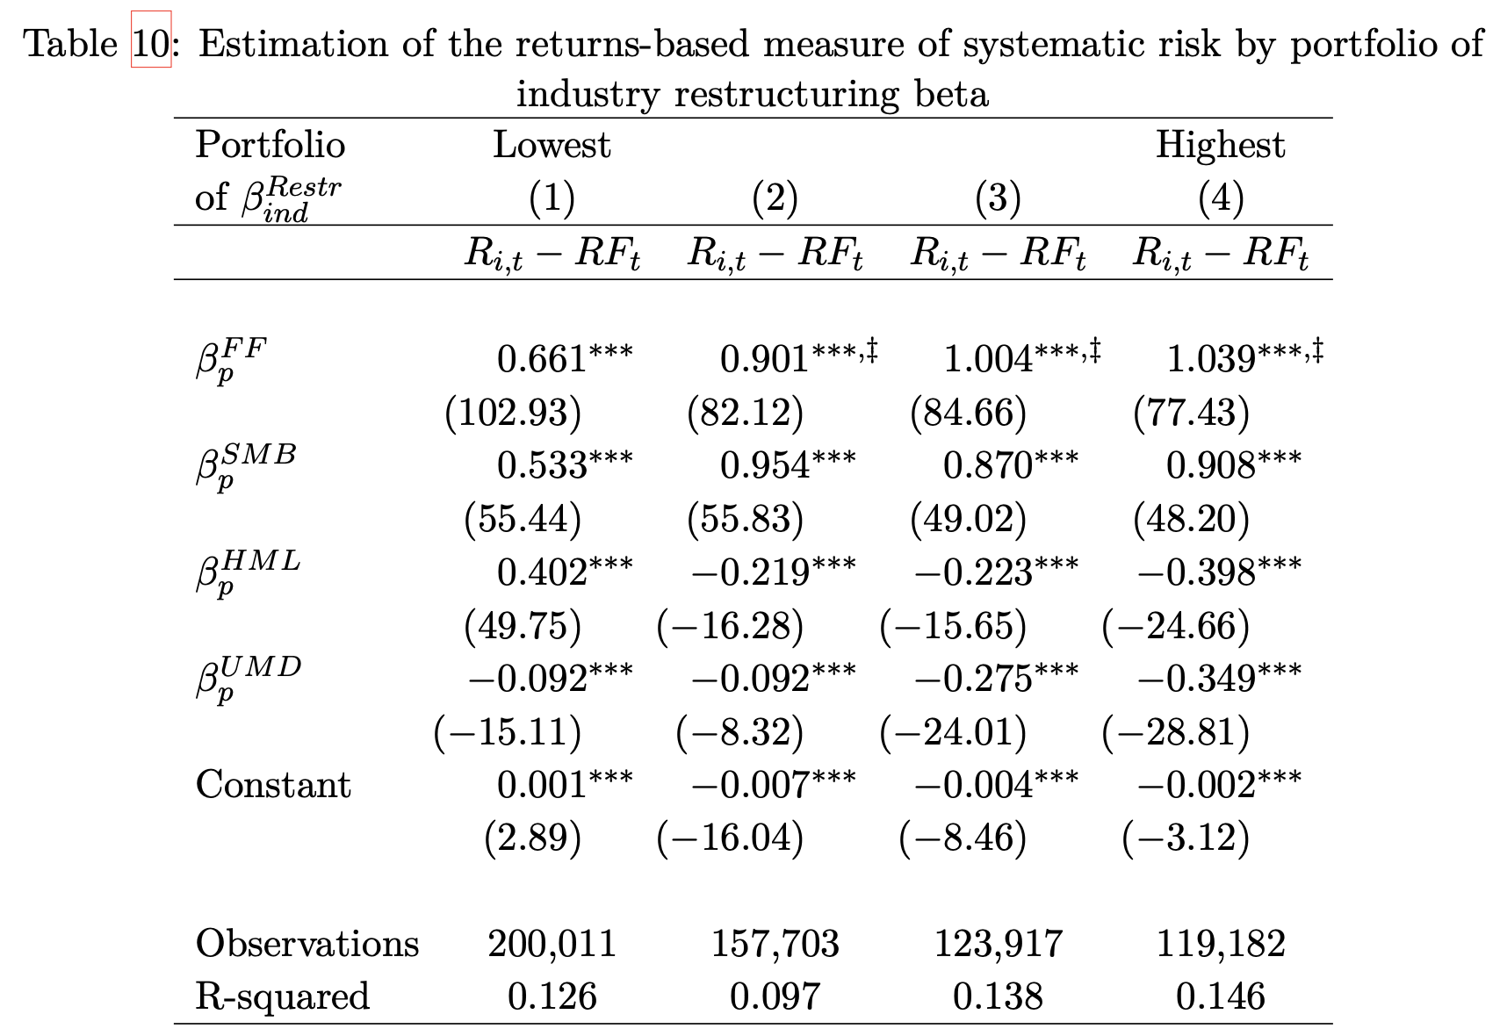


Can $β^{Restr}$ be useful for firms with limited restructuring?
Estimate $β^{Restr}$ and create portfolios
Using restructuring to assess systematic risk requires firms record restructuring expense
This can limit the usefulness of $β^{Restr}$.
However, $β^{Restr}$ can also be assessed by industry and applied to similar firms.
Estimate systematic risk using only firms without restructuring expense

Slide 12
Conclusion
Usefulness of observing firm decisions when assessing systematic risk
Inputs
Firm
Outputs
Sys. Risk
Labor
Project A
Returns
PP&E
Sys. Risk
Earnings
Labor: Schoar (2024)
Returns: Sharpe (1964); Fama & French (1992, 1993, 2015);
Both: This study
Restructuring
Project B
Project C
Earnings: Heflin et al. (2024); Ball, Sadka, Tseng (2022); Ellahie (2021); Ogneva et al. (2020); Heflin et al. (2024)
Sys. Risk
Sys. Risk
RQ: Does restructuring expense provide information about systematic risk?
Usefulness of restructuring despite its flaws

Slide 13
Thank you.

Slide 14
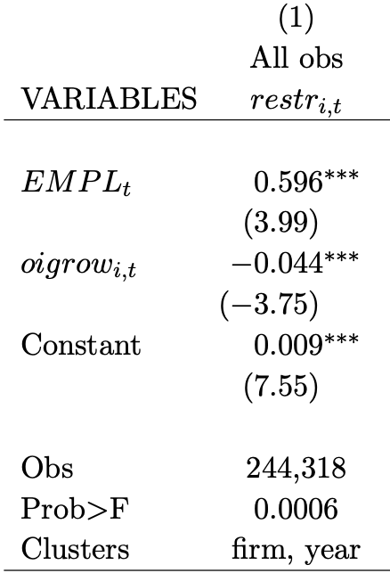
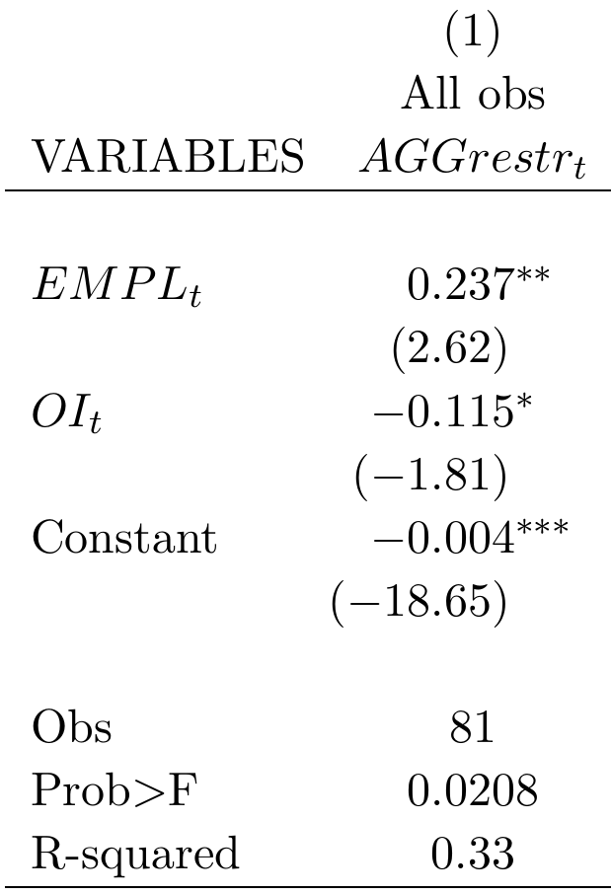
Aggregate component of restructuring
Aggregate restructuring (cross-sectional mean)
Firm restructuring
***
Aggregate employment growth
(a major input to production, correlated with aggregate demand shocks)
**
Firm-year observations
(Tobit regression)
Quarterly observations
(OLS regression, Newey-West (4) errors)
Restructuring has an aggregate component

Slide 15
Aggregate component of restructuring
Aggregate restructuring (cross-sectional mean)
Firm restructuring
***
Aggregate employment growth
(a major input to production, correlated with aggregate demand shocks)
**
Firm-year observations
(Tobit regression)
Quarterly observations
(OLS regression, Newey-West (4) errors)
Restructuring has an aggregate component

Slide 16
Demand shocks and employment fluctuations
The risk of the firm is driven by its projects
The firm has an abandonment option for each of the projects
To the extent that a project is subject to macroeconomic changes, so is the value of the abandonment option
If the firm tends to exercise the abandonment option (restructure) when aggregate growth expectations are low, the firm’s projects are likely exposed to macroeconomic (systematic) risk
In aggregate (macroeconomic)
At the firm (microeconomic)
Expected demand shock
Expected demand shock
Aggregate labor demand response ^{(Gali, 1999)}
Firm cuts inputs to production (ex. labor)
Correlation: Systematic Risk?
Actual aggregate demand shock
Actual firm demand shock
Correlation: Systematic Risk
Restructuring

Slide 17
The motivating idea for this study
Macroeconomic changes
Macroeconomic demand shocks
Can firm’s financial reporting tell us about this relation?
Firms
Firm project abandonment (restructuring)
Labor flows
Layoffs & related divestment
Lifetime wages
Aggregate pattern?
Employment
…
Which firms contribute the most?
(Those exposed to the macroeconomy)

Slide 18
The literature motivating this study
Future firm cash flows
What can the financial statements tell us about cash flows?
e.g., Dechow, Kothari, Watts (1998); Ball & Nikolaev (2022)
Value of the firm
Function of:
Riskiness of the cash flows
What can the financial statements tell us about risk? ^{(Barth, 2018)}
Restructuring is a managerial action taken in response to a change in expectations.
Provides insight into how firms exposed to systematic risk respond to aggregate shocks.
Provides more color to the mosaic used to assess systematic risk.
Earnings: Ball, Sadka, Tseng (2022); Ellahie (2021); Barth & So (2014)
Specific expense: Restructuring
THIS STUDY

Slide 19
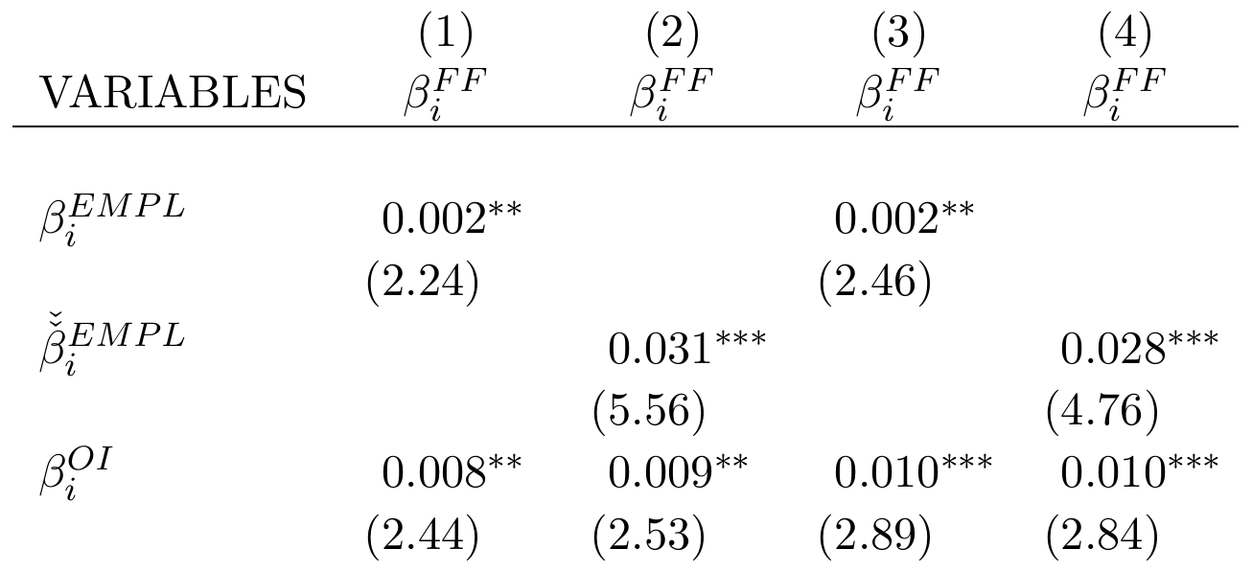
Firm-specific systematic risk test
Returns-based systematic risk
Restructuring-based risk
**
**
Ranked restructuring-based risk
***
***
Operating-income based risk
Labor leverage controls
No
No
Yes
Yes
Obs (firms)
2,688
2,688
2,495
2,495
R-squared (OLS)
0.004
0.014
0.050
0.057
The restructuring-based measure of systematic risk is associated with higher returns-based measures of systematic risk.
The relation is not explained alternatively by operating earnings.

Slide 20
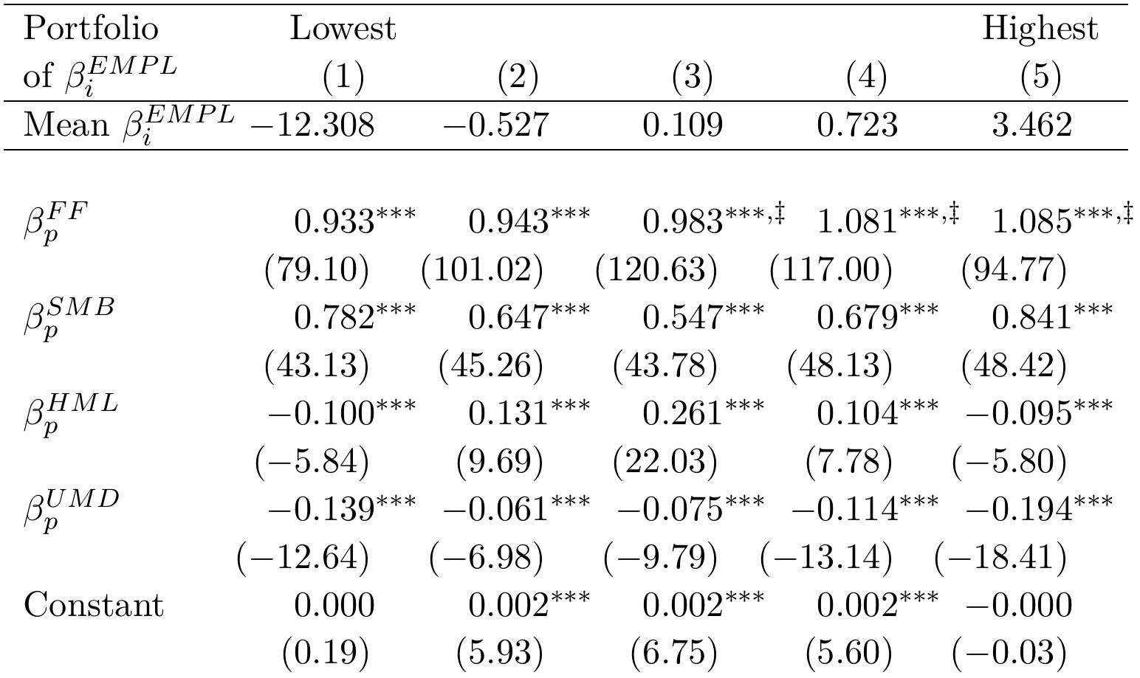
Portfolio systematic risk test
Restructuring-based risk portfolio
Systematic exposure to the market
‡
‡
‡
Monotonically increasing
Highest three portfolios are significantly higher than the lowest
Fama-French-Carhart factor betas
OLS (similar results using Fama-MacBeth)
The restructuring-based measure of systematic risk is associated with higher returns-based measures of systematic risk.

Slide 21
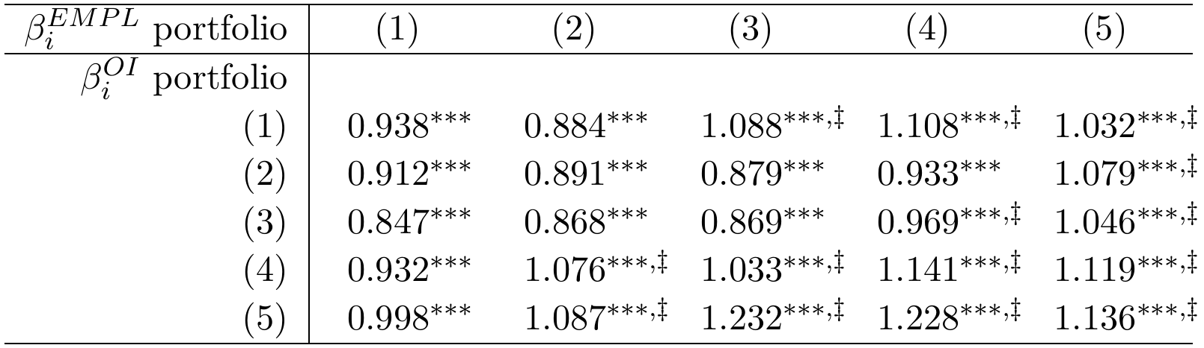

Double-sort portfolio systematic risk test
Restructuring-based risk portfolio
$$β_{p}^{FF}$$
Operating earnings-based alternative portfolio
‡
‡
‡
Risk is increasing in restructuring-based measure at all levels of OI-based measure
‡
‡
‡
‡
‡
‡
‡
‡
‡
‡
‡
The restructuring-based measure of systematic risk is associated with higher returns-based measures of systematic risk.
The increase is not explained by information in operating earnings

Slide 22
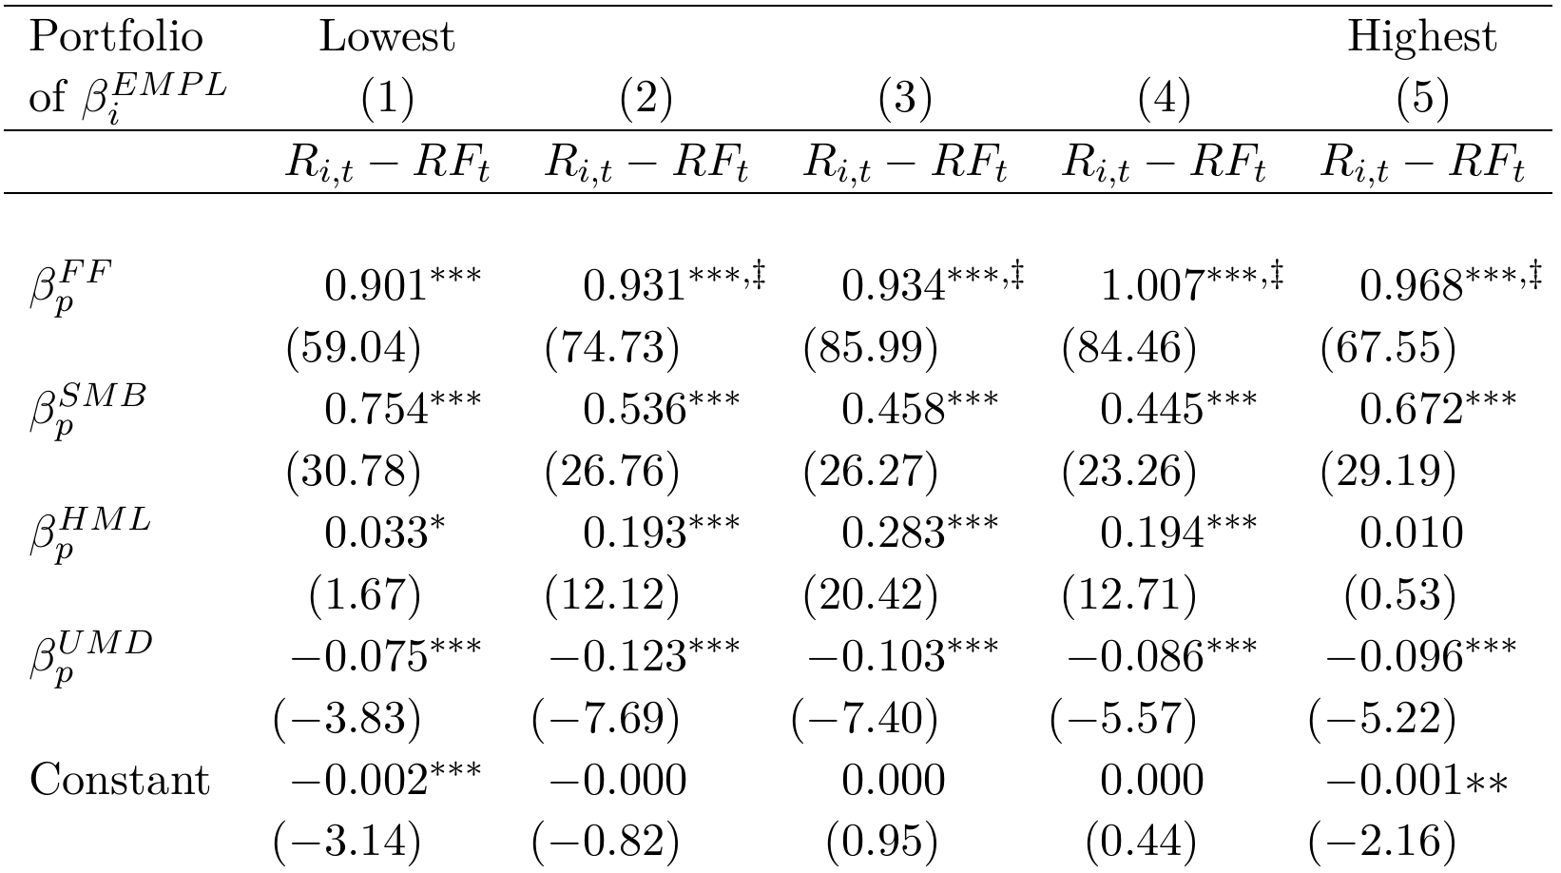

Out-of-sample portfolio systematic risk test
Restructuring-based risk portfolio, based on estimates of $β_{i}^{EMPL}$ prior to estimation of FF factor loadings
‡
‡
‡
‡
Increasing, monotonically through portfolio 4.
Highest 4 portfolios are significantly higher than the lowest portfolio.
The restructuring-based measure of systematic risk is associated with higher returns-based measures of systematic risk.
The increase is not explained by overlapping beta calculations.

Slide 23
Does risky firm restructuring predict aggregate demand shocks?
In aggregate (macroeconomic)
At the firm (microeconomic)
Expected demand shock
Expected demand shock
Correlation: Systematic Risk
Aggregate labor demand response ^{(Gali, 1999)}
Firm labor demand response (restructuring)
Do firms that demonstrate labor divestment patterns consistent with the aggregate market actually realize macroeconomic demand shocks after restructuring?
Actual aggregate demand shock
Actual firm demand shock

Slide 24

Do risky firms realize aggregate demand shocks?
***
***
***
***
$β_{i}^{EMPL}$ Portfolio
***
***
***
***
***
Significantly different smaller than portfolio 1. Figures x1000.

Slide 25



Other tests fill out the story
Further evidence restructuring is in response to aggregate shocks
Firms know less about the macroeconomy relative to the firm ^{(Hutton, Lee, Shu, 2012)}
Higher $β_{i}^{EMPL}$ firms reverse more of their restructuring accruals
Aggregate employment is not only a signal of expected demand shock
VIX is also a predictor of aggregate demand shocks (Foerster et al., 2014; Leduc and Liu, 2016)
Replacing aggregate employment growth with negative VIX provides the same results
Restructuring is more than just labor costs
Capital expenditure is also an important input to production
Forming $β_{i}^{EMPL}$ from both labor and capital expenditure growth provides the same results
Firms with no restructuring are left out
Systematic risk is also an industry characteristic ^{(Chan et al., 2007)}
Calculating industry $β_{i}^{EMPL}$ is effective for determining the systematic risk of non-restructuring firms

Slide 26
Conclusion
There is evidence that restructuring costs, taken in context of expected demand shocks, can provide systematic risk information.
Firms exposed to systematic risk need to restructure in response to expected aggregate demand shocks

Slide 27
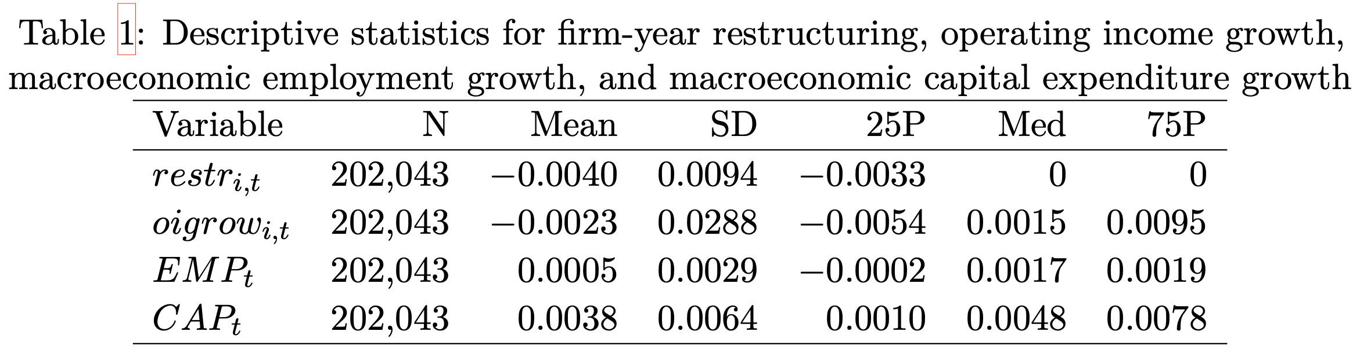

Slide 28
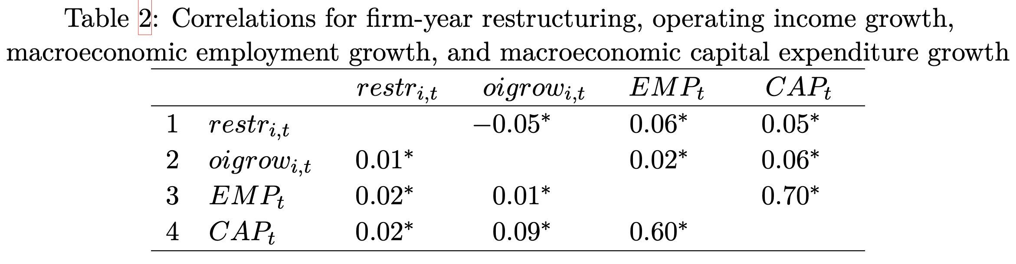

Slide 30
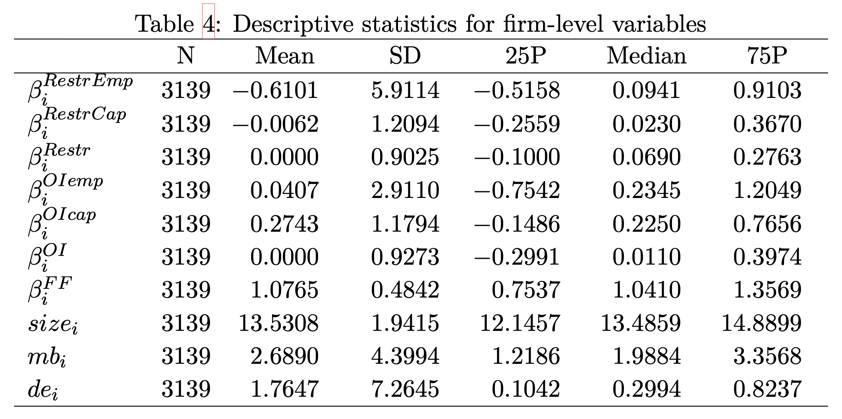

Slide 31
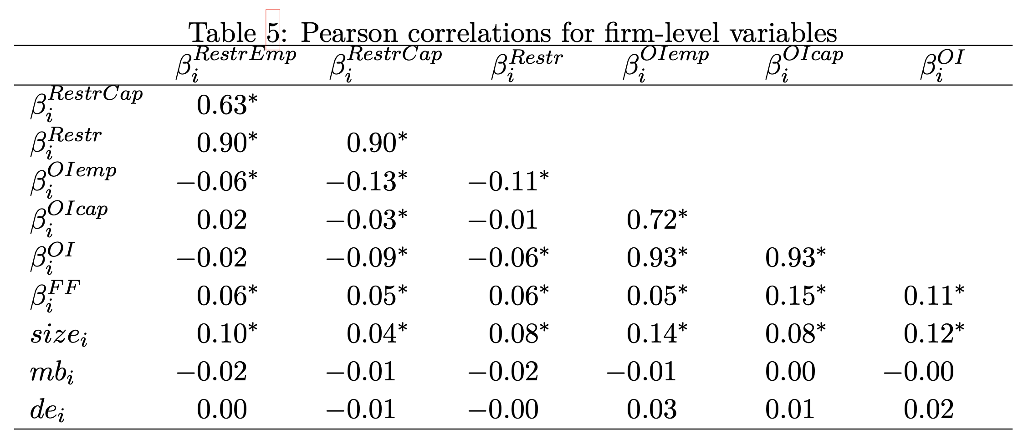

Slide 33
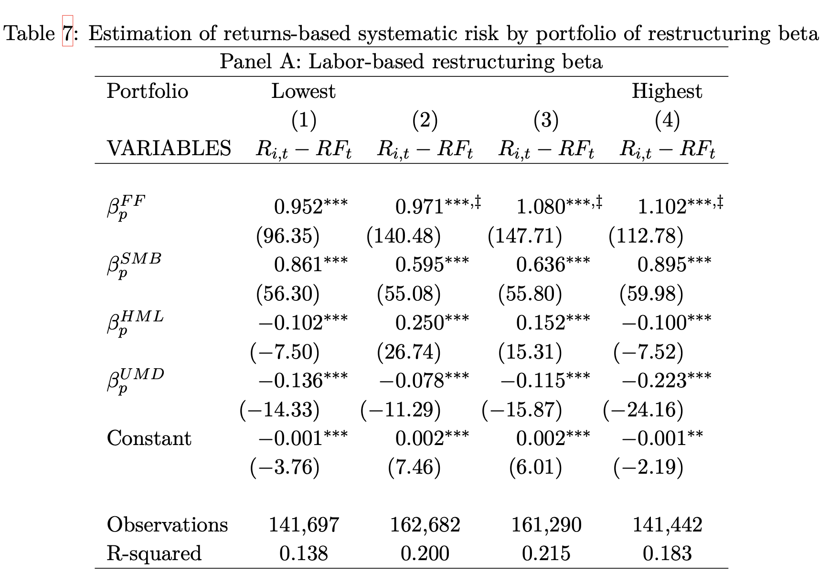

Slide 34
