Slide 1
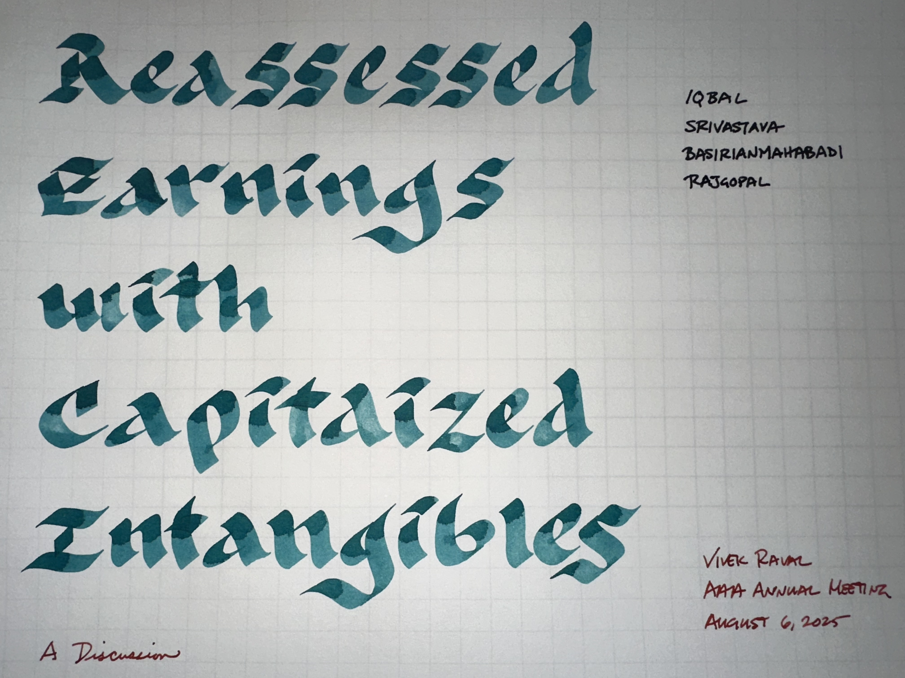

Slide 2
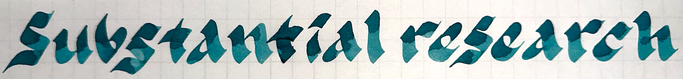
A long line of research
Capitalize
Expense
This paper
Lev & Sougiannis 1996: Capitalize R&D, find it is value-relevant and predictive of future returns.
Lev & Srivastava 2022: Capitalize R&D and SG&A, find it improves value investing returns.
Gu, Lev, & Zhu 2023: Capitalize R&D and SG&A, show improved performance of accounting-driven loss firms.
Iqbal, Rajgopal, Srivastava, and Zhao 2024: Improves on rules-of-thumb for capitalizing intangibles.
Skinner 2008: Capitalizing would mean lower accounting consistency, more earnings management, recognizing assets but not liabilities, poorly-defined assets, inseparability of assets.
Penman 2023: Expensing provides no loss of information, information on uncertainty, consistent tangible/ intangible accounting, consistent with risk-return principles. Capitalization does not really provide matching or reflect the economics.
Z. King (2024, w/p): The time lag between R&D investment and payoff reduces the benefit of capitalization below expensing.
This paper uses the most current techniques to focus arguments against claims that intangible capitalization would decrease matching and the persistence of earnings.
How important are these claims in the overall argument?
Can this paper address the core issues presented against capitalization?
Can this paper contribute to standard setting more effectively?
Notes:
To the authors: This is intended to be a true discussion, and not a referee report, so the ‘comments’ are largely high-level and contextual. My objective was to elicit the most helpful comments from the audience. Regardless, I hope you find the discussion helpful in thinking about your research. I enjoyed the paper and wish you the best of luck in conducting further research on this topic.

Slide 3
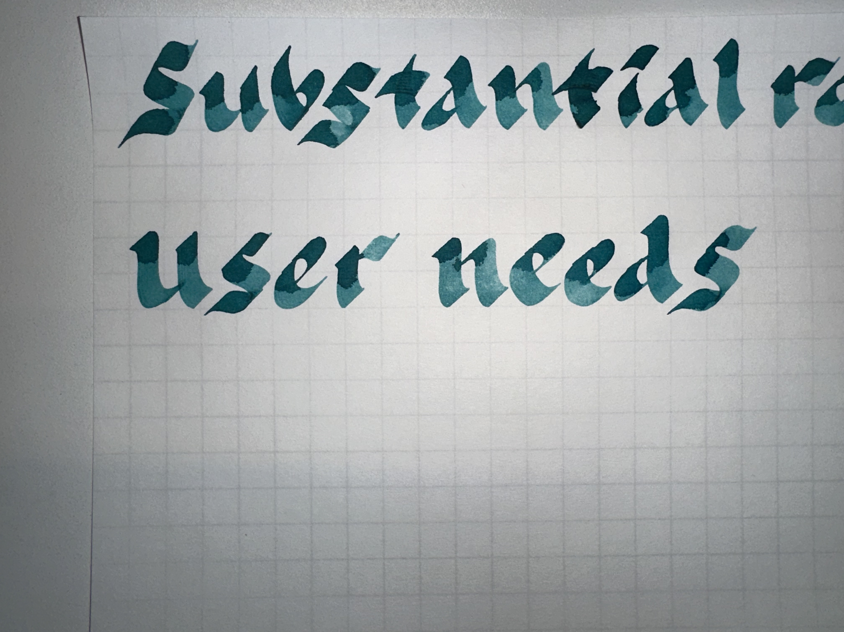
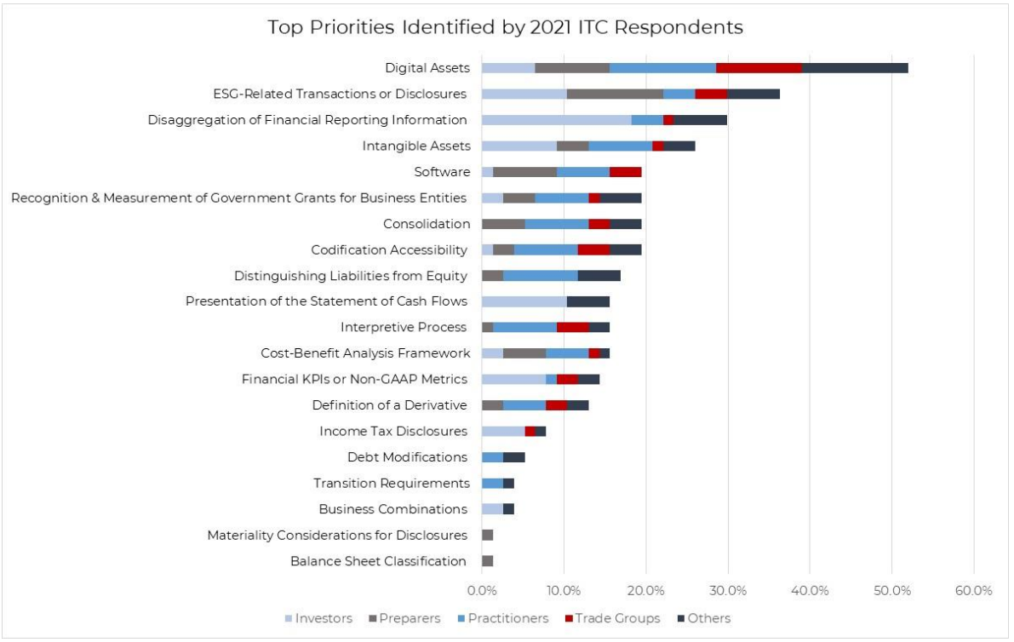
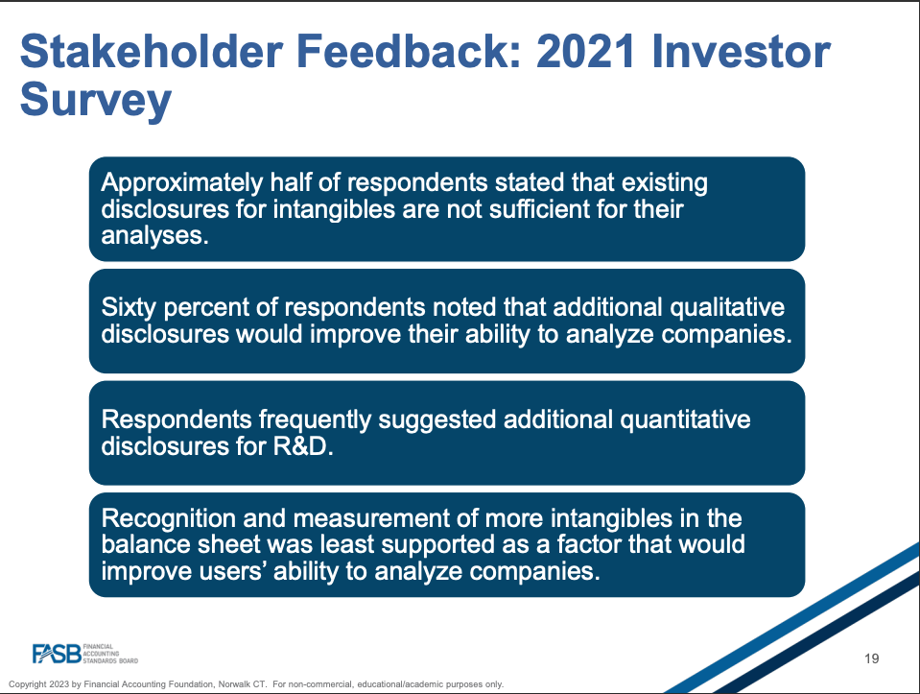
Users want more information.
Capitalization is a re-organization of the existing information (excluding the disclosures)
Can users do this on their own, better?
2021 agenda consultation report (FASB)
2023 webinar on intangibles (FASB)
Notes:
To the authors: This is intended to be a true discussion, and not a referee report, so the ‘comments’ are largely high-level and contextual. My objective was to elicit the most helpful comments from the audience. Regardless, I hope you find the discussion helpful in thinking about your research. I enjoyed the paper and wish you the best of luck in conducting further research on this topic.

Slide 4
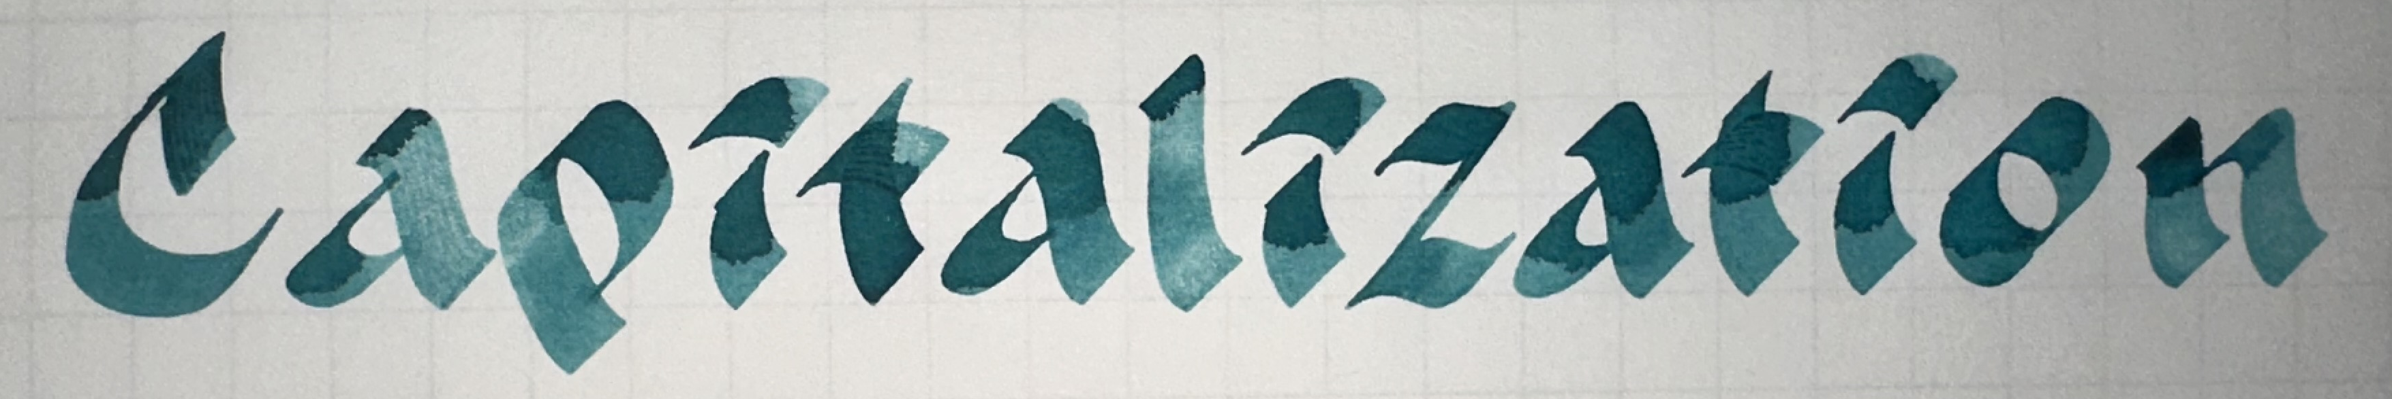
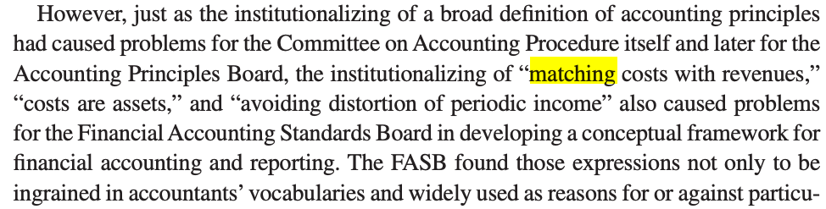
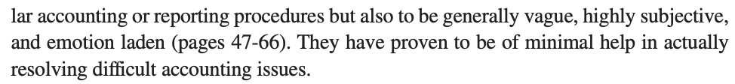
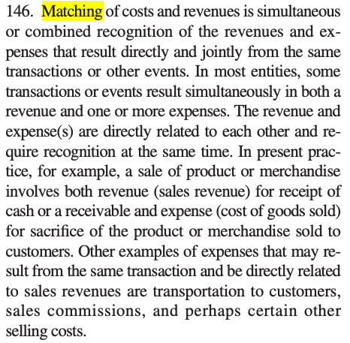
Matching
Less Volatility
Amortization
Volatility can be informative
See Raval 2025 as one example (apologies)
The amortization rate of intangibles would be new information
Potentially value-relevant information in amortization rates?
Perhaps worth incorporating into this study
More predictable success or failure
Storey & Storey (1998): The framework of financial accounting concepts and standards.
Con 6 (FASB)
Confirms finding in Gu et al. 2023
Was anyone fooled by the unadjusted earnings?
This paper assumes [returns = truth].
  This is reasonable
  But it leaves little room for demonstrating the importance of capitalization
Costs that are less direct are allocated
Or expensed immediately if difficult to align with a period of benefit.
Notes:
To the authors: This is intended to be a true discussion, and not a referee report, so the ‘comments’ are largely high-level and contextual. My objective was to elicit the most helpful comments from the audience. Regardless, I hope you find the discussion helpful in thinking about your research. I enjoyed the paper and wish you the best of luck in conducting further research on this topic.

Slide 5
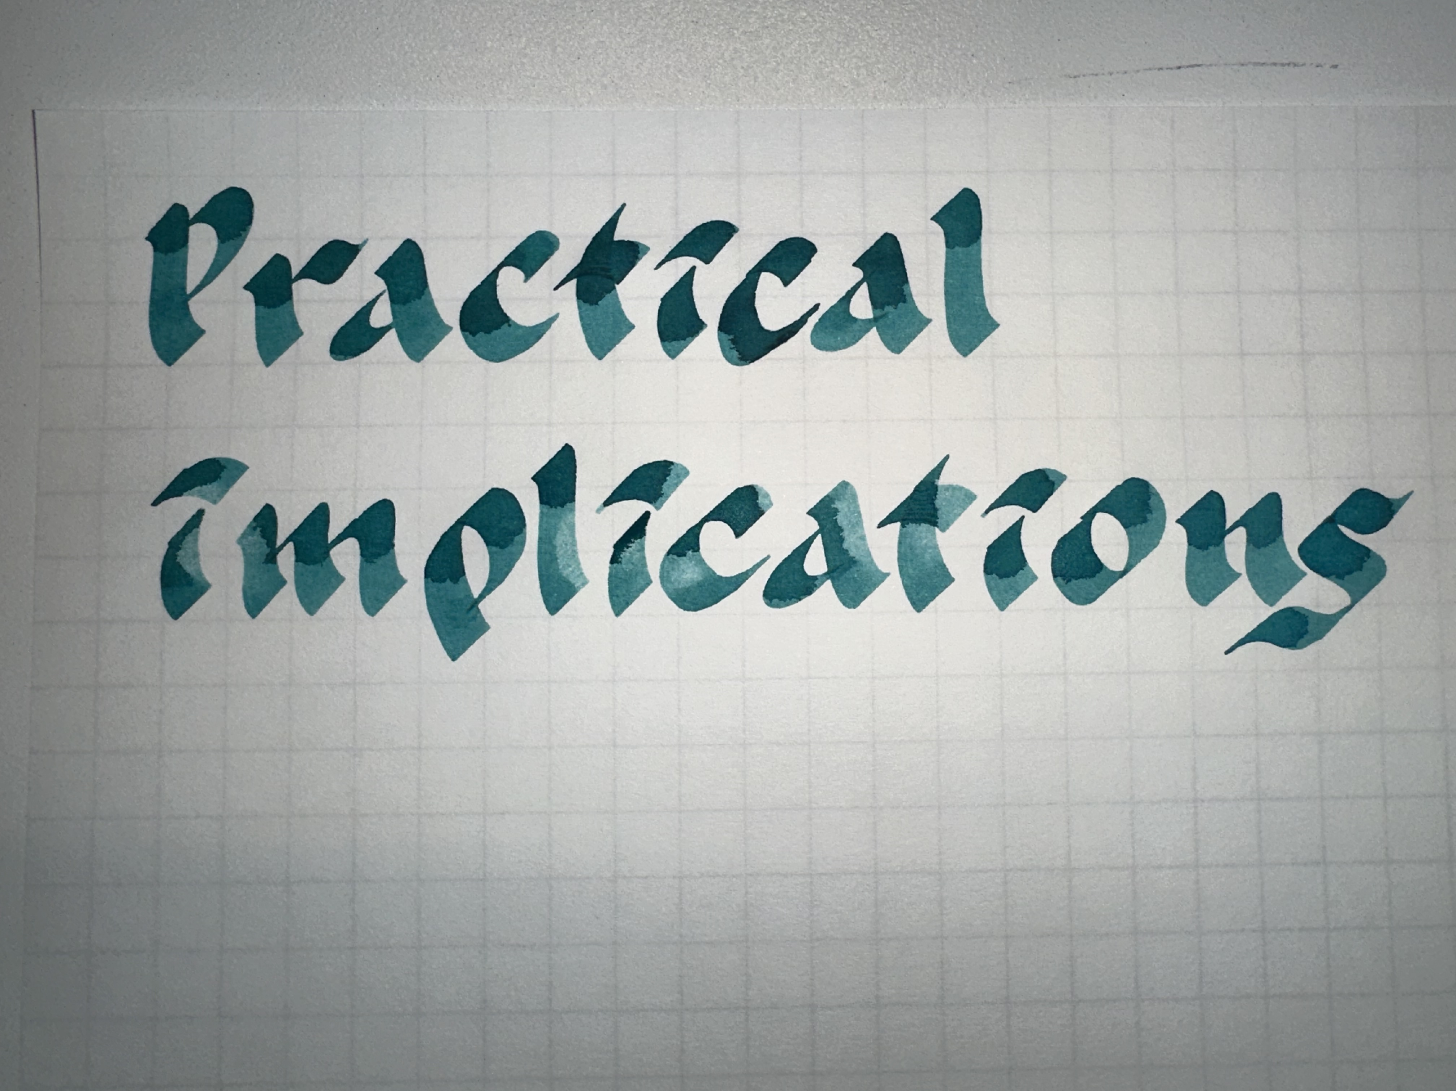
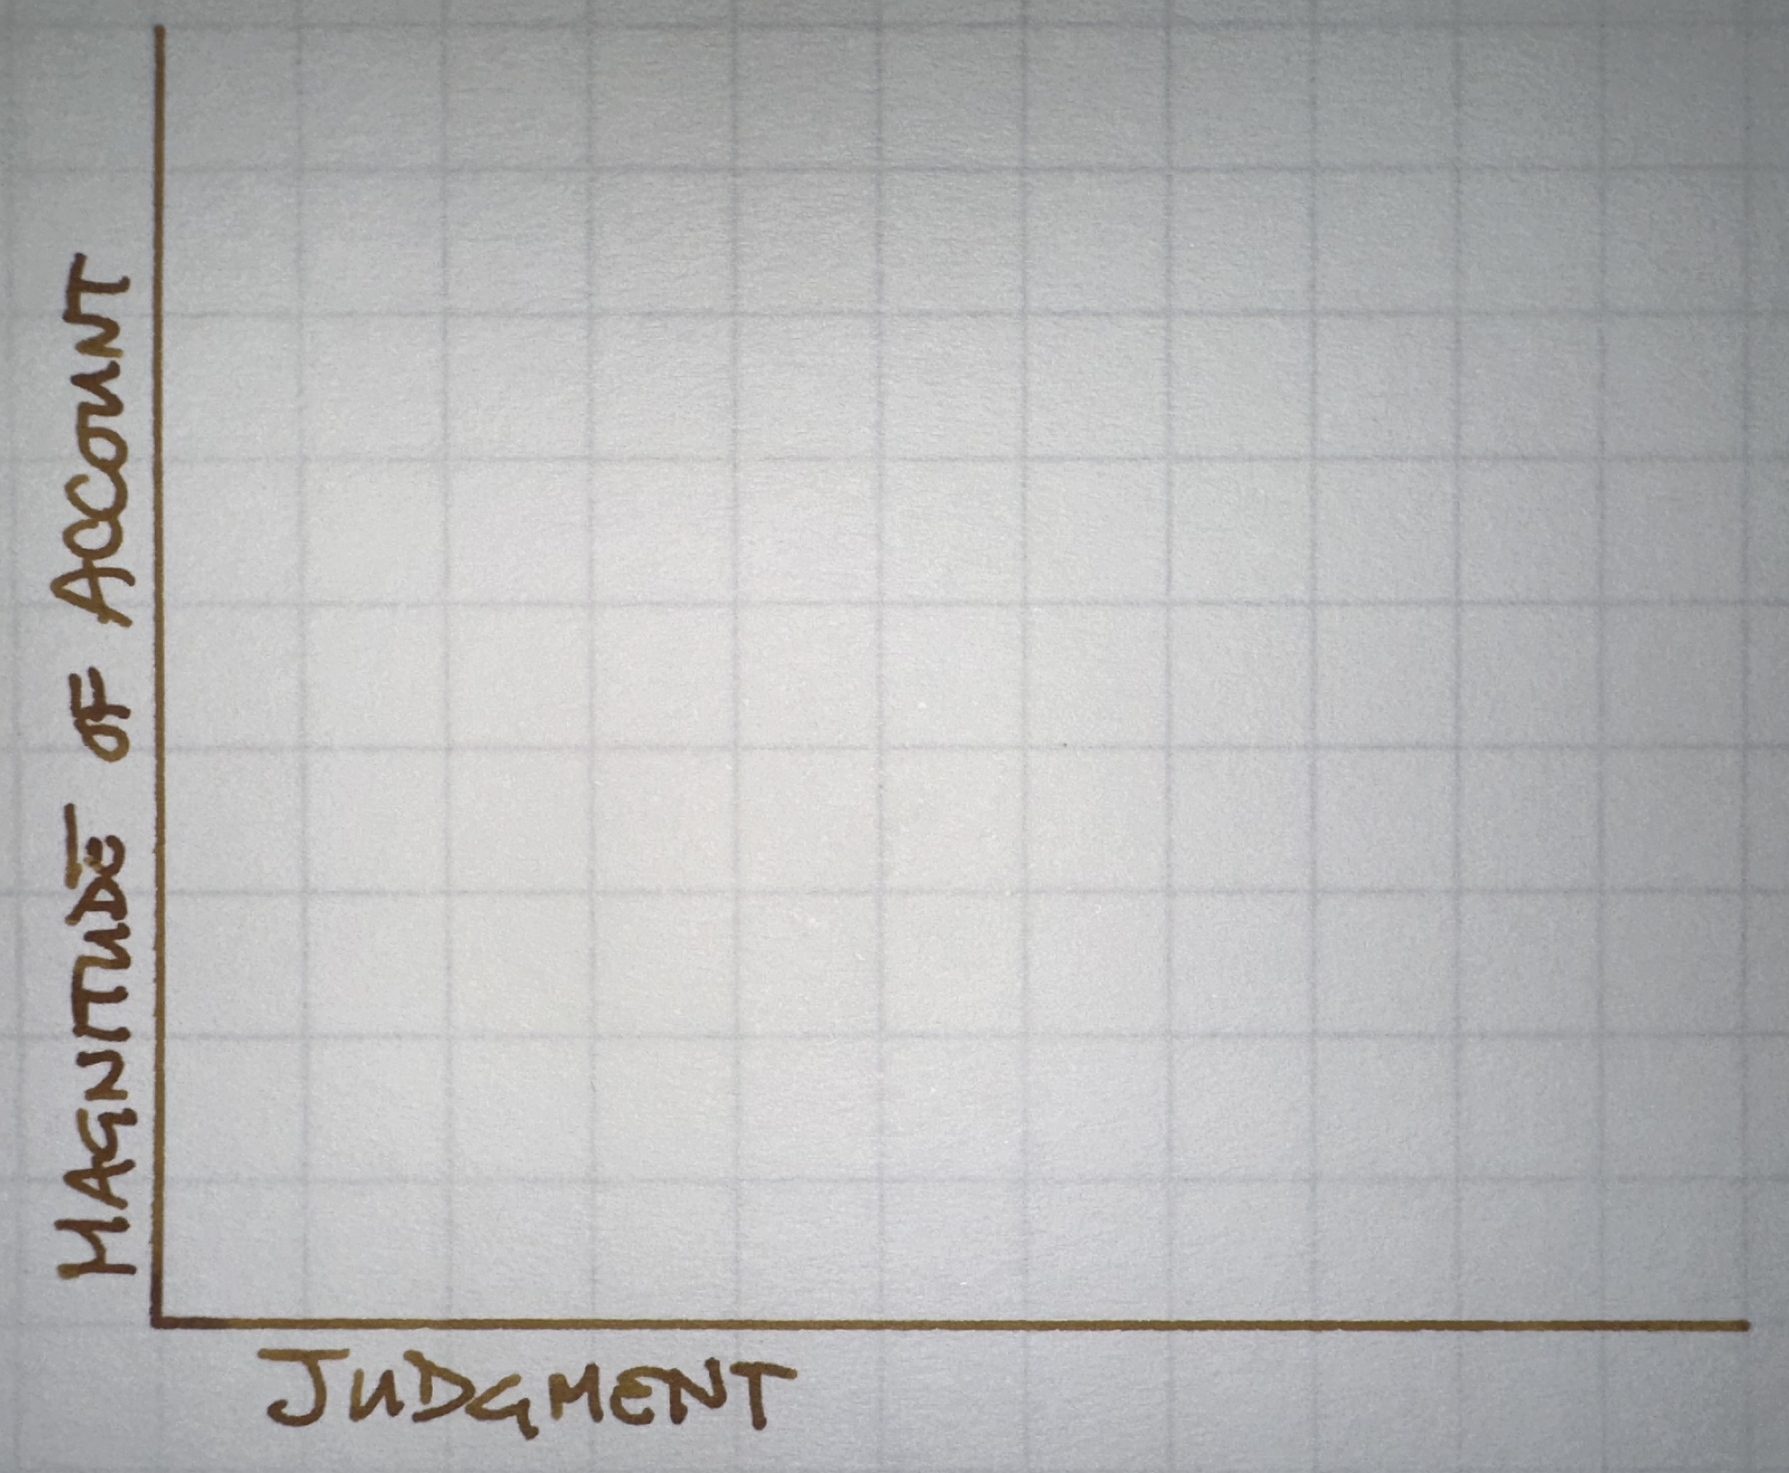
Simply not how firms look at this
Easy for us to capitalize – we see some consolidated number and apply some industry averages.
Executing capitalization from the bottom up is very difficult
How do we determine if R&D generates a separable asset?
Is the work maintenance (expensed) or an improvement (capitalized) to existing intangible assets?
Do some employee salaries get fully capitalized? Others partially?
How would you audit this account?
Huge impact on earnings
Most information asymmetry
Internal Intangibles
Revenue
PPE
Amortization is not how we account for goodwill
Perhaps fair value provides more information than historical cost?
What useful life will assets have? And what sort of depreciation would be appropriate? Decelerated?
Perhaps an impairment approach makes more sense?
  Impairments have information
  However, opportunities for earnings management
Goodwill
A/R
Proprietary costs
Notes:
To the authors: This is intended to be a true discussion, and not a referee report, so the ‘comments’ are largely high-level and contextual. My objective was to elicit the most helpful comments from the audience. Regardless, I hope you find the discussion helpful in thinking about your research. I enjoyed the paper and wish you the best of luck in conducting further research on this topic.

Slide 6
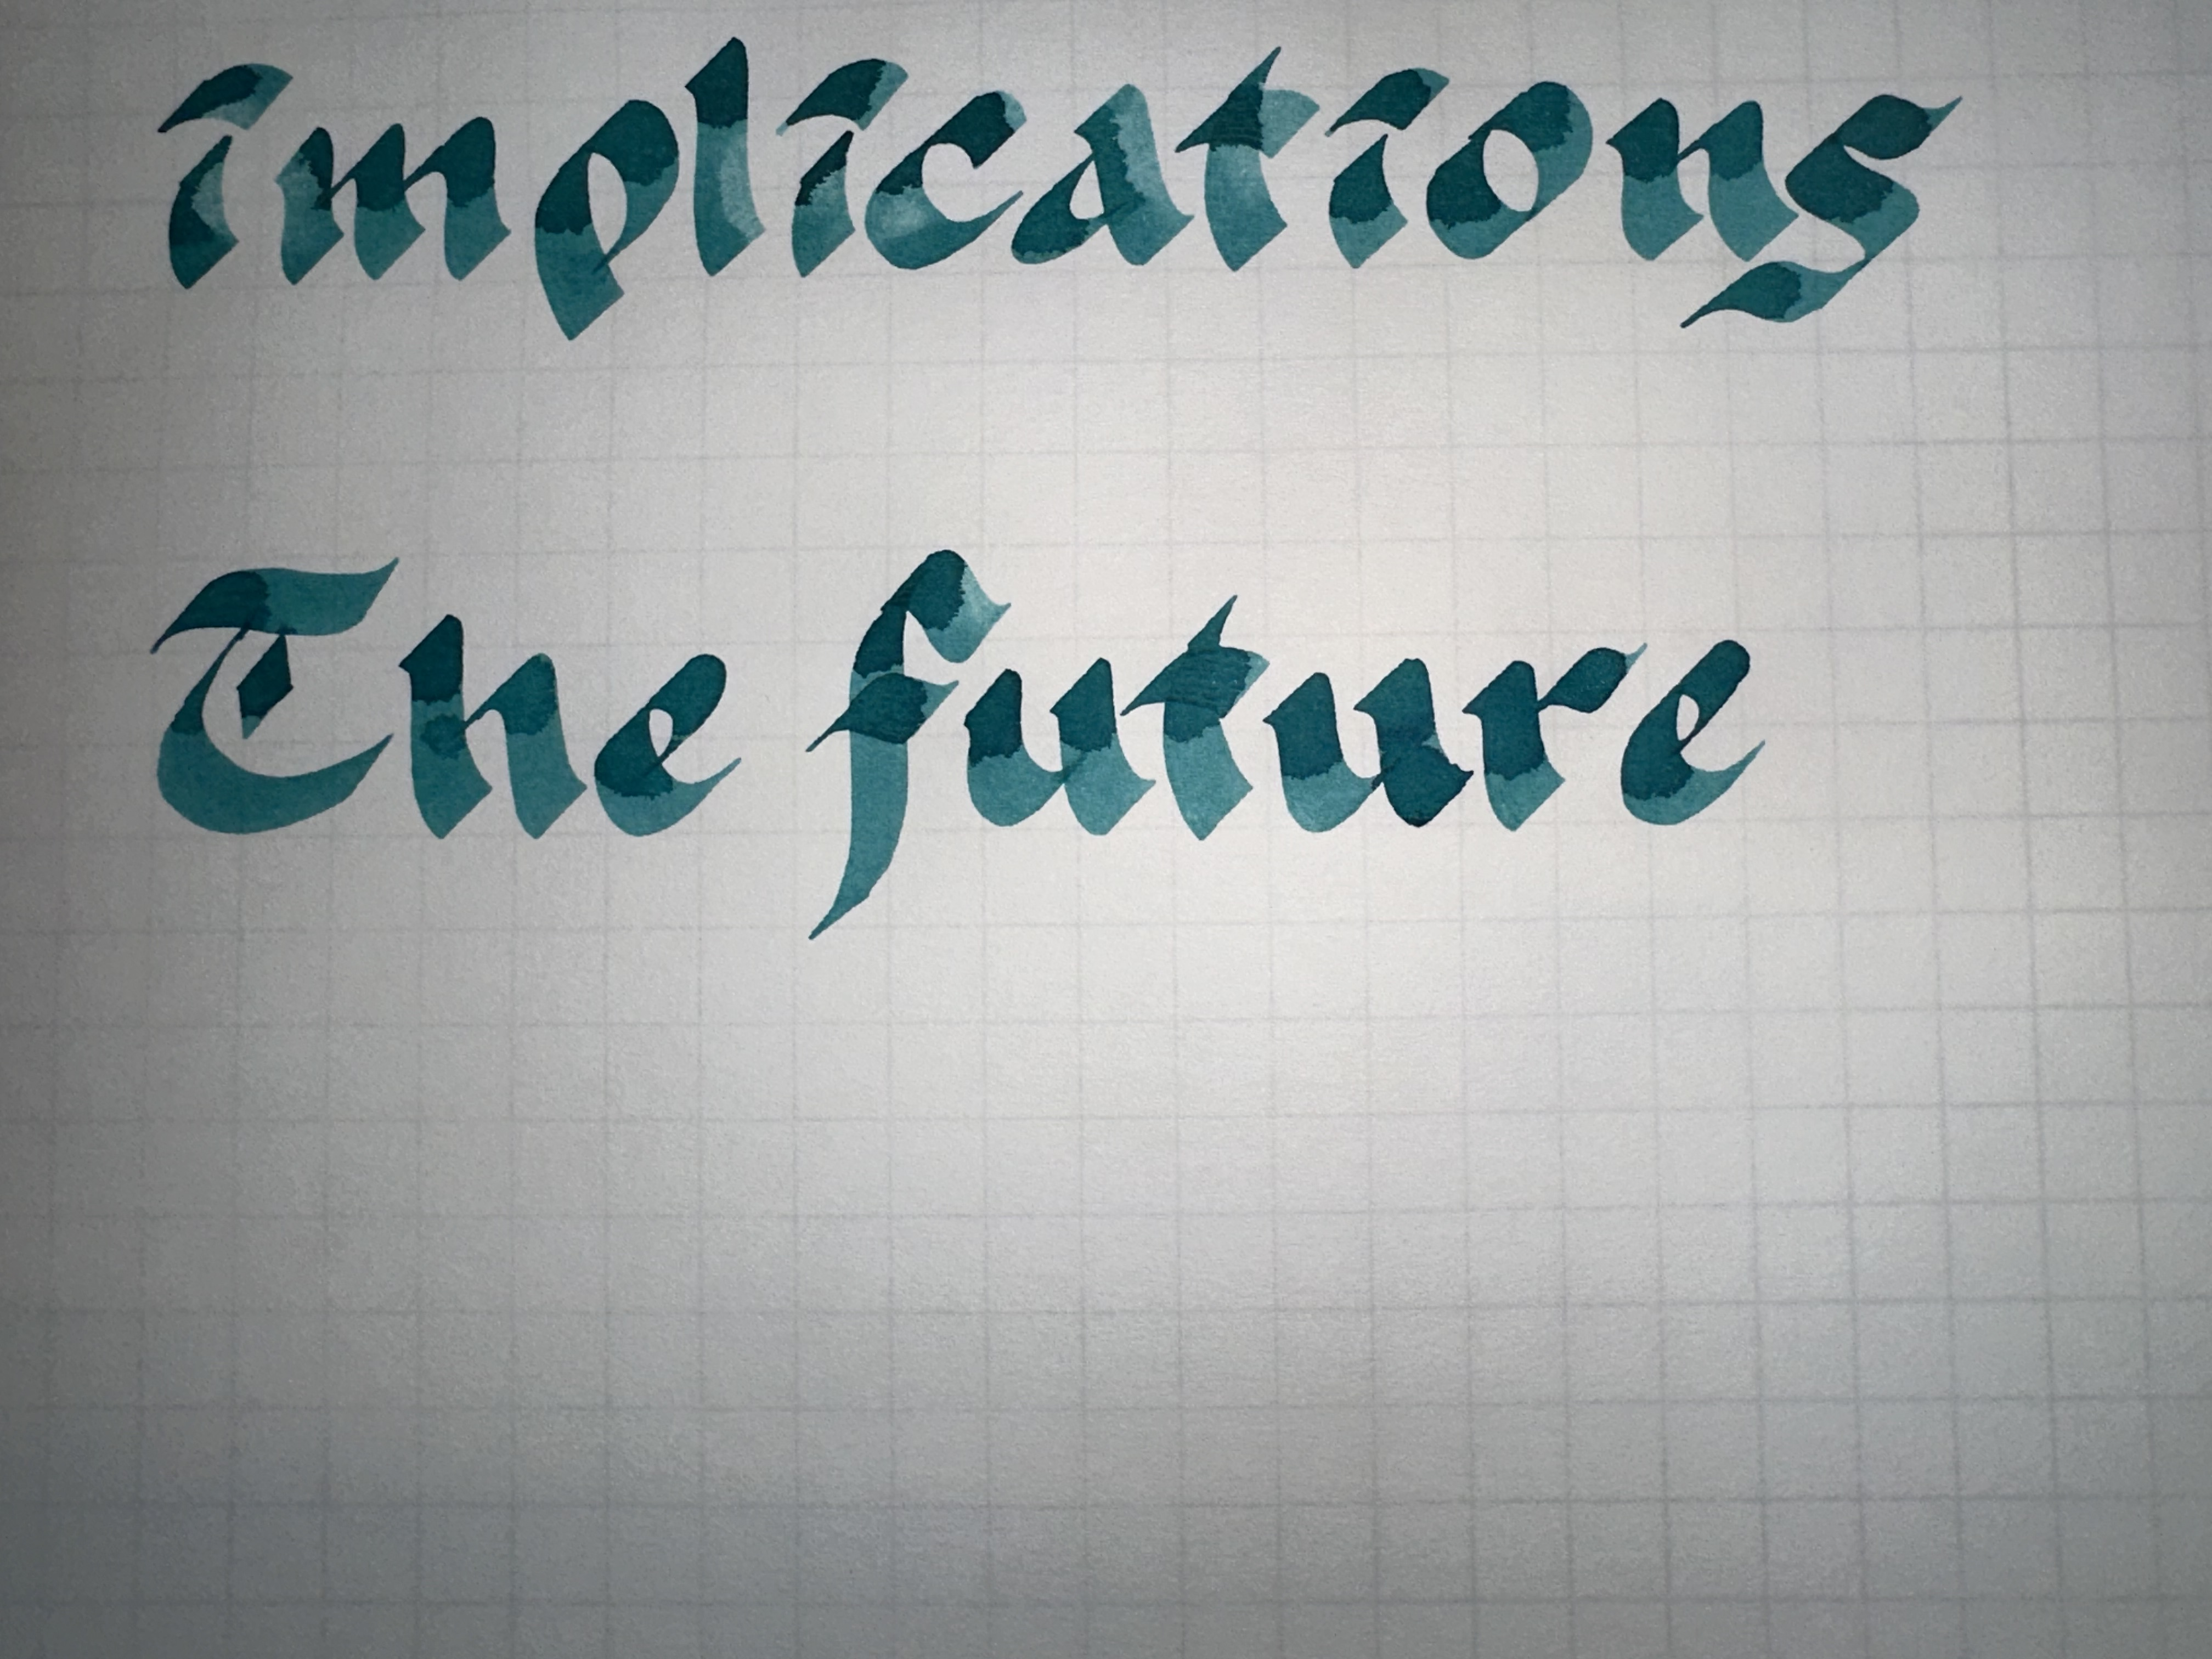
How should we account for [stuff]?
This question matters, and we need to develop the expertise to answer it.
What matters?
VS
But we seem to be running in circles
Stewardship
Valuation
VS
Verifiability
Value Relevance
This paper follows a well-trodden path, but to influence standard-setting meaningfully, it must carve out a new one.
VS
Conservatism
Fair Value
VS
Expense
Capitalize
That new path may be how we return to this literature with assurance that our research delivers impact.
VS
Balance Sheet
Income
Notes:
To the authors: This is intended to be a true discussion, and not a referee report, so the ‘comments’ are largely high-level and contextual. My objective was to elicit the most helpful comments from the audience. Regardless, I hope you find the discussion helpful in thinking about your research. I enjoyed the paper and wish you the best of luck in conducting further research on this topic.

Slide 7

Notes:
To the authors: This is intended to be a true discussion, and not a referee report, so the ‘comments’ are largely high-level and contextual. My objective was to elicit the most helpful comments from the audience. Regardless, I hope you find the discussion helpful in thinking about your research. I enjoyed the paper and wish you the best of luck in conducting further research on this topic.

