Slide 1
Accounting Matters
Vivek Raval
October 3, 2025

Slide 2
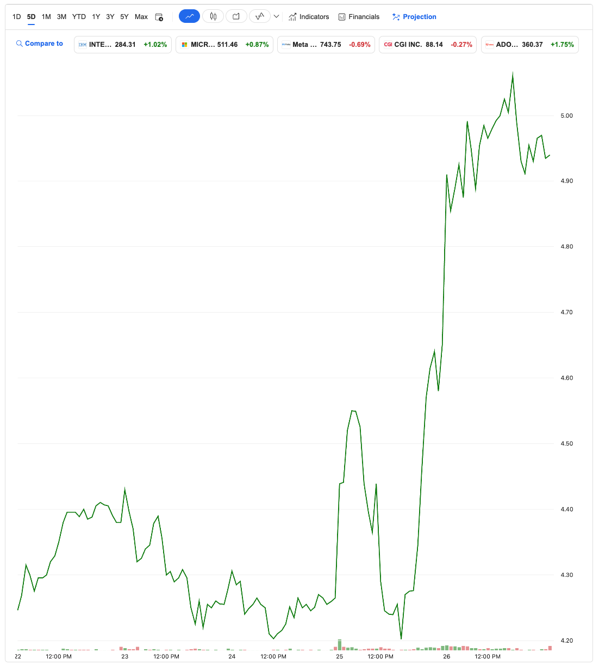
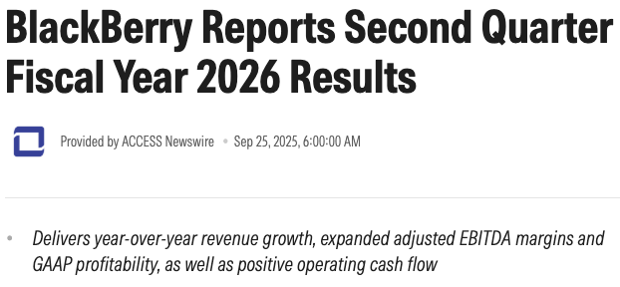
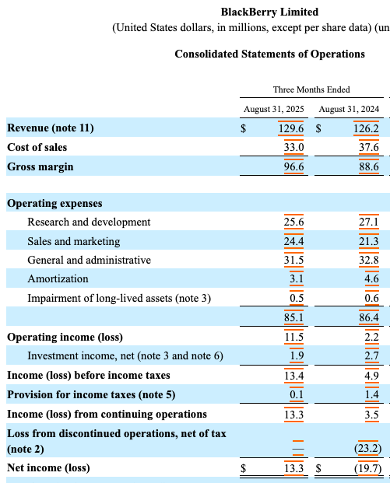
BlackBerry Ltd (BB)
17% return in one day last week
CEO earned $343,000 in a day
Why?

Slide 3
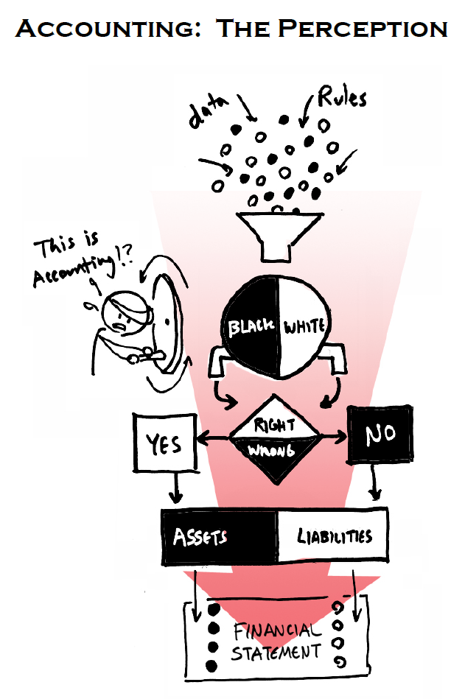
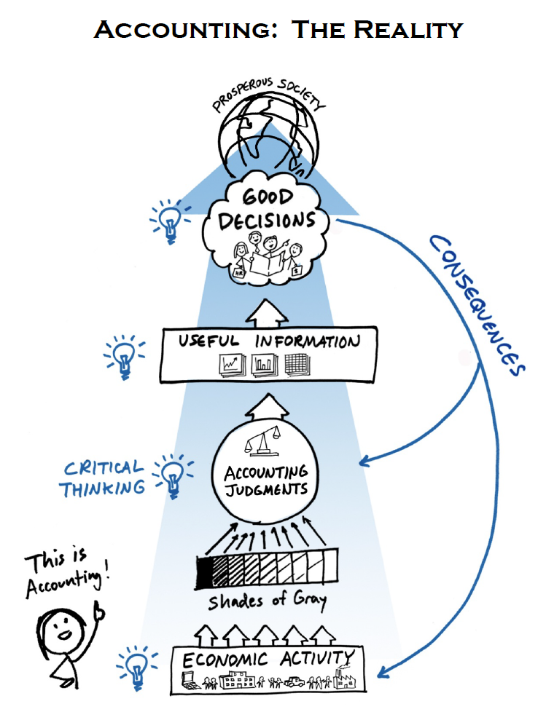

Slide 4
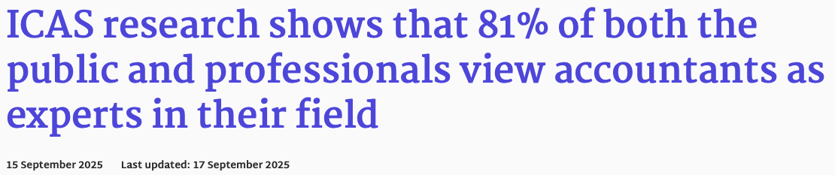
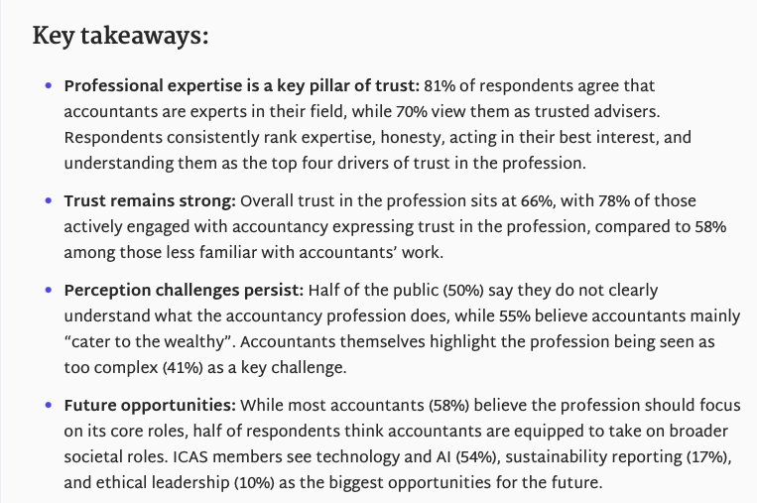
The role of accountants
What they are hired to do
What they are not hired to do
Maintain trust in capital markets
Provide unbiased opinions on financial reports
Be an expert consultant on financial information
Sniff out any issues in the numbers
Engage with their teams and clients
Attempt to make money at all costs
Quietly sit on the sidelines
Sell, sell, sell
Tedious work

Slide 5
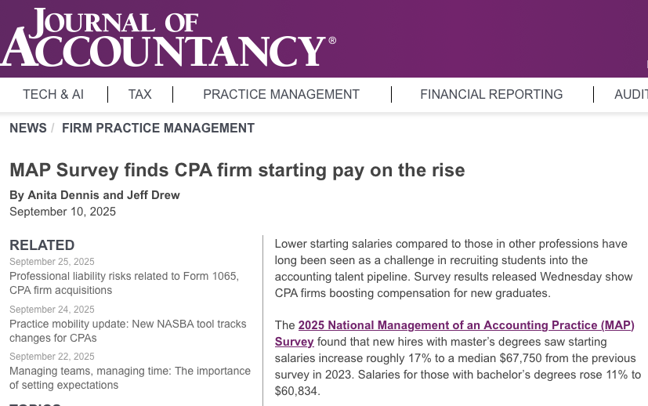
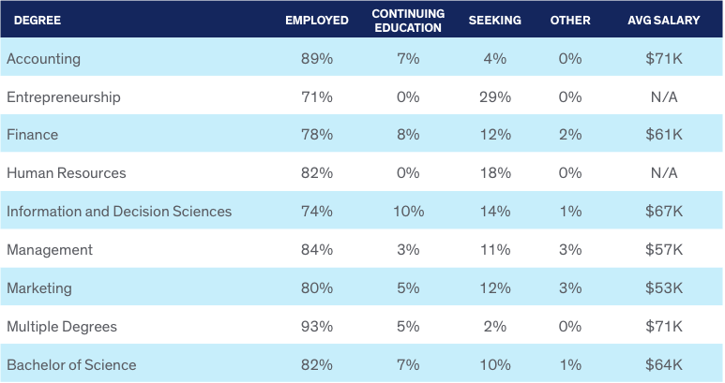
Strong job market
UIC undergraduate outcomes – class of 2023 - 2024
Accounting majors are:
In high demand
Compensated well
Offered flexibility
Well-trained
A tight-knit group

Slide 6



































Slide 7
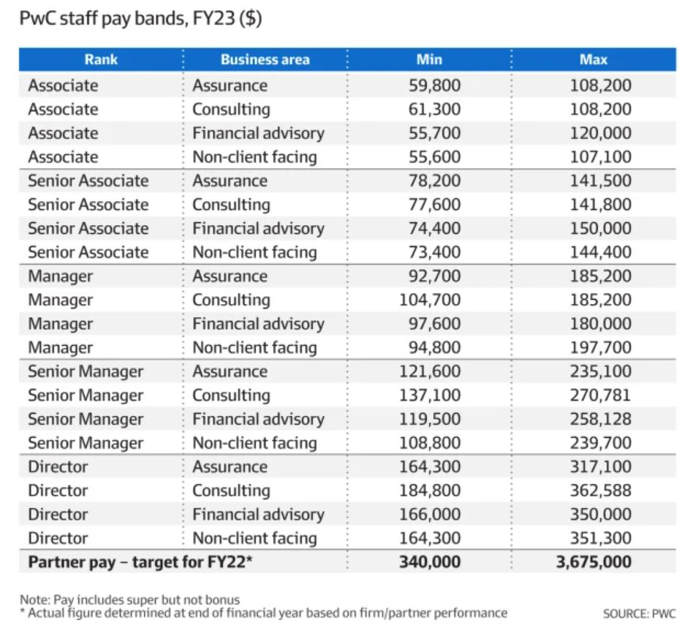
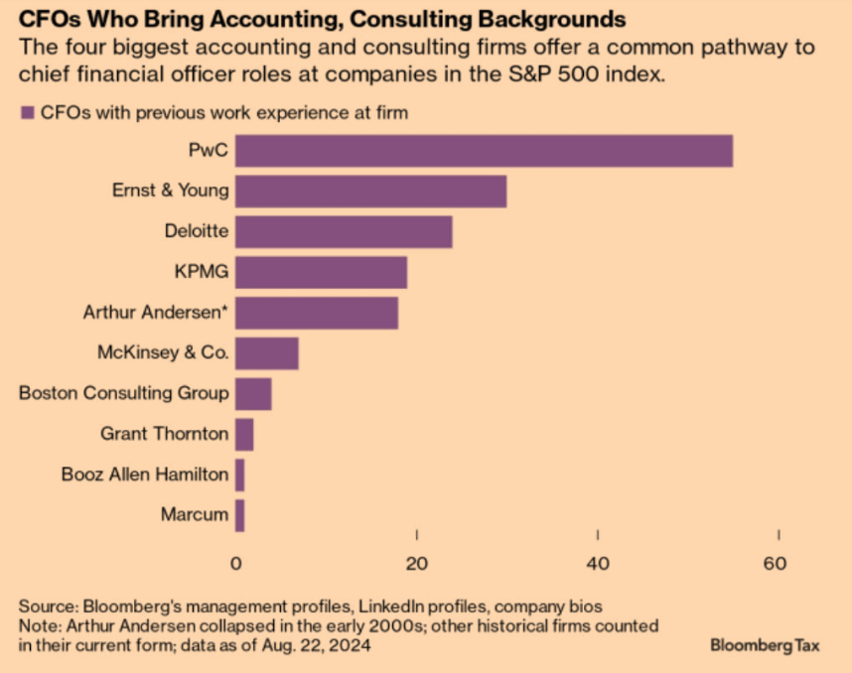
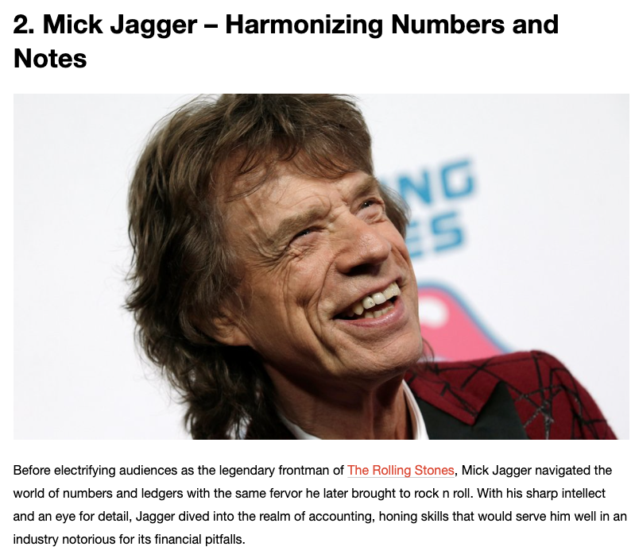
The career path can be straightforward…
…or not

Slide 8
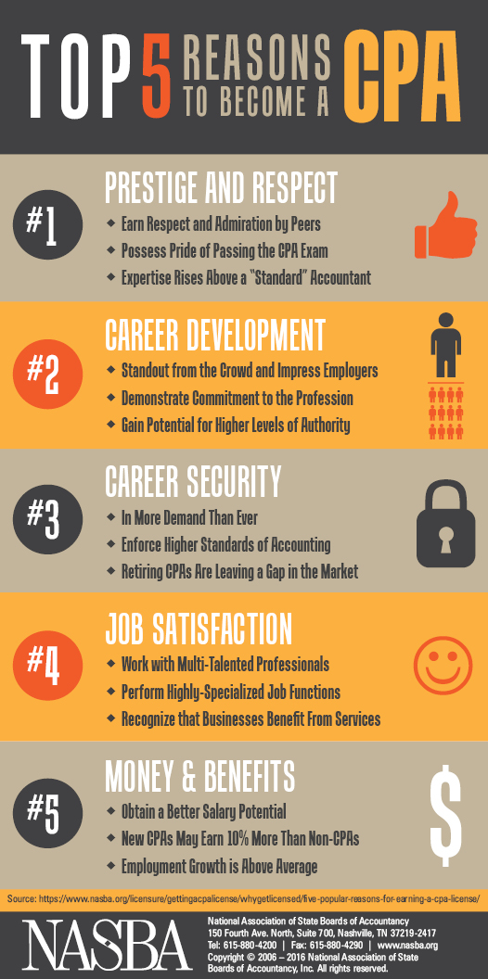
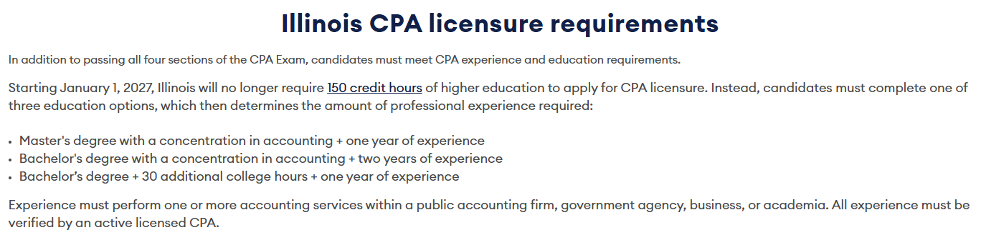
Curriculum
6 required courses:
Intermediate Financial Accounting I
Intermediate Financial Accounting II
Cost Accounting
Auditing
Federal Tax I
Accounting Information Systems
4 elective courses:
Business Law I
Advanced Financial Accounting
Federal Income Tax II
Government and Not-for-Profit Accounting
Database Accounting Systems
International Accounting
The Ethical Environment of Business
Accounting Cases – Research and Analysis
Accounting Data Analytics I and II
Tax Research
Advanced Auditing
Curriculum is geared towards preparation for the CPA exam

Slide 9
Plenty of support
Every accounting major has a faculty mentor
  Meet every semester
Accounting club!
  Visit them after class – 2nd floor café in DH
  Offers career guidance and help
  Very social group
Mentoring program
  Pairs students up with recent graduates or senior students
  Helps prepare you for recruiting season

Slide 10
Thank you
Vivek Raval
vraval@uic.edu

