Slide 1
Accounting Matters.
Vivek Raval
Presented to the Tuck School of Business
November 14, 2025

Slide 2

Is a hot dog a sandwich?
Notes:
Not exhaustive

Slide 3
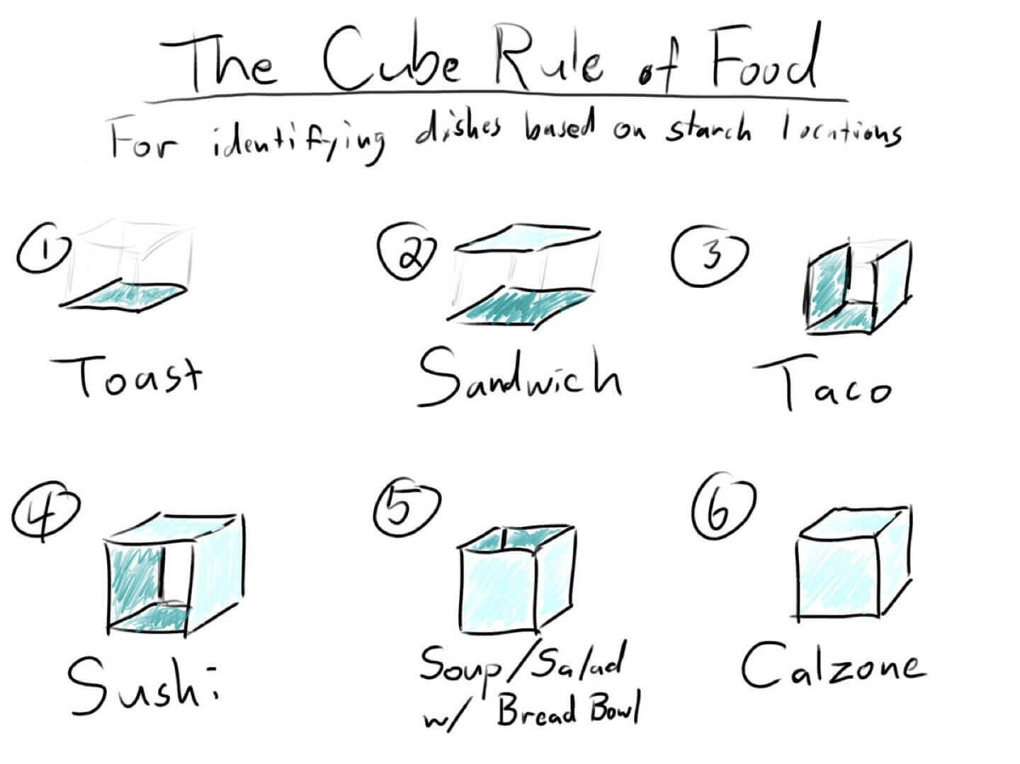
We need a standard to guide us.
The Cube Rule
Notes:
Not exhaustive

Slide 4
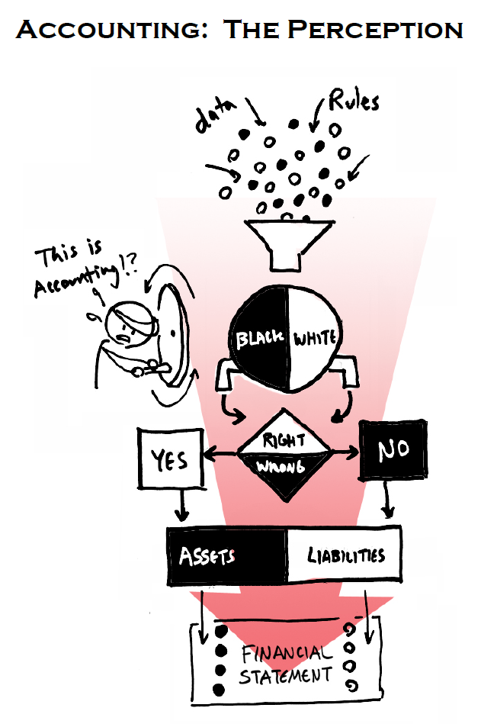
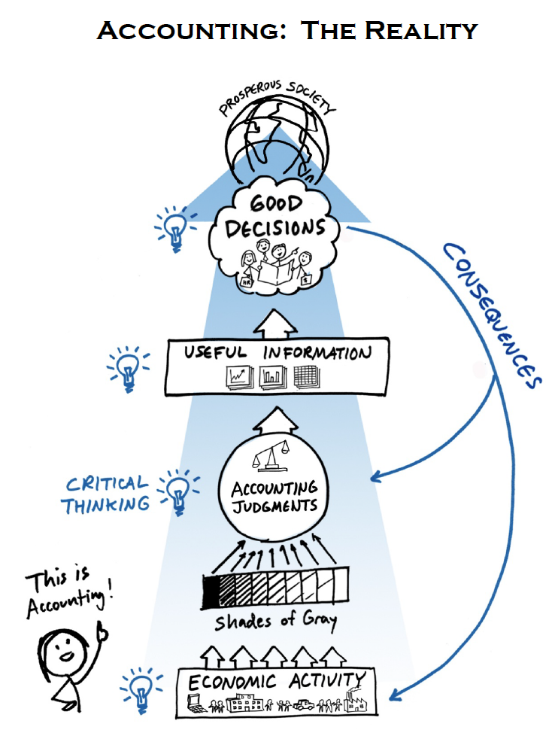
This is what we study in financial accounting.
Accounting standards
Economic activities
Accounting information
CPA Pathways Commission
Notes:
This is what we study, how economic activities are translated into accounting information.
In this way, accounting acts as the language of business, giving us the vocabulary to understand what is happening inside the business.
It is a perception that accounting is just the processing of rules on data, working with clear right and wrong answers.
But in reality, the outputs of economic activity are rarely clearly categorized, and therefore accountants and managers are working with shades of gray. Accounting judgments are needed to generate, hopefully, useful information leading to good decisions.
This is what we will be studying this term.
Let me take a breath here and describe where we are going for the remaining time we have.
I don’t want to talk about specific accounting standards just yet – I want to instead start by talking through the usefulness of accounting information, who is interested in this information, and where there are shades of grey..
Any questions?
Okay, we have been speaking very abstractly for a bit – why don’t we dive into something a little more concrete.

Slide 5
Charting the path.
The importance of information in markets.
The role of accounting in information transfer.
The stakeholders in accounting.
How stakeholders contextualize accounting.
Note: We may discuss some accounting-specific terms. For this class session, it is not important that you know what they mean or how they are calculated. We will cover this later in the term.
Notes:
This is what we study, how economic activities are translated into accounting information.
In this way, accounting acts as the language of business, giving us the vocabulary to understand what is happening inside the business.
It is a perception that accounting is just the processing of rules on data, working with clear right and wrong answers.
But in reality, the outputs of economic activity are rarely clearly categorized, and therefore accountants and managers are working with shades of gray. Accounting judgments are needed to generate, hopefully, useful information leading to good decisions.
This is what we will be studying this term.
Let me take a breath here and describe where we are going for the remaining time we have.
I don’t want to talk about specific accounting standards just yet – I want to instead start by talking through the usefulness of accounting information, who is interested in this information, and where there are shades of grey..
Any questions?
Okay, we have been speaking very abstractly for a bit – why don’t we dive into something a little more concrete.

Slide 6
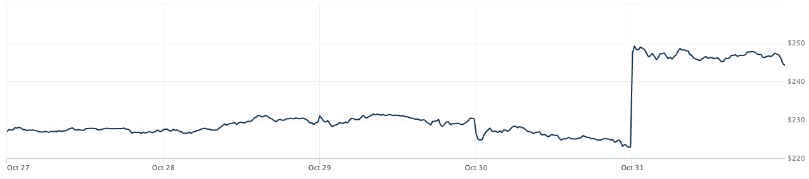
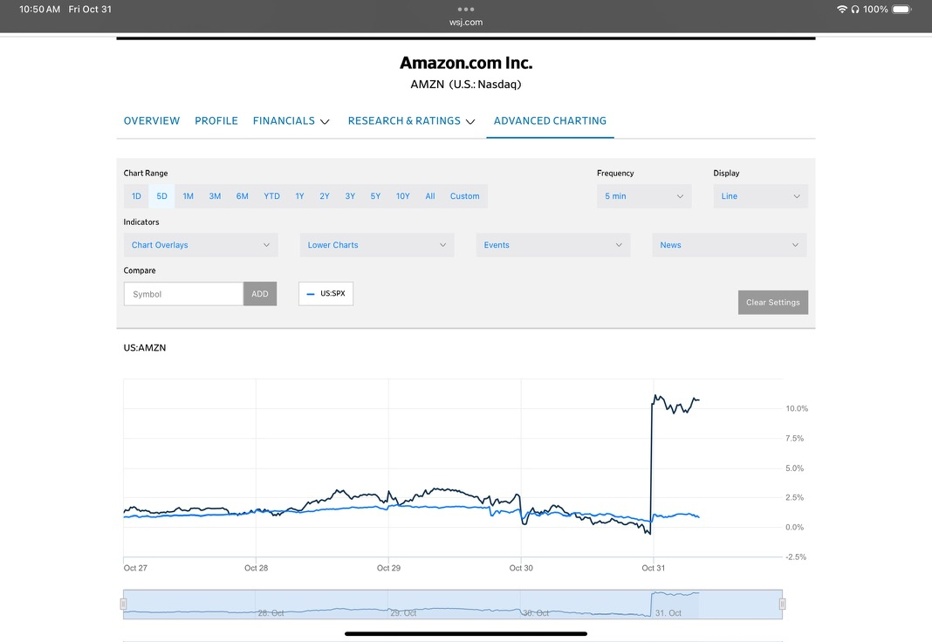
What are we looking at here?
Stock Chart: Presents the price of a stock over time.
Stock: A financial instrument representing ownership interest in a company.
Stock prices: determined by an active market of buyers and sellers, indicating changes in the supply and demand for the stock.
On October 31, the stock price leapt from $222 to $249.
  A $27 per share increase.
  A 12% increase.
Why?
Notes:
Questions:
What are we looking at here? (Stock chart)
What do we have on the x-axis? y-axis? (time, price)
What is a stock? (Portion of ownership of a company)
How is price determined? (In a market, not set by the company)
Anything notable in this stock chart? (price has a sharp increase on 10/31)
How much did the price move? (from about $222 to $249, $27 increase, about 12%)

Slide 7
Why did the price move so much?
Information: A primary cause of stock price movements.
Particularly when the information is:
  Relevant
  Pertinent and timely to be useful in forming or confirming expectations about the company’s success.
  Reliable
  Reflecting the underlying economic activity in an accurate, unbiased way.
S&P 500
Notes:
The suggestions may be something like:
Earnings announcement
Interest rates (or other macro factors)
CEO-related things (retirement)
M&A announcements
The suggestions are all good, because they all are suggesting types of information. The information is not just any information, but it meets 2 characteristics which make information very powerful: Relevance and Reliability

Slide 8
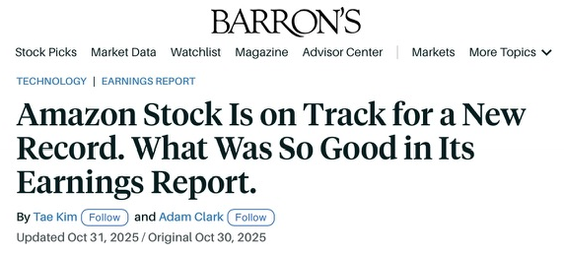
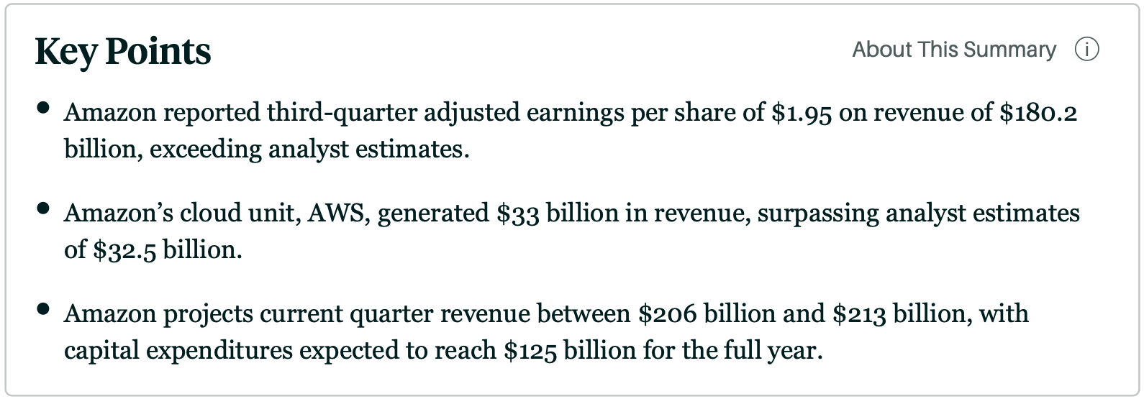
The headline.
  Earnings Report (Announcement)
  An official public disclosure of a company’s financial performance.
  Relevant: Generated by Amazon using information not available to the public. Released quarterly.
  Reliable: Common metrics calculated using accounting standards. Results are reviewed by auditors.
Impact!
S&P 500
Notes:
On 10/31, Amazon released earnings.
This information matters.

Slide 9
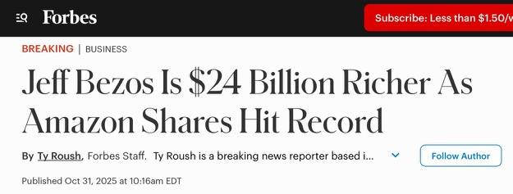
Earnings matter. But to whom? And why?
  Employees
  Is the company earning enough to continue to pay me?
  Analysts
  Are earnings useful for forecasting?
  Stockholders
  Are earnings supporting the stock price?
  CEO & Executives
  I want to blow earnings targets out of the water!
  CEO: Andrew Jassy made $59 million on 10/31.
  Debtholders (lenders)
  Are earnings sufficient to ensure I get paid back?
Earnings
  Auditors
  Are earnings calculated according to the rules?
  Competitors
  Is there a piece of the earnings we can take?
Notes:
Not exhaustive

Slide 10
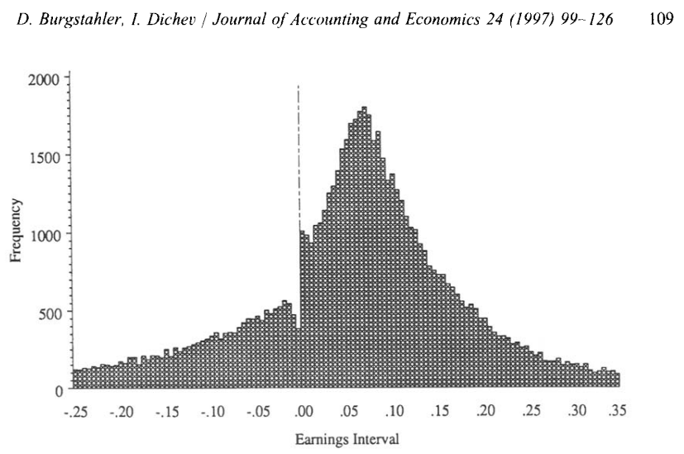
Incentives are powerful.
  Sample about 76,000 reported annual EPS
  Divide EPS by stock price
  Create a histogram
  CEO & Executives
  I want to blow earnings targets out of the water!
  CEO: Andrew Jassy made $59 million on 10/31.

Slide 11
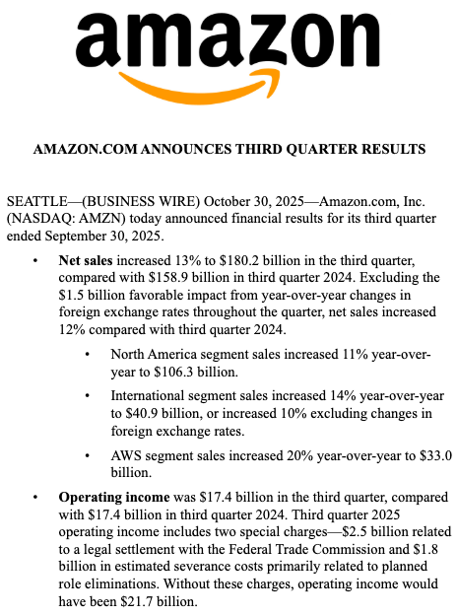
General purpose. Not purpose-built.
  Analysts
  Are earnings useful for forecasting?
  Debtholders
  Are earnings sufficient to ensure I get paid back?
“Operating income was $17.4 billion in the third quarter, compared with $17.4 billion in third quarter 2024. Third quarter 2025 operating income includes two special charges—$2.5 billion related to a legal settlement with the Federal Trade Commission and $1.8 billion in estimated severance costs primarily related to planned role eliminations. Without these charges, operating income would have been $21.7 billion.”

Slide 12
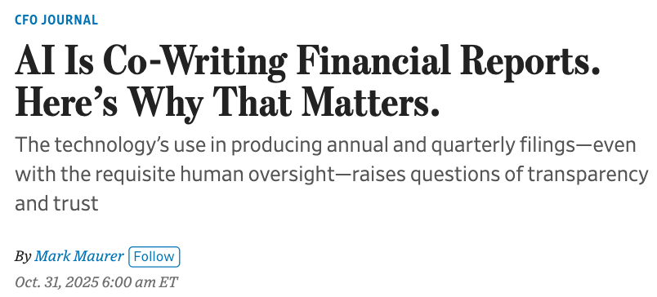
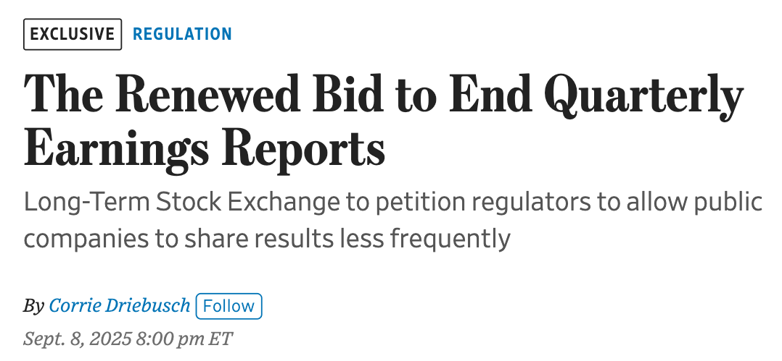
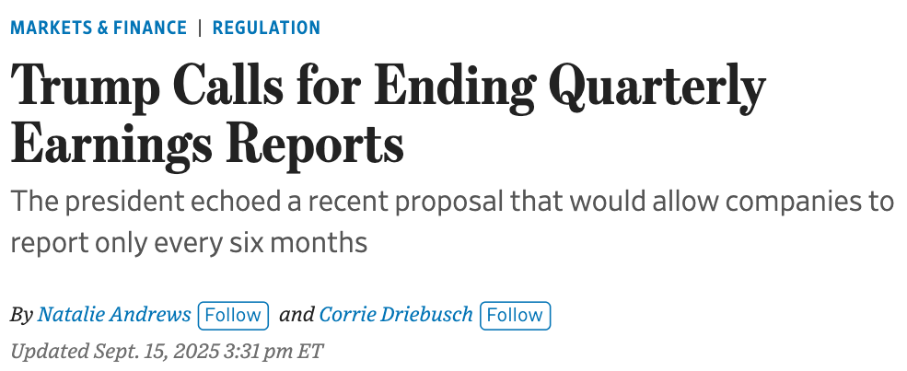
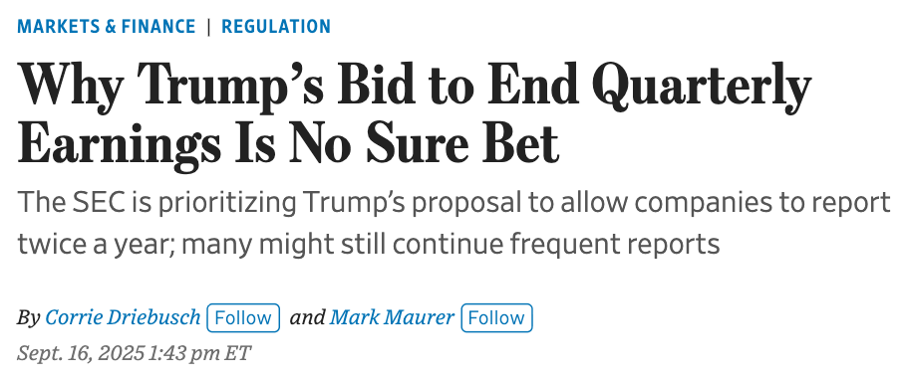
And accounting evolves.

Slide 13
Things to remember:
Earnings announcements can provide relevant and reliable information to public markets.
There are standards for determining what is included in earnings and other accounting measures.
There are a variety of judgements required in accounting, and incentives can affect what is reported.

Slide 14

Looking ahead.
Information
Standards
Judgments
Revenue Recognition
How much is the company is getting from customers?
The 5-steps in revenue recognition
The expected value of contingent consideration
Property, Plant, and Equipment, intangibles
How long until new resources are needed?
Depreciation & amortization of long-lived assets
The useful life of resources
Financial Investments
How is the company managing its financial needs?
Classification of financial instruments (HTM, Trading, AFS)
Intention and ability to hold or trade investments

Slide 15
Thank you.

Slide 17
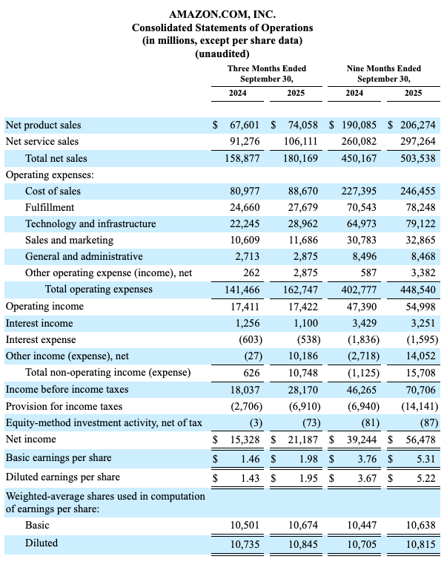

Slide 18
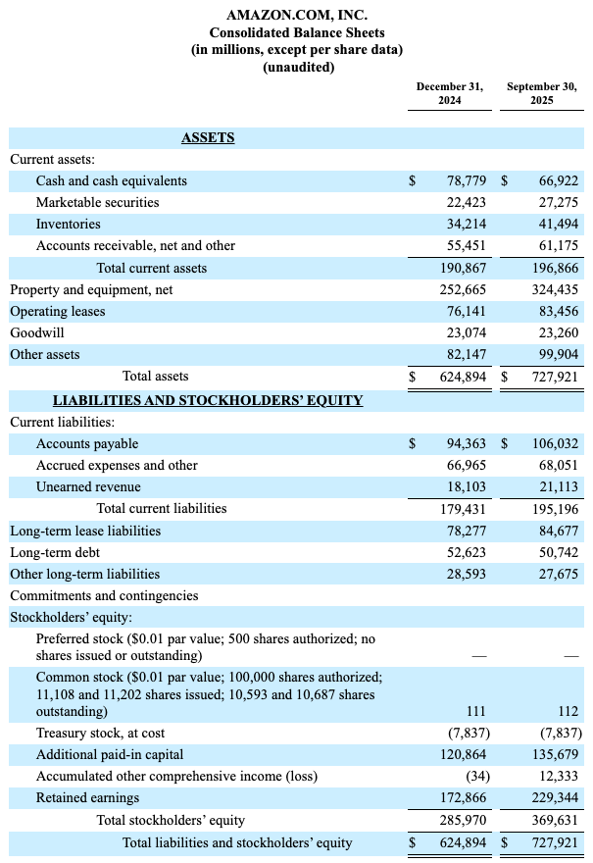

Slide 20
Earnings matter. But to who? And why?
  Analysts
  What will earnings be next quarter?
  Is this a bellwether for other companies?
    Are earnings useful for forecasting?
  Employees
  Is my job safe?
  Are earnings going to continue?
  Stockholders
  Want to value the shares.
  Are earnings useful for valuation?
  CEO & Executives
  Reputation: I want to blow earnings targets out of the water!
  Compensation
    CEO: Andrew Jassy
      Made $59 million on 10/31
  Debtholders (lenders)
  Will we get paid back?
  Are earnings supporting outstanding loans?
Earnings
  Competitors
  Should we imitate or acquire them?
  Is there a piece of the earnings we can take?
  Auditors
  Are earnings calculated according to the rules?
Notes:
Not exhaustive

Slide 22
This is what we study.
Identify the contract
A contract establishes the legal rights and obligations of the seller and customer with respect to one or more performance obligations.
Identify the performance obligation(s)
A performance obligation is a promise to transfer a good or service that is distinct, which is the case if the good or service is both (a) capable of being distinct and (b) separately identifiable.
Determine the transaction price
The transaction price is the amount the seller is entitled to receive from the customer.
Allocate the transaction price
The seller allocates the transaction price to performance obligations based on the relative stand-alone selling prices of the goods or services in each performance obligation.
Recognize revenue when (or as) each performance obligation is satisfied
The seller recognizes revenue at a single point in time when control passes to the customer, which is more likely if the customer has:
• An obligation to pay the seller
• Legal title to the asset
• Possession of the asset
• Assumed the risks and rewards of ownership
• Accepted the asset
The seller recognizes revenue over a period of time if:
• Customer consumes beneﬁt of seller’s work as it is performed,
• Customer controls asset as it’s
created, or
• Seller is creating an asset that has no alternative use to the seller and the seller has a legal right to receive payment for work completed
Notes:
Not exhaustive

Slide 23
Why did the price move so much?
Stock Chart: Presents the price of a stock over time.
Stock: A financial instrument representing ownership interest in a company.
Stock prices: determined by an active market of buyers and sellers, indicating changes in the supply and demand for the stock.
On October 31, the stock price leapt from $222 to $249
  A $27 per share increase
  A 12% increase
Notes:
Questions:
What are we looking at here? (Stock chart)
What do we have on the x-axis? y-axis? (time, price)
What is a stock? (Portion of ownership of a company)
How is price determined? (In a market, not set by the company)
Anything notable in this stock chart? (price has a sharp increase on 10/31)
How much did the price move? (from about $222 to $249, $27 increase, about 12%)

Slide 24
Why did the price move so much?
Stock Chart: Presents the price of a stock over time.
Stock: A financial instrument representing ownership interest in a company.
Stock prices: determined by an active market of buyers and sellers, indicating changes in the supply and demand for the stock.
On October 31, the stock price leapt from $222 to $249
  A $27 per share increase
  A 12% increase
Notes:
Questions:
What are we looking at here? (Stock chart)
What do we have on the x-axis? y-axis? (time, price)
What is a stock? (Portion of ownership of a company)
How is price determined? (In a market, not set by the company)
Anything notable in this stock chart? (price has a sharp increase on 10/31)
How much did the price move? (from about $222 to $249, $27 increase, about 12%)

Slide 25
What are we looking at here?
S&P 500
S&P 500
Notes:
Questions:
What are we looking at here? (Stock chart)
What do we have on the x-axis? y-axis? (time, price)
What is a stock? (Portion of ownership of a company)
How is price determined? (In a market, not set by the company)

Slide 26
S&P 500

